Slide 2
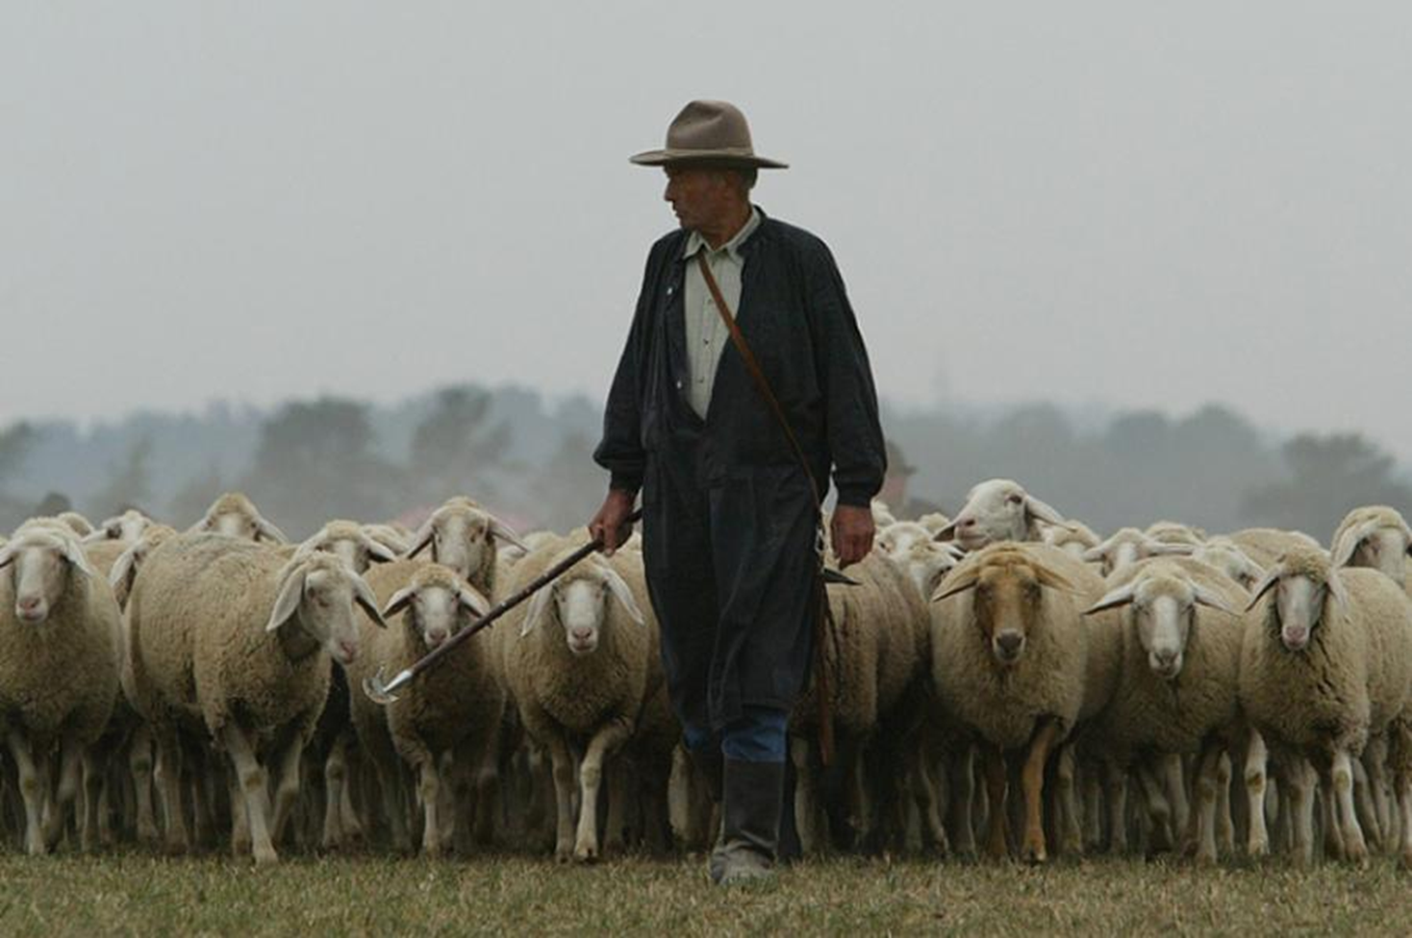
Supporting Our Shepherds
John 10:1-5

Slide 3
Hear Them vv. 3, 16, 27
Acts 20:32
1 Thess. 5:14
Titus 1:9
Heb. 13:17

Slide 4
Follow Them vv. 4, 5, 27
1 Cor. 11:1
1 Peter 5:1-4
Heb. 13:7
1 Tim. 3:2-7
Titus 1:6-9

Slide 5
Know Them vv. 4, 5, 14-15
Heb. 13:24
1 Thess. 5:12-13
1 Tim. 5:17-18
1 Tim. 5:19

