Slide 1
Opinions/Scriptural Conclusions and Doctrine
How to tell them apart?

Slide 2
A Principle or Two to Consider Now:
Point 3 - Because of this, different folks in ANY congregation will view different Scriptures differently.
1 Corinthians 8
This passage is similar to Romans 14 as some could say we are talking about eating of meats, but others could say we are actually talking about idol worship in relations to eating of meats.
While others could say we are talking about different levels of knowledge/understanding of principles taught within the Scriptures or different levels of maturity in any congregation.
Vs 1-3 – Paul says he is about to answer a question the Corinthians apparently had asked about whether a person could eat meats sacrificed to idols.

Slide 3
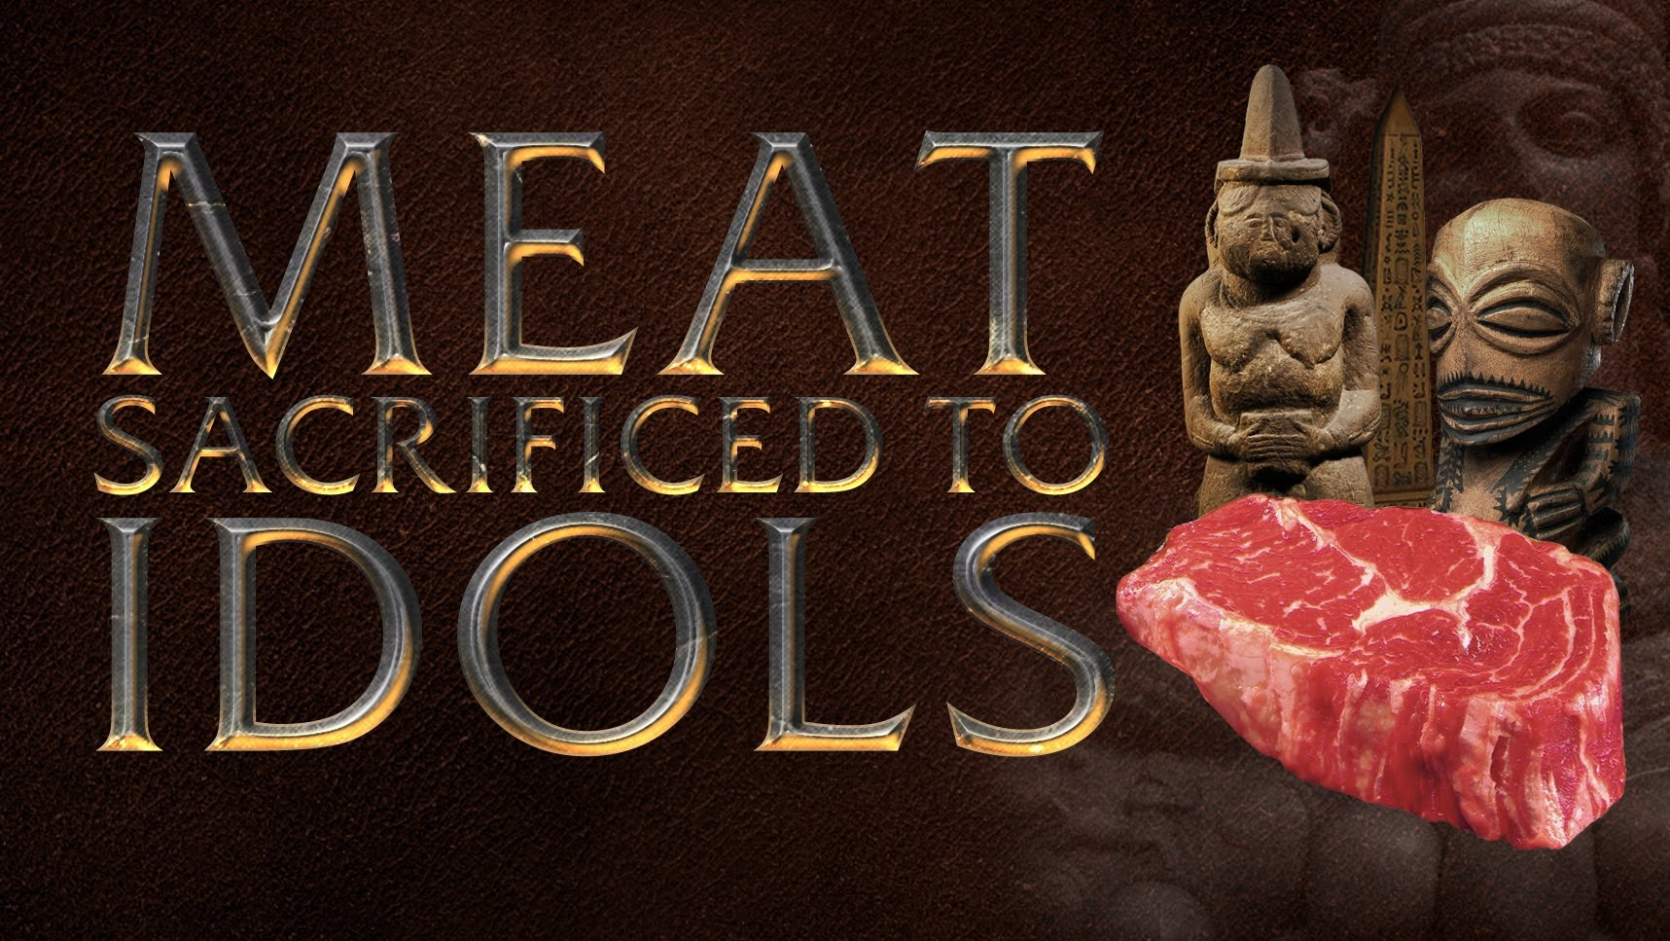
1 Corinthians 8
Now concerning things offered to idols: We know that we all have knowledge. Knowledge puffs up, but love edifies. ² And if anyone thinks that he knows anything, he knows nothing yet as he ought to know. ³ But if anyone loves God, this one is known by Him.

Slide 4
A Principle or Two to Consider Now:
Vs 4-6 – Principle he teaches is here. The Spiritually Mature realizes Idols are nothing as we realize there is one true God and we worship Him and Him only.

Slide 5
1 Corinthians 8
⁴ Therefore concerning the eating of things offered to idols, we know that an idol is nothing in the world, and that there is no other God but one. ⁵ For even if there are so-called gods, whether in heaven or on earth (as there are many gods and many lords), ⁶ yet for us there is one God, the Father, of whom are all things, and we for Him; and one Lord Jesus Christ, through whom are all things, and through whom we live.

Slide 6
A Principle or Two to Consider Now:
Vs 4-6 – Principle he teaches is here. The Spiritually Mature realizes Idols are nothing as we realize there is one true God and we worship Him and Him only.
Vs 7,8 – Therefore, if we eat meat that has been sacrificed to an idol the spiritually mature will realize it is nothing more than meat, but to others who are not as mature, it offends their conscience and they sin (1 Corinthians 10:25-27; Romans 14:23).

Slide 7
1 Corinthians 8
⁷ However, there is not in everyone that knowledge; for some, with consciousness of the idol, until now eat it as a thing offered to an idol; and their conscience, being weak, is defiled. ⁸ But food does not commend us to God; for neither if we eat are we the better, nor if we do not eat are we the worse.

Slide 8
A Principle or Two to Consider Now:
Vs 4-6 – Principle he teaches is here. The Spiritually Mature realizes Idols are nothing as we realize there is one true God and we worship Him and Him only.
Vs 7,8 – Therefore, if we eat meat that has been sacrificed to an idol the spiritually mature will realize it is nothing more than meat, but to others who are not as mature, it offends their conscience and they sin (1 Corinthians 10:25-27; Romans 14:23).
Vs. 9-12 – The spiritually mature need to be aware their example can cause others to stumble and sin. The spiritually mature need to make sure their knowledge (idols are nothing and meat sacrificed to them is nothing) doesn’t cause the immature/weak to sin and be lost (V 11) or the spiritually mature! (V 12).

Slide 9
1 Corinthians 8
⁹ But beware lest somehow this liberty of yours become a stumbling block to those who are weak. ¹⁰ For if anyone sees you who have knowledge eating in an idol’s temple, will not the conscience of him who is weak be emboldened to eat those things offered to idols? ¹¹ And because of your knowledge shall the weak brother perish, for whom Christ died? ¹² But when you thus sin against the brethren, and wound their weak conscience, you sin against Christ.

Slide 10
A Principle or Two to Consider Now:
Vs 4-6 – Principle he teaches is here. The Spiritually Mature realizes Idols are nothing as we realize there is one true God and we worship Him and Him only.
Vs 7,8 – Therefore, if we eat meat that has been sacrificed to an idol the spiritually mature will realize it is nothing more than meat, but to others who are not as mature, it offends their conscience and they sin (1 Corinthians 10:25-27; Romans 14:23).
Vs. 9-12 – The spiritually mature need to be aware their example can cause others to stumble and sin. The spiritually mature need to make sure their knowledge (idols are nothing and meat sacrificed to them is nothing) doesn’t cause the immature/weak to sin and be lost (V 11) or the spiritually mature! (V 12).
V 13 – The spiritually mature give up liberties for the better of our brothers.

Slide 11
1 Corinthians 8
¹³ Therefore, if food makes my brother stumble, I will never again eat meat, lest I make my brother stumble.

Slide 12
A Principle or Two to Consider Now:
The overall point of 1 Corinthians 8 as related to this topic?
MY faith is based upon THE Faith.
To form MY faith, I take principles taught in the New Testament and make application to my life to specific instances.
As I grow and mature in Christ and His teachings, the application of those principles will change as I learn other principles that are applicable to specific situations.
Thus, MY faith grows stronger/changes/progresses.
Finally, to me, this chapter says the exact same thing Romans 14 says: MY faith cannot be dictated to any others to follow (It is MY faith) AND I MUST RESPECT OTHERS FAITH.

Slide 13
A Couple Quick Points about V 8:
Let’s revisit verse 8:
I think this verse/chapter does indicate, we don’t have to give up meat totally in our lives if we don’t find it offensive to eat. The overall idea of this chapter, is I won’t eat meat while around my brother and cause his conscience to be bothered.
Second, both views, of the spiritually mature and immature, are conclusions reached based on Scriptures. Neither one has crossed any red line, neither one doctrinally incorrect. This is the point of verse 8 as well.
⁸ But food does not commend us to God; for neither if we eat are we
the better, nor if we do not eat are we the worse.

Slide 14
If not careful, then we can become like:
The pharisees of Mark 7, started teaching as doctrine our traditions, our opinions, our rules, our precepts.
This is why this is so hard of a topic and one that I think we need to think about.
How can THE SPIRITUALLY MATURE discern between a Scriptural opinion/conclusion and doctrine within our own lives?

Slide 15
Personal Preferences Acts 15:36-41

Slide 16
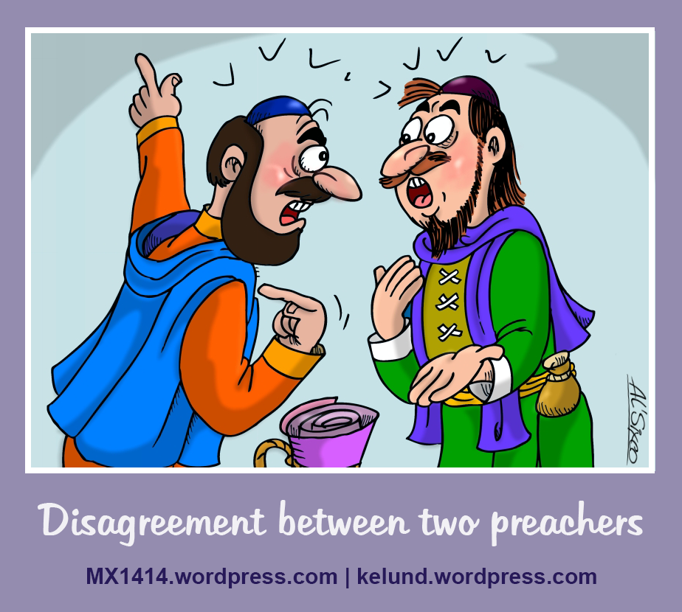
³⁶ Then after some days Paul said to Barnabas, “Let us now go back and visit our brethren in every city where we have preached the word of the Lord, and see how they are doing.” ³⁷ Now Barnabas was determined to take with them John called Mark. ³⁸ But Paul insisted that they should not take with them the one who had departed from them in Pamphylia, and had not gone with them to the work. ³⁹ Then the contention became so sharp that they parted from one another. And so Barnabas took Mark and sailed to Cyprus; ⁴⁰ but Paul chose Silas and departed, being commended by the brethren to the grace of God. ⁴¹ And he went through Syria and Cilicia, strengthening the churches.

Slide 17
Personal Preferences Acts 15:36-41
The Problem? – Vs 37,38

Slide 18
³⁷ Now Barnabas was determined to take with them John called Mark. ³⁸ But Paul insisted that they should not take with them the one who had departed from them in Pamphylia, and had not gone with them to the work.

Slide 19
Personal Preferences Acts 15:36-41
The Problem? – Vs 37,38
One had one preference for a person to accompany them and the other had another preference
Paul had a logical reason for his preference – V 38

Slide 20
³⁸ But Paul insisted that they should not take with them the one who had departed from them in Pamphylia, and had not gone with them to the work.

Slide 21
Personal Preferences Acts 15:36-41
The Problem? – Vs 37,38
One had one preference for a person to accompany them and the other had another preference
Paul had a logical reason for his preference – V 38
I am sure Barnabas also had a legitimate reason to want to take John Mark – to encourage John Mark!
What does the phrase “strong contention” mean?
“heated disagreement”
While they had their personal convictions on this matter, it did not cause them to separate/break fellowship with one another.

Slide 22
Personal Preferences Acts 15:36-41
Note:
1 Corinthians 9:6
2 Timothy 4:11
So, who was right?
So, how does this apply to our topic of discussion?
There are going to be times when we have differences of thought with our fellow brethren, and the feelings of what to do are strong convictions.
We may even have very good logical reasoning on our part for our beliefs on the matter.

Slide 23
Personal Preferences Acts 15:36-41
BUT, if we are dealing with PERSONAL PREFERENCES, we have to realize, both sides are correct.
These are NOT reasons to end relationships over.
These are NOT reasons to end fellowship with one another.
Examples:
Order of Worship
Bible Class Topics/Needs
Preach with a tie or in a coat
All the verses of a song

Slide 24
Personal Preferences Acts 15:36-41
Examples:
Paint the walls of the auditorium? What color to paint the walls? Do the walls even need to be painted?
Do we pad the pews or not?
How do you deal with a problem? When do you deal with the problem? How long do you let it go on?
What to spend money on?! When to spend the money?! How much to spend?!

