Slide 1
Opinions/Scriptural Conclusions and Doctrine
How to tell them apart?

Slide 2
Let’s Review from Last Week:
Mark 7:7 – “. . . teaching as doctrine the precepts of men”
  “. . . commandments of men”
  “. . . teach human rules as doctrine of God.”
Point of Romans 14, when it comes to areas of MY FAITH, I look to find ways to be able to get along with my brethren (Romans 14:19; 15:7; Ephesians 4:1-3).
THE FAITH, there is NO COMPROMISE, Romans 14 is talking about practicing those things that do NOT separate us from God (Vs 3, and 18) [ V 3: “. . . For God has received him.”] [V 18: “. . . Serve Christ is acceptable to God.”].
So, the eating of meats and observing of days, or not eating meats or observing days are dealing with subjects that God has not spoken on.
So the parameters of this chapter are: we are talking about things that are neither commanded to do or prohibited to do, in other words, we are talking about our opinions and NOT doctrine.

Slide 3
I don’t like the word “Opinions”
I really don’t like the word opinion that many use in the context of Romans 14.
By definition, opinion means “a view or judgment formed about something, not necessarily based on fact or knowledge.”
Note the last part of that definition: “. . . not necessarily based on fact or knowledge.”
Most folks don’t have beliefs unless they have some Scripture somewhere to back up their belief/practice.
Point = even those who practiced NOT eating meats or observing days had verses they looked to in order to confirm their beliefs.

Slide 4
Romans 14
Leviticus 11:3-8 – Strict dietary laws governed the Jews

Slide 5
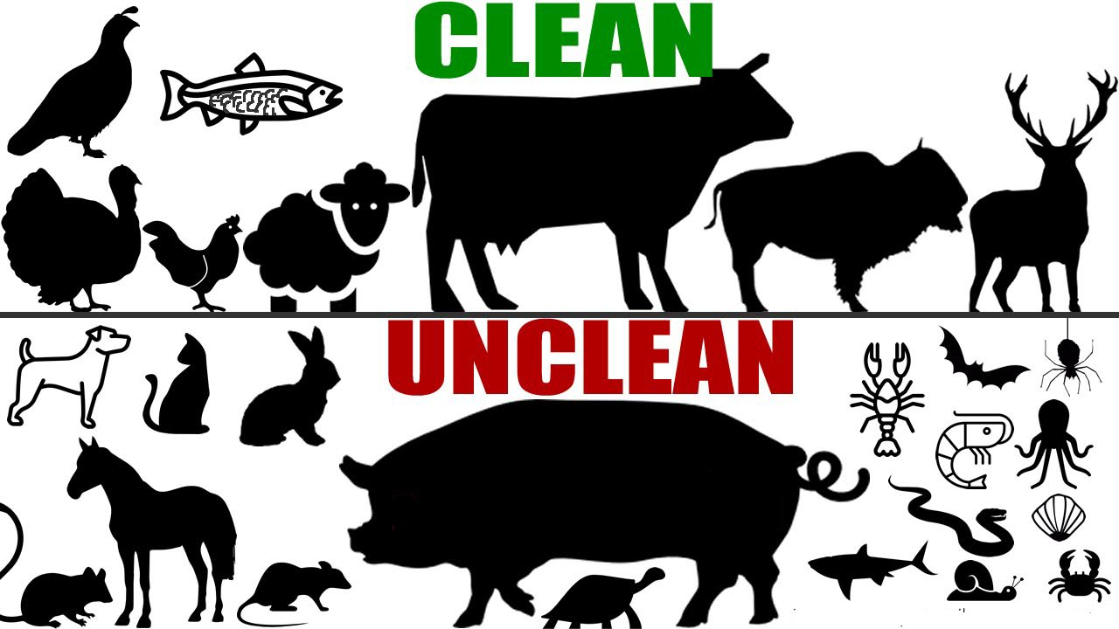
³ Among the animals, whatever divides the hoof, having cloven hooves and chewing the cud—
that you may eat. ⁴ Nevertheless these you shall not eat among those that chew the cud
or those that have cloven hooves: the camel, because it chews the cud but does not have
cloven hooves, is ^{[a]}unclean to you; ⁵ the ^{[b]}rock hyrax, because it chews the cud but does
not have cloven hooves, is ^{[c]}unclean to you; ⁶ the hare, because it chews the cud but does
not have cloven hooves, is unclean to you; ⁷ and the swine, though it divides the hoof, having
cloven hooves, yet does not chew the cud, is unclean to you. ⁸ Their flesh you shall not eat,
and their carcasses you shall not touch. They are unclean to you.

Slide 6
Romans 14
Leviticus 11:3-8 – Strict dietary laws governed the Jews
2 Chronicles 8:13 - These three major feasts include the Feast of Unleavened Bread (Pesach/Passover), the Feast of Weeks (Shavout/Pentecost), and the Feast of Booths (Sukkoth).

Slide 7
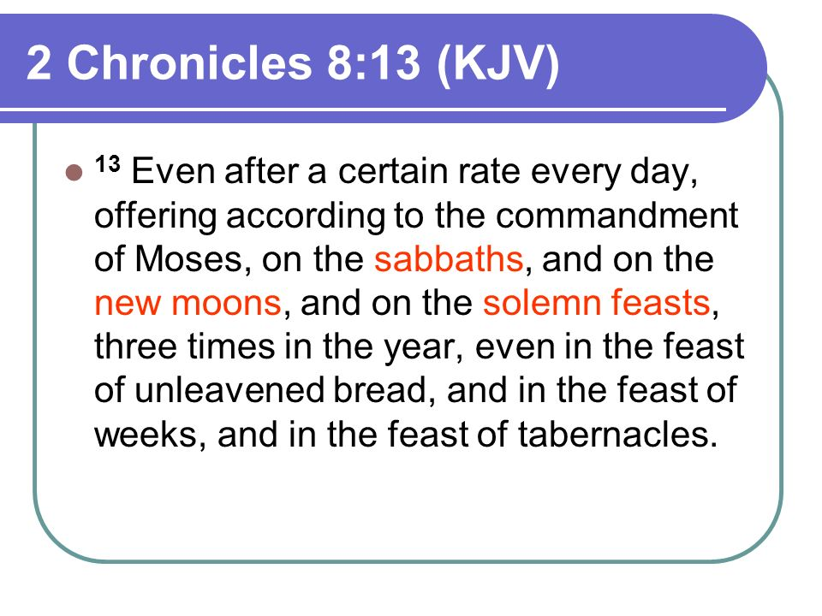

Slide 8
Romans 14
Leviticus 11:3-8 – Strict dietary laws governed the Jews
2 Chronicles 8:13 - These three major feasts include the Feast of Unleavened Bread (Pesach/Passover), the Feast of Weeks (Shavout/Pentecost), and the Feast of Booths (Sukkoth).
V 13 – How is a stumbling block placed in front of someone here?

Slide 9
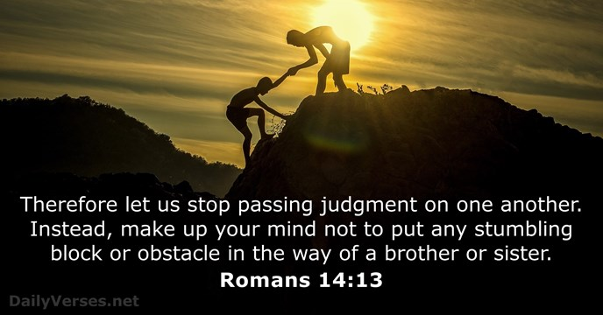

Slide 10
Romans 14
Leviticus 11:3-8 – Strict dietary laws governed the Jews
2 Chronicles 8:13 - These three major feasts include the Feast of Unleavened Bread (Pesach/Passover), the Feast of Weeks (Shavout/Pentecost), and the Feast of Booths (Sukkoth).
V 13 – How is a stumbling block placed in front of someone here?
By making them go against an opinion/conclusion they have formed based on Scriptures.

Slide 11
So, what word to use?
If not opinions, then what?
Scriptural opinions perhaps?
Scriptural personal conclusions?
Our judgments?
Conscience decisions/conclusions?
Our Faith which is based on THE Faith?
Whatever word we use, we need to understand this is a pretty serious topic because if we do that which we have determined to be sin, we sin; even if God has not declared it to be sin (V 23).
^{23 ”}But he who doubts is condemned if he eats, because he does
not eat from faith; for whatever is not from faith is sin.”

Slide 12
Romans 14
So, then, what is the problem with all of this? It sure seems that this should be easy to accomplish.
  These Scriptural opinions are formed by taking principles from Scriptures and applying them to our lives.
  Not only is this a stumbling block, but when a person goes against these Scriptural conclusions, notice what Paul says it becomes to us in verse 23 – SIN.
  The problem? Our Scriptural opinions become DOCTRINE to us. It becomes hard for us to discern between what is opinion and what is doctrine.
  If it is doctrine, then we need to teach to all? Do we not?
²³ And he that doubteth is damned if he eat, because he eateth not
of faith: for whatsoever is not of faith is sin.

Slide 13
Let me be CLEAR HERE:
When God has spoken, that is the end of all questioning and controversy. BUT where God has not spoken we are to be tolerant, understanding, and patient toward the cultural customs, habits, scruples, and traditions of others.

Slide 14
A Principle or Two to Consider Now:
When we become obedient, we are commanded to grow – 2 Peter 3:18

Slide 15


Slide 16
A Principle or Two to Consider Now:
When we become obedient, we are commanded to grow – 2 Peter 3:18
Point 1– the longer a person is apart of the Lord’s body (this should mean) the stronger spiritually they are. They have been growing and maturing over that specific period of time. They will have their own spiritual thoughts on topics taught in the bible like the eating of meats and observing of days.
Point 2 – in any church, there are varying levels of spiritual maturity/growth
  Hebrews 5:10-6:3
  1 Corinthians 6:5

Slide 17

¹⁰ Called of God an high priest after the order of Melchisedec. ¹¹ Of whom we have many things to say, and hard to be uttered, seeing ye are dull of hearing.
¹² For when for the time ye ought to be teachers, ye have need that one teach you again which be the first principles of the oracles of God; and are become such as have need of milk, and not of strong meat. ¹³ For every one that useth milk is unskilful in the word of righteousness: for he is a babe. ¹⁴ But strong meat belongeth to them that are of full age, even those who by reason of use have their senses exercised to discern both good and evil 6 Therefore leaving the principles of the doctrine of Christ, let us go on unto perfection; not laying again the foundation of repentance from dead works, and of faith toward God, ² Of the doctrine of baptisms, and of laying on of hands, and of resurrection of the dead, and of eternal judgment. ³ And this will we do, if God permit.

Slide 18
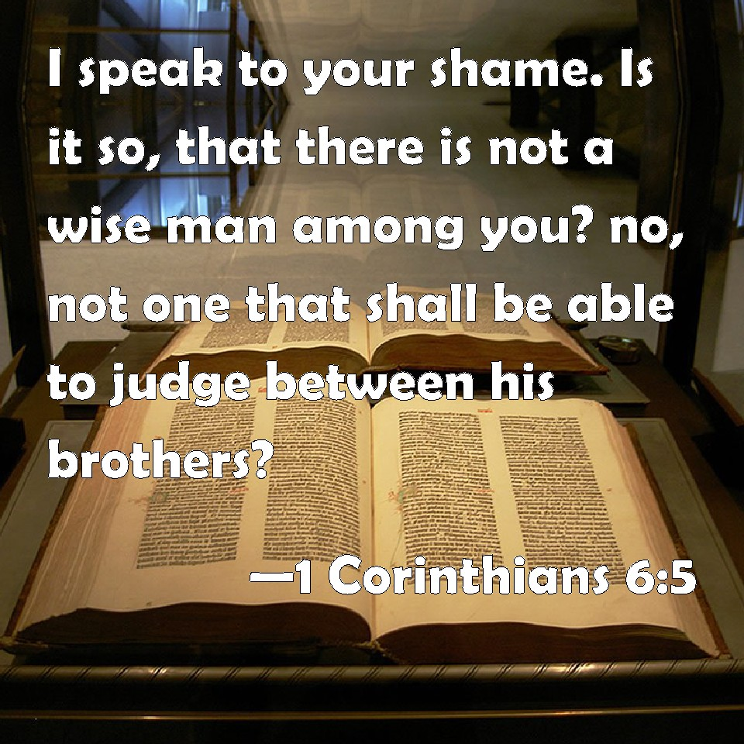

Slide 19
A Principle or Two to Consider Now:
Point 3 - Because of this, different folks in ANY congregation will view different Scriptures differently.
  1 Corinthians 8

