Slide 1
Opinions/Scriptural Conclusions and Doctrine
How to tell them apart?

Slide 2
Why this class and topic?
Congregation from Eddie Paden’s 2019 Preaching Trip
This problem, of forcing our opinions on others is not a new one and has caused problems to the Lord’s people down through the ages
Mark 7:7 – “. . . teaching as doctrine the precepts of men”
“. . . commandments of men”
“. . . teach human rules as doctrine of God.”

Slide 3
Why this class and topic?
Synonyms for precepts – dogma, instruction, principle, motto, opinion, rule
The Jews just didn’t dream up this belief or teaching. It seems to have come from Scriptures to a degree
There seems to be two passages where the Pharisees got the idea of needing to wash hands from – Leviticus 15:11 and Exodus 30:19

Slide 4
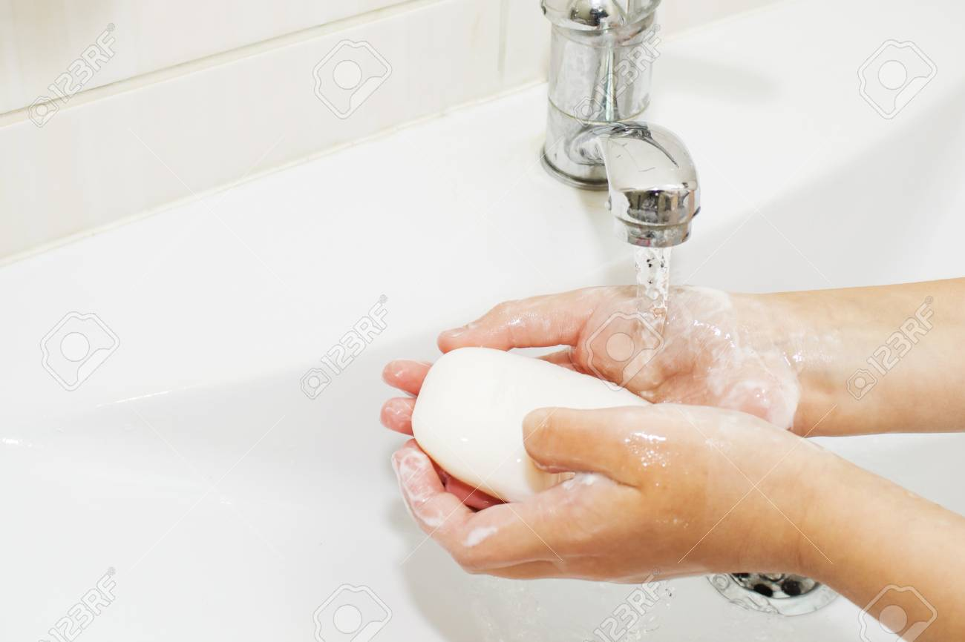
“And whomever the one who has the discharge touches, and has not rinsed his hands in water, he shall wash his clothes and bathe in water, and be unclean until evening.” (Lev 15:11)
“And Aaron and his sons shall wash their hands
and their feet thereat; when they go into the tent
of meeting, they shall wash with water, that they
die not; or when they come near to the altar to
minister, to cause an offering made by fire to
smoke unto the LORD.” Exodus 30:19

Slide 5
Why this class and topic?
All this got me to thinking, how can we differentiate between when something is our opinion and when something is truly a doctrine of God?
This is NOT an easy class and there may be some who will disagree with me.
Let’s start with Romans 14

Slide 6
Romans 14:1-15:7
Point/Theme of Romans 14?
V. 19 – Paul is giving a way for us to be able to get along with one another in terms of our differences. (Romans 15:7; Ephesians 4:1-3)

Slide 7
Romans 15:7
“Therefore receive one another, just as Christ also received us, to the glory of God.”
Ephesians 4:1-3
I, therefore, the prisoner of the Lord, beseech you to walk worthy of the calling with which you were called, with all lowliness and gentleness, with longsuffering, bearing with one another in love, endeavoring to keep the unity of the Spirit in the bond of peace.

Slide 8
Romans 14:1-15:7
Point/Theme of Romans 14?
V. 19 – Paul is giving a way for us to be able to get along with one another in terms of our differences. (Romans 15:7; Ephesians 4:1-3)
V. 1 – Receiving those weak in the faith, being able to get along with each other

Slide 10
Romans 14:1-15:7
Point/Theme of Romans 14?
V. 19 – Paul is giving a way for us to be able to get along with one another in terms of our differences. (Romans 15:7; Ephesians 4:1-3)
V. 1 – Receiving those weak in the faith, being able to get along with each other
Define differences then?
In the context of this chapter, observing days and eating of meats is talking about OUR faith (V 23) [V. 6 “unto the Lord”]
Not THE faith (doctrinal teachings of Christ/apostles)
Vs. 13, 21 – Pretty serious as this can cause another to sin.

Slide 13
Romans 14:1-15:7
Point/Theme of Romans 14?
V. 19 – Paul is giving a way for us to be able to get along with one another in terms of our differences. (Romans 15:7; Ephesians 4:1-3)
V. 1 – Receiving those weak in the faith, being able to get along with each other
Define differences then?
In the context of this chapter (observing days and eating of meats is talking about OUR faith (V 23) [V. 6 “. . . unto the Lord”]
Not THE faith (doctrinal teachings of Christ/apostles)
Vs. 13, 21-23 – Pretty serious as this can cause another to sin.
So then these differences, does Paul want to include everything that we may differ on or does he give some parameters on what types of differences we are to put in this chapter?

Slide 14
Romans 14
What are the parameters of getting along with others as concerning this chapter?
V 3 – Eating and observing days are given in the context of “. . . for God hath received him.”
V 18 – Again, the parameters are that the topics under discussion are such that what we are doing to “serve Christ is acceptable to God.”
Isaiah 59:2 – under old law, God could not accept a sinner
Matthew 7:21-23 – We must do the will of God to enter heaven
So the parameters of this chapter are: we are talking about things that are neither commanded to do or prohibited to do, in other words, we are talking about our opinions and NOT doctrine.

Slide 15
I don’t like the word “Opinions”

