Slide 2
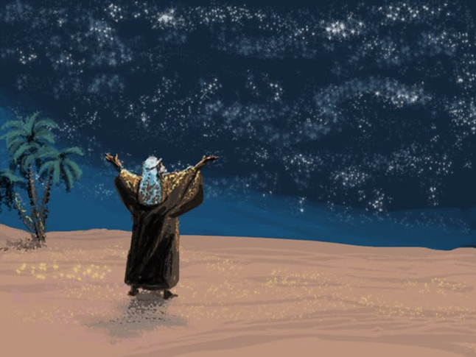
The “Seed” Promise

Slide 3
The “Seed” Promise Given
The “Seed” Promise
Genesis 12:1-3
Genesis 13:14-18
Genesis 15:1-5
Genesis 17:1-8
Genesis 22:15-18

Slide 4
The “Seed” Promise Fulfilled
The “Seed” Promise
Romans 4:13-25
Galatians 3:6-9, 16, 26-29

