Slide 2
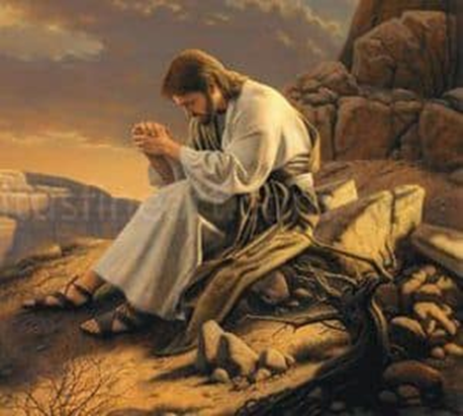
Jesus and Prayer

Slide 3
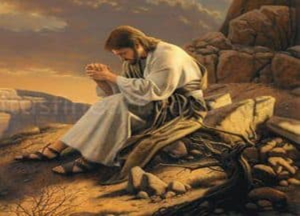
WHY Jesus Prayed
Luke 10:21 – to praise His Father
John 11:41-42 – to thank His Father
John 17:1-2a – to show trust in and dependence on His Father
John 17:2b, 9, 11, 15, 17, 20-21, 24 – to pray for His disciples
Jesus and Prayer

Slide 4
WHERE Jesus Prayed
ALONE
Matthew 14:22-23 – He “went up on the MOUNTAIN BY HIMSELF to pray”
Mark 1:32-35 – He “went away to a SECLUDED place, and was praying”
Luke 5:15-16 – Jesus “would often SLIP AWAY to the WILDERNESS and pray”
Jesus and Prayer

Slide 5
WHERE Jesus Prayed
WITH HIS DISCIPLES
Luke 9:28 – three of His closest apostles were present when He prayed
Luke 11:1 – the disciples observed Jesus praying
Jesus and Prayer

Slide 6
WHERE Jesus Prayed
IN A CROWD
Luke 9:16; John 6:11 – in a crowd of thousands, Jesus prayed
John 12:27-29 – as a great crowd gathered in Jerusalem, Jesus prayed
Jesus and Prayer

