Slide 2
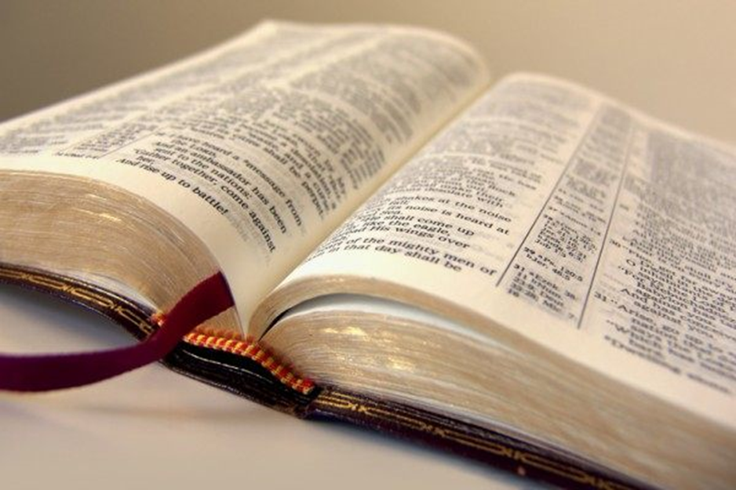
Preparing for Our Gospel Meeting

Slide 3
PLAN!
James 4:13-17
Proverbs 21:5
THREE PREPARATIONS

Slide 4
PARTICIPATE!
Hebrews 10:23-25
Romans 14:19
1 Corinthians 14:26
Revelation 3:15-19
THREE PREPARATIONS

Slide 5
PRAY!
Ephesians 6:18-20
Colossians 4:2-6
THREE PREPARATIONS

