Slide 2
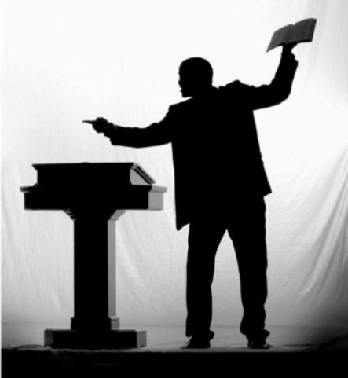
A Preacher’s Charge
2 Timothy 4:1-2

Slide 3
“Preach the word”
Acts 20:20, 27
Psalm 119:105
Hebrews 4:12
James 1:21-24

Slide 4
“Be ready in season and out of season”
Acts 14:1-3
Acts 16:32
Acts 17:23

Slide 5
“Reprove, rebuke, exhort”
Titus 1:12-13
1 Timothy 5:20
Titus 2:15

Slide 6
“With great patience and instruction”
2 Timothy 2:24-26

