Slide 2
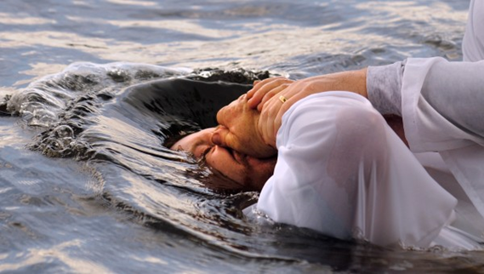
What Happens In Baptism?

Slide 3
In Baptism…
We appeal to God for a good conscience
1 Peter 3:21-22
What Happens In Baptism?

Slide 4
In Baptism…
We appeal to God for a good conscience
We are saved from our sins
Mark 16:15-16
Acts 2:36-38
Acts 22:14-16
What Happens In Baptism?

Slide 5
In Baptism…
We appeal to God for a good conscience
We are saved from our sins
We put on Christ
Galatians 3:26-27
What Happens In Baptism?

Slide 6
In Baptism…
We appeal to God for a good conscience
We are saved from our sins
We put on Christ
We receive a new identity
Romans 6:1-7
What Happens In Baptism?

Slide 7
In Baptism…
We appeal to God for a good conscience
We are saved from our sins
We put on Christ
We receive a new identity
Christ adds us to His church
Acts 2:41, 47
What Happens In Baptism?

