Slide 2
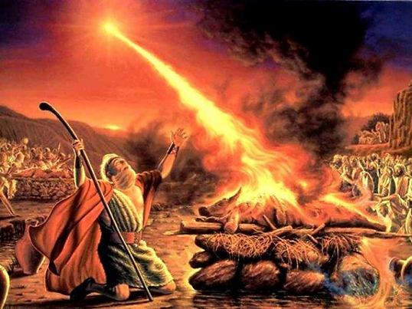
Elijah at Mt. Carmel
Lessons in God’s Power

Slide 3
Setting the Scene
Elijah at Mt. Carmel
1 Kings 17:1
1 Kings 16:29-33; 21:25-26
1 Kings 18:17-19

Slide 4
The Mt. Carmel Challenge
Elijah at Mt. Carmel
1 Kings 18:20-40
NO answer or response (v. 26)
NO answer or response (v. 29)
INSTANTLY, God answered Elijah’s prayer!
What an amazing demonstration of God’s power, as well as Elijah’s trust in God and courage to do God’s will!

Slide 5
Lessons in God’s Power
Elijah at Mt. Carmel
God displays His power in a diversity of ways
1 Kings 19:5-8, 11-12

Slide 6
Lessons in God’s Power
Elijah at Mt. Carmel
God uses ordinary people to do extraordinary things
James 5:17-18

Slide 7
Lessons in God’s Power
Elijah at Mt. Carmel
Experiencing God’s power changes people
1 Kings 18:21, 39-40
Romans 1:16-17
Acts 2:41-47

