Slide 1
Creation vs Science

Slide 2
Evolutionist “by-product” teaching on the origin of religion
Religion is a by-product of dealing with death
Religion is a by-product of communal living
Religion is a by-product of an attempt to fill in gaps

Slide 3
“God of the Gaps”
Preached throughout the Evolutionist community as a way Christians show their scientific illiteracy.

Slide 4
“God of the Gaps”

Slide 5
“God of the Gaps”
Is belief in a Creator a sign of scientific illiteracy?

Slide 6
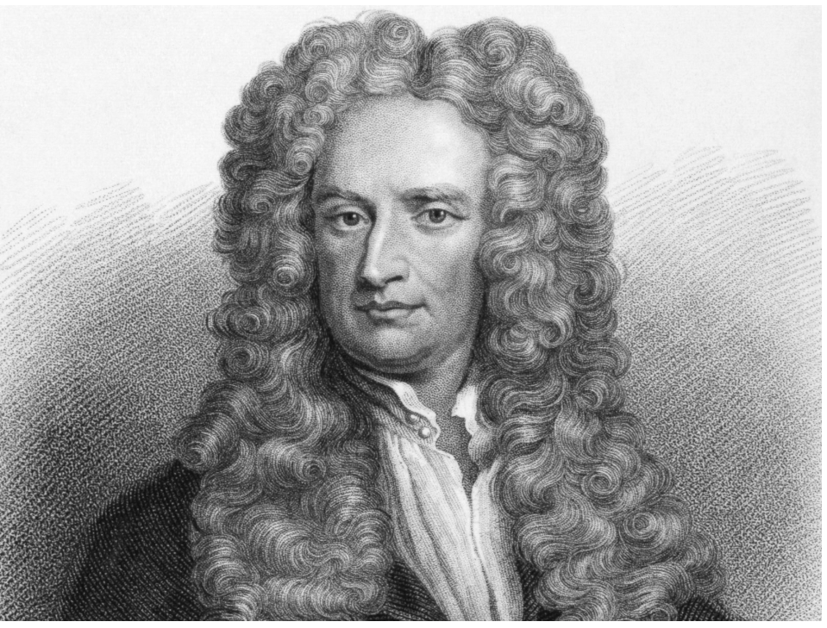
Architect of mechanics and the universal law of gravity
Co-inventor of calculus
Discoverer of some of the fundamental laws of optics
Inspirer of the Enlightenment and quintessential model of rationality

Slide 7
Sir Isaac Newton
"This most elegant system of the sun, planets, and comets could not have arisen without the design and dominion of an intelligent and powerful being.”

Slide 8
Characteristics of a trustworthy scientific attitude
A scientific attitude can be defined as way of viewing things, a curiosity to know how and why things happen with an open mind an governed by facts. Scientific attitude is governed by factors like intellectual honest, open mindedness and creativity.

Slide 9
Guidelines to the Evolutionary faith
A belief in Mechanical Materialism
Understand Epiphenomenalism

Slide 10
Mechanical Materialism
Theory that the world consists entirely of hard, massy material objects.
The theory denies that immaterial or apparently immaterial things (such as minds) exist or else explains them away as being material things or motions of material things.

Slide 11
Epiphenomenalism
Sensations and thoughts do exist in addition to material processes but are nonetheless wholly dependent on material processes and without causal efficacy of their own.
A person would be indistinguishable with or without consciousness.

Slide 12
Guidelines to the Evolutionary faith
A belief in Mechanical Materialism
Understand Epiphenomenalism
Closed minded to anything outside of the physical world

Slide 13
Characteristics of a trustworthy scientific attitude
A scientific attitude can be defined as way of viewing things, a curiosity to know how and why things happen with an open mind an governed by facts. Scientific attitude is governed by factors like intellectual honest, open mindedness and creativity.

Slide 14
To be an evolutionist one must be a close-minded scientist

Slide 16
Evolutionist “by-product” teaching on the origin of religion
Questions/Comments

Slide 17
Dangers of Creation Science
Both creationist and evolutionist are equally passionate
Scriptural theories taught as fact
Respect for the lost is lacking

