Slide 1
Creation vs Science

Slide 2
Robert Hazen’s Evolution of Earth

Slide 3
Where did the water come from?

Slide 4
Bryan Greene
Water is so vital to our survival, but strangely enough, we don’t know the first thing about it—literally the first.

Slide 5
Microscopic Evolution
More than 3.6 billion years ago, a major transition was made on Earth whereby a dilute, swirling cauldron of simple chemical soup made a critical step towards creating the building blocks of life. The simple chemicals became amino acids, the fundamental building blocks of more complicated protein molecules. These proteins then somehow came together to form a single, primitive cell.

Slide 6
Microscopic Evolution

Slide 7
Microscopic Evolution

Slide 8
Microscopic Evolution

Slide 9
Microscopic Evolution

Slide 10
Stanley Miller 1953

Slide 11
Douglas Axe
The chances for common functional sequences (i.e., Proteins) among all the possible combinations of Amino Acids
1:10e77 100,000,000,000,000,000,000,000,000,000,000,000,000,000,000,000,000,000,000,000,000,000,000,000,000,000

Slide 12
Douglas Axe
Chances of finding a functional Protein (for life) by chance
1:10e164
100,000,000,000,000,000,000,000,000,000,000,000,000,000,000,000,000,000,000,000,000,000,000,000,000,000,000,000,000,000,000,000,000,000,000,000,000,000,000,000,000,000,000,000,000000,000,000,000,000,000,000,000,000,000

Slide 13
Evolution
Three Principles
No example in the geological time scale
Cannot modify what cannot form
Cannot improve what never formed

Slide 14
Evolution
Three Principles
The geological time scale must be supported
A species cannot rapidly evolve, but to genetically evolve they must breed the modification into their offspring
For natural genetics to continue to improve there must be an extinction of the parent species

Slide 15
Stromatolites

Slide 16
Evolution
Three Principles
Why is this fossil above ground?
Given the chances to make life, the only had 100 to 200 million years (that’s rapid for evolution), Where is the modified offspring?
Where is the extinction of the parent species?

Slide 17
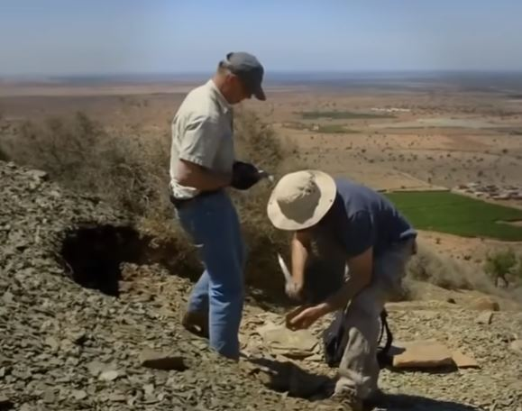
Trilobites

Slide 18
Evolution
Three Principles
Why is this fossil above ground?
Why are artists drawing evolution? Between microbial life and a trilobite we have no proof of transitions.
Where is the extinction of the parent species?

Slide 19
Evolution of Man

Slide 20
Evolution of Man

Slide 21
Evolution of Man

Slide 22
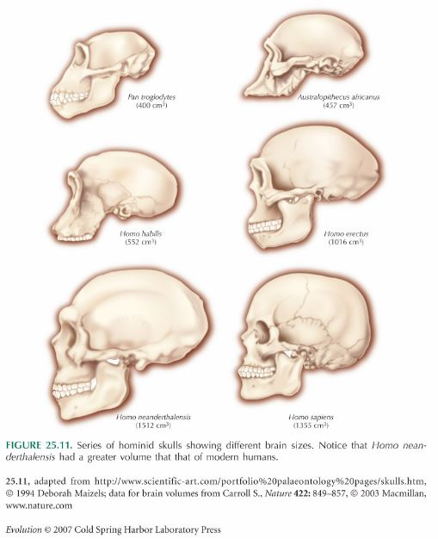
Evolution by Ranking

Slide 23
Evolution of Man

Slide 24
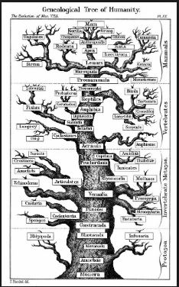
Evolution Family Tree

Slide 25
Australopithecus (Lucy)
During a survey at Hadar in 1974, Donald Johanson and research assistant Tom Gray observed a hominid forearm jutting from the bank of a gully. They noticed that the forearm and other remains nearby appeared to be from the same individual. When the excavation was complete, they had found more than 40 percent of a single hominid skeleton. The specimen, called Lucy, was dated to 3.2 million years ago and classified in 1978 as the first known member of A. afarensis, a species thought to be one of the direct ancestors of modern humans.

Slide 26
Australopithecus (Lucy)

Slide 27
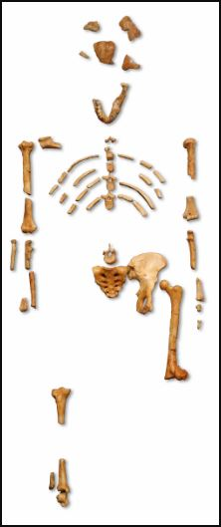
Australopithecus (Lucy)

Slide 28
Evolution
Questions/Comments

Slide 29
Piltdown Man
In 1912 Charles Dawson, an amateur archaeologist claimed to have discovered the ‘missing link’ between ape and man. He had found part of a human-like skull in Pleistocene gravel beds near Piltdown village in Sussex, England. Dawson wrote to Arthur Smith Woodward, Keeper of Geology at the Natural History Museum at the time, about his find. Dawson and Smith Woodward started working together, making further discoveries in the area.

Slide 30
Piltdown Man
They found a set of teeth, a jawbone, more skull fragments and primitive tools, which they suggested belonged to the same individual. Smith Woodward made a reconstruction of the skull fragments, and the archaeologists hypothesized that the find indicated evidence of a human ancestor living 500,000 years ago. They announced their discovery at a Geological Society meeting in 1912. For the most part, their story was accepted in good faith.

Slide 31
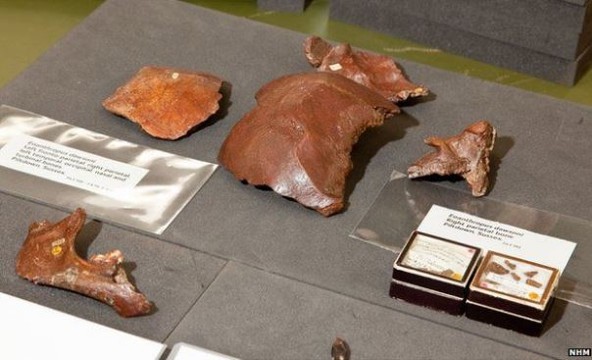
Piltdown Man

Slide 32
Piltdown Man
Discovered in 1912. The British museum knew about the hoax in 1923 but the hoax wasn’t reviled until 1953.

Slide 33
Evolution
Evolutionist are not honest Scientists
Questions/Comments

Slide 34
Pithecanthropus erectus (Java Man)
In the late 1800s, Dr Ernst Haeckel held seminars explaining to the German population that Pithecanthropus Alalus was the missing link. Haeckel did this using only a drawing. Then in 1880s he sent his disciple Dr Eugene Dubois to find Pithecanthropus Alalas, with two Dutch engineers, prison convicts and two Military guards.

Slide 35
Pithecanthropus erectus (Java Man)
Pithecanthropus was found in 1891 along the banks of the Solo River in Java, Indonesia. Excited about his find he sent a telegram to Dr. Haeckel. In response Dr. Haeckel wrote. “From the inventor of Pithecanthropus to his happy discoverer.”

Slide 36
Pithecanthropus erectus (Java Man)

Slide 37
Pithecanthropus erectus (Java Man)
1920s Dubios admitted his false discovery
Large Ape Skull
Three teeth, 1-Human, 2-Orangutan
A Human thigh bone found 1 year later and 50 ft away

Slide 38
Pithecanthropus erectus (Java Man)
During his search (1890-1892) he found Human skulls and hid them under his bed.

Slide 39
Evolution
Evolutionist are not honest Scientists
Questions/Comments

Slide 40
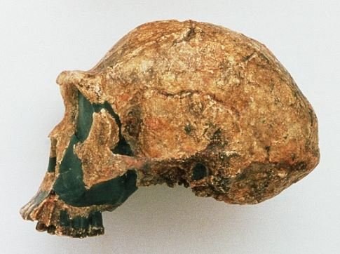
Sinanthropus pekinensis (Peking Man)
Discovered in 1923
Named by Davidson Black who worked with neuroanatomist Grafton Elliot Smith. During the discovery of Piltdown Man

Slide 41
Sinanthropus pekinensis (Peking Man)
In 1941 all but 4 teeth were lost at sea.
Only models exist today

Slide 42
Homo Erectus
Piltdown Man
Java Man
Peking Man
Solo Man
Nebraska Man

Slide 43
Homo Sapiens
Rhodesian Man
Neanderthal
Cro-Magnon Man
Modern Man

Slide 44
Evolution of Man

Slide 45
Evolution of Man
Where are all the bones?

Slide 46
Evolution
Evolutionist are not honest Scientists
Questions/Comments

