Slide 1
Creation vs Science

Slide 2
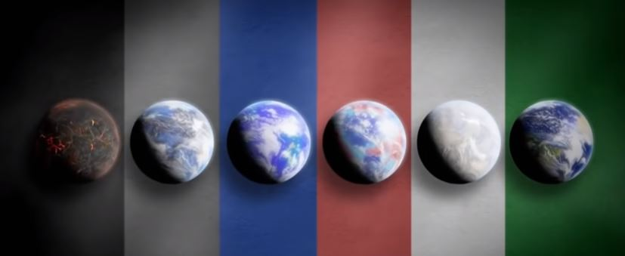
Robert Hazen’s Evolution of Earth

Slide 3
Where did the water come from?

Slide 4
Bryan Greene
Water is so vital to our survival, but strangely enough, we don’t know the first thing about it—literally the first.

Slide 5
Bryan Greene
… Here’s the part we think we understand well: Just shy of a trillionth of a trillionth of a second after the Big Bang, the energy that sparked the outward swelling of space transmuted into a hot, uniform bath of particles.

Slide 6
Bryan Greene
Water is so vital to our survival, but strangely enough, we don’t know the first thing about it—literally the first.

Slide 7
Microscopic Evolution
More than 3.6 billion years ago, a major transition was made on Earth whereby a dilute, swirling cauldron of simple chemical soup made a critical step towards creating the building blocks of life. The simple chemicals became amino acids, the fundamental building blocks of more complicated protein molecules. These proteins then somehow came together to form a single, primitive cell.

Slide 8
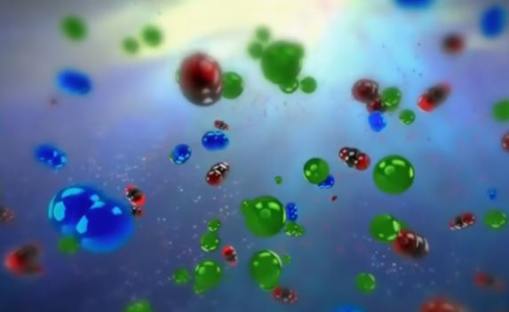
Microscopic Evolution

Slide 9
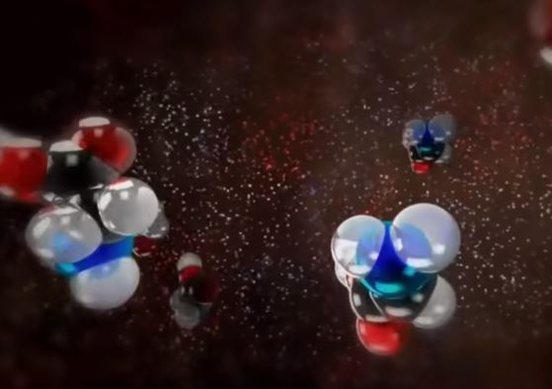
Microscopic Evolution

Slide 10
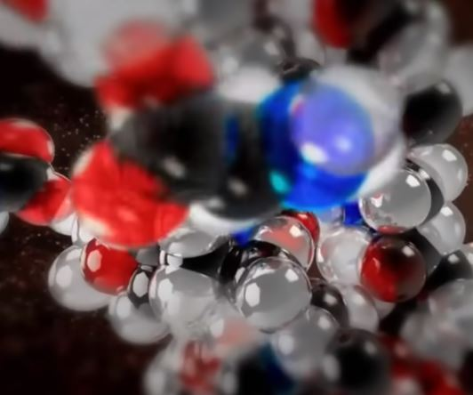
Microscopic Evolution

Slide 11
National Library of Medicine
Proteins are large, complex molecules that play many critical roles in the body. They do most of the work in cells and are required for the structure, function, and regulation of the body’s tissues and organs.

Slide 12
National Library of Medicine
Proteins are made up of hundreds or thousands of smaller units called amino acids, which are attached to one another in long chains. There are 20 different types of amino acids that can be combined to make a protein. The sequence of amino acids determines each protein’s unique 3-dimensional structure and its specific function.

Slide 13
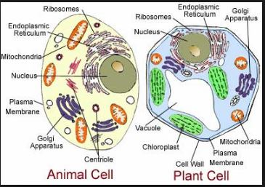
Microscopic Evolution

Slide 14
Microscopic Evolution
Question/Comments

Slide 15
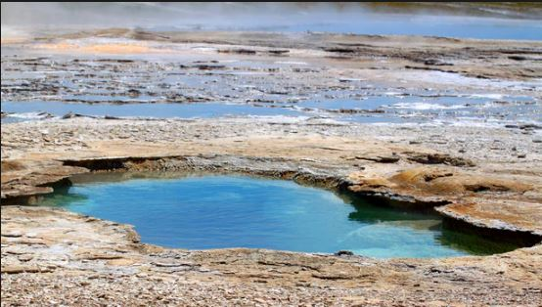
Microscopic Evolution

Slide 16
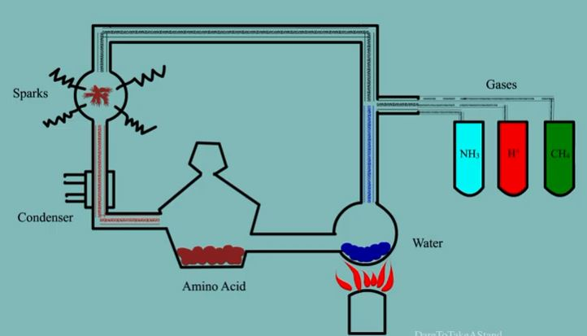
Stanley Miller 1953

Slide 17
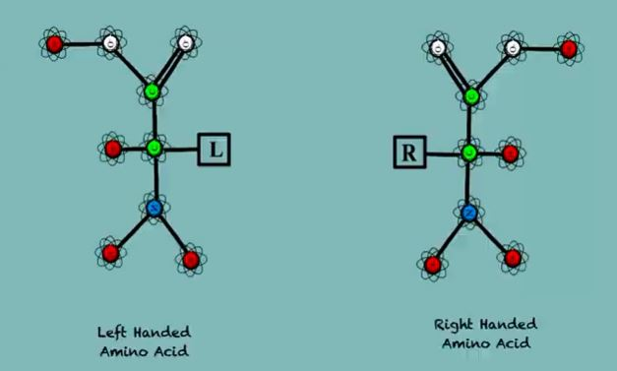
Stanley Miller 1953

Slide 18
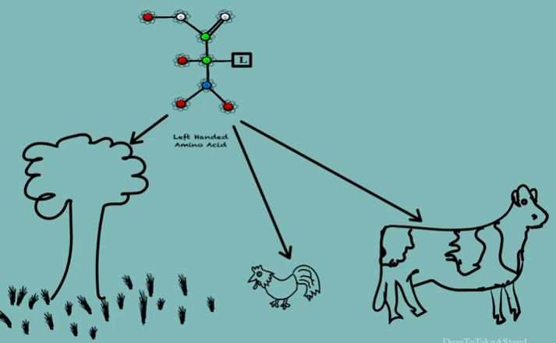
Stanley Miller 1953

Slide 19
Douglas Axe
[I]f evolution is unguided, then the whole process has no idea what sequence it needs in order to get to a particular function. Yet somehow it ends up finding these functions. I estimated it to be about one good sequence in 10e77 sequences. So, roughly, one in a trillion, trillion, trillion, trillion, trillion, trillion – which is not very good odds.

Slide 20
Douglas Axe
The chances for common functional sequences (i.e., Proteins) among all the possible combinations of Amino Acids
1:10e77 100,000,000,000,000,000,000,000,000,000,000,000,000,000,000,000,000,000,000,000,000,000,000,000,000,000

Slide 21
Douglas Axe

Slide 22
Douglas Axe
Chances of finding a functional Protein (for life) by chance
1:10e164
100,000,000,000,000,000,000,000,000,000,000,000,000,000,000,000,000,000,000,000,000,000,000,000,000,000,000,000,000,000,000,000,000,000,000,000,000,000,000,000,000,000,000,000,000000,000,000,000,000,000,000,000,000,000

Slide 23
Microscopic Evolution

Slide 24
Evolution
Three Principles
No example in the geological time scale
Cannot modify what cannot form
Cannot improve what never formed

Slide 25
Microscopic Evolution
Question/Comments

Slide 26
Evolution
Three Principles
The geological time scale must be supported
A species cannot rapidly evolve, but to genetically evolve they must breed the modification into their offspring
For natural genetics to continue to improve there must be an extinction of the parent species

Slide 27
Stromatolites
Evidence suggests that life first evolved around 3.5 billion years ago. This evidence takes the form of microfossils (fossils too small to be seen without the aid of a microscope) and ancient rock structures in South Africa and Australia called stromatolites.

Slide 28
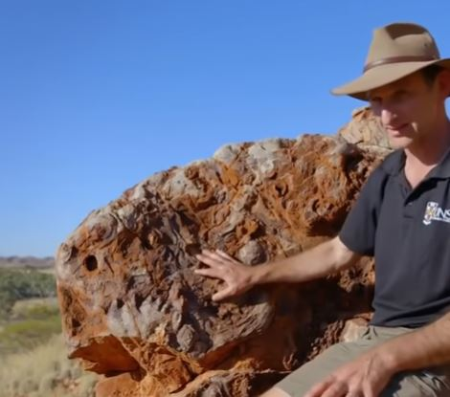
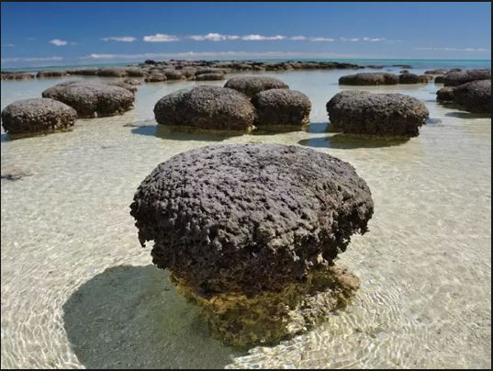
Stromatolites

Slide 29
Evolution
Three Principles
Why is this fossil above ground?
Given the chances to make life, the only had 100 to 200 million years (that’s rapid for evolution), Where is the modified offspring?
Where is the extinction of the parent species?

Slide 30
Trilobites
Trilobites are the oldest animals on the planet and it’s because of their shell that we can find them today. Their shell is made of calcium carbonate, the same minerals found in limestone.

Slide 31
Robert Hazen
If you had a shell, you’re going to survive a lot longer than that soft body animal that doesn’t have a shell. The trilobite had an advantage. It’s survival of the fittest...... Shells, then eventually bones and teeth that paved the way for life to grow taller and stronger

Slide 32
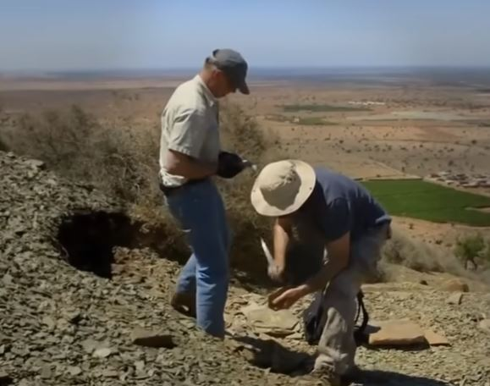
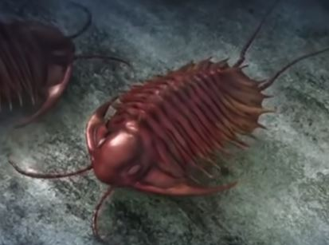
Trilobites

Slide 33
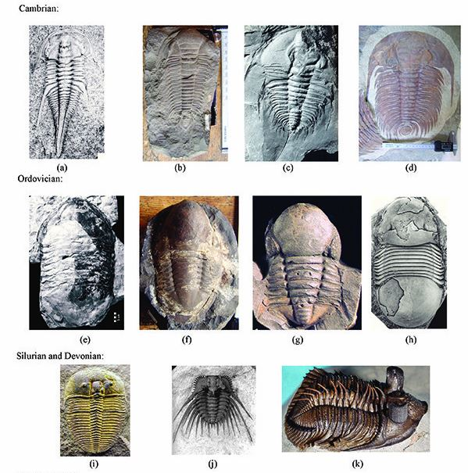

Slide 35
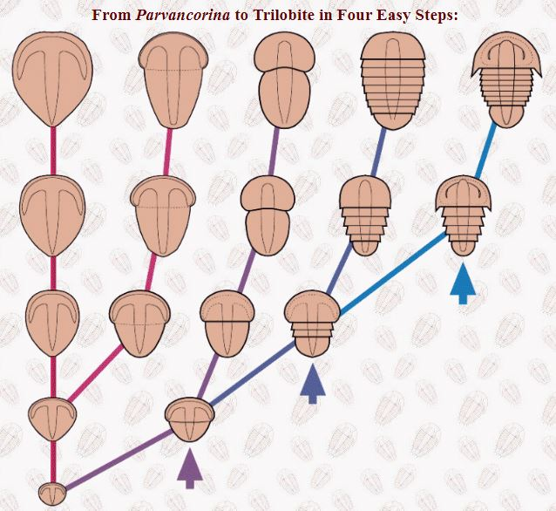

Slide 36
Evolution
Three Principles
Why is this fossil above ground?
Why are artists drawing evolution? Between microbial life and a trilobite we have no proof of transitions.
Where is the extinction of the parent species?

