Slide 2
Creation vs Science

Slide 3
Who taught the first humans?

Slide 4
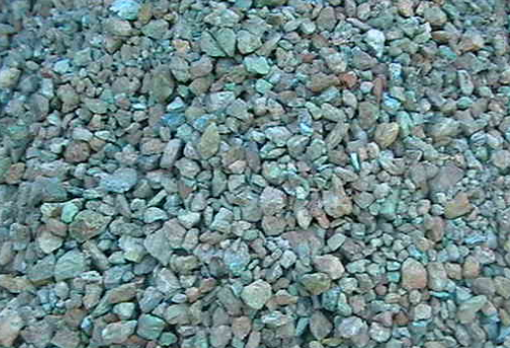
Who taught the first humans?
Why are these rocks important?

Slide 5
Who taught the first humans?
Raw Copper

Slide 6
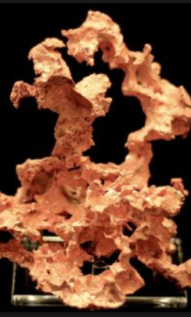
To smelt the copper
Rocks ground into powder
Placed into fire
Heated to 1983°F
Then you get shapes

Slide 7
What would life look like without a teacher?

Slide 8
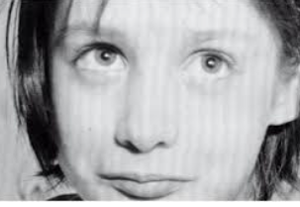
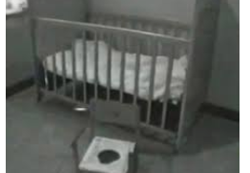
What would life look like without a teacher?
1970 Genie Wiley

Slide 9
What would life look like without a teacher?
1970 Genie Wiley
Unable to perform at normal standards
Progress was made with treatment
She started to form basic communication and social skills
But the team of physicians gave up and she quickly returned to the state she was in before treatment

Slide 10
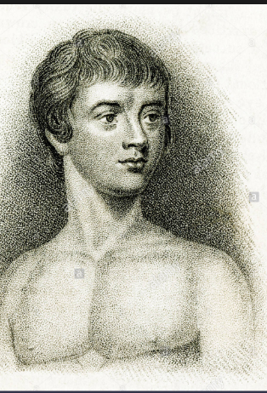
What would life look like without a teacher?
1800 Victor of Aveyron

Slide 11
What would life look like without a teacher?
1800 Victor of Aveyron
Lived in the woods most of his life
Had no communication or social skills
Progress was made but came to a standstill
Physician abandon him to an adoptee

Slide 12
Without a community to teach us we could not have evolved.
Questions/Comments

Slide 13
Evolutionist believe religion is a “By-Product”

Slide 14
What is a by-product?
A secondary result, unintended but inevitably produced in doing or producing something else

Slide 15
Evolutionist “by-product” teaching on the origin of religion
Religion is a by-product of dealing with death
Religion is a by-product of communal living
Religion is a by-product of an attempt to fill in gaps

Slide 16
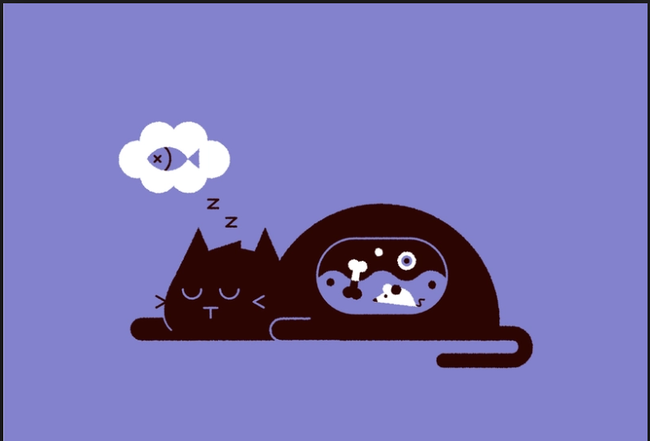
Is religion a by-product of death?
Dr. Andy Thomson’s cat

Slide 17
Is religion a by-product of death?
What does the mouse need?
What is the mouse thinking?

Slide 18
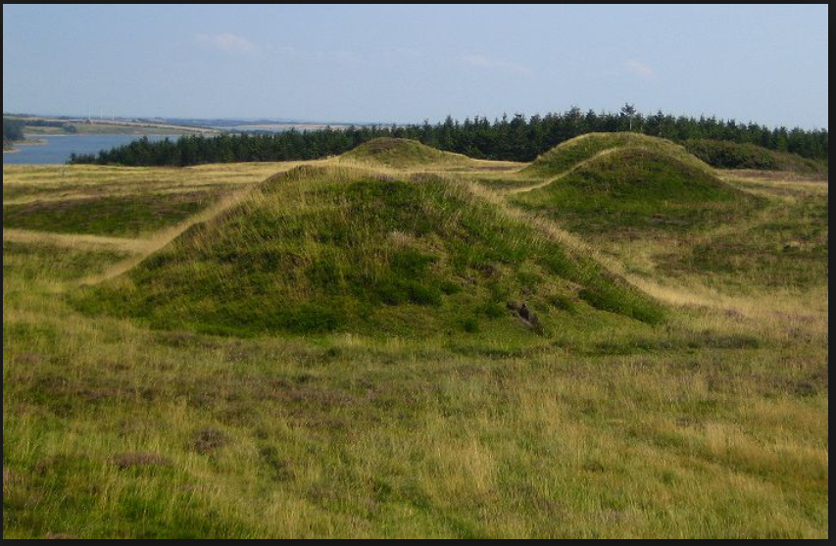
Is religion a by-product of death?
Why we respectfully bury our dead

Slide 19
Is religion a by-product of death?
Gen 4: 9-10
9And the LORD said to Cain, “Where is your brother Abel?” “I do not know!” he answered. “Am I my brother’s keeper?”
10“What have you done?” replied the LORD. “The voice of your brother’s blood cries out to Me from the ground.

Slide 20
Is religion a by-product of death?
No
Our understanding that death isn’t the end, was taught to us from the beginning

Slide 21
Evolutionist “by-product” teaching on the origin of religion
Questions/Comments

Slide 22
Evolutionist “by-product” teaching on the origin of religion
Religion is a by-product of dealing with death
Religion is a by-product of communal living

Slide 23
Is religion a by-product of communal living?
Kinship or Brotherhood
Rules must be established to sort out and punish cheaters, without overthrowing the Lawmaker

Slide 24
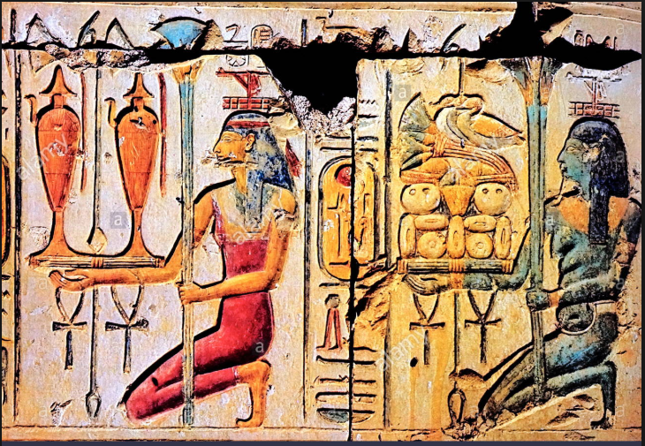
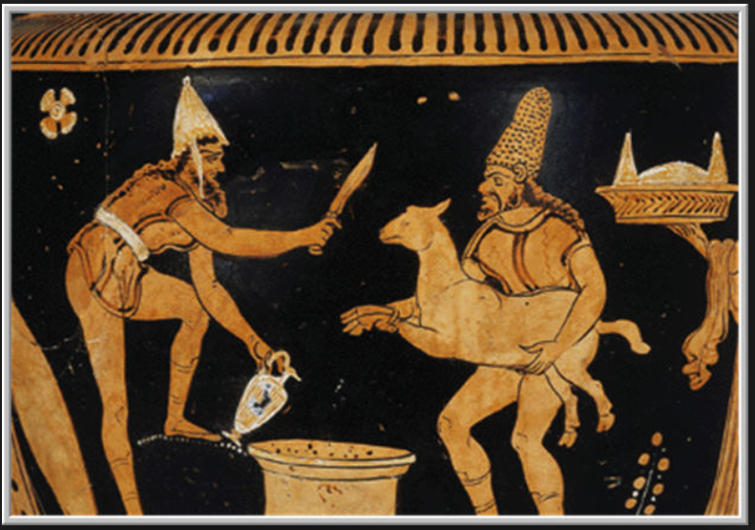
Kinship or Brotherhood
Requires an offering or sacrifice

Slide 25
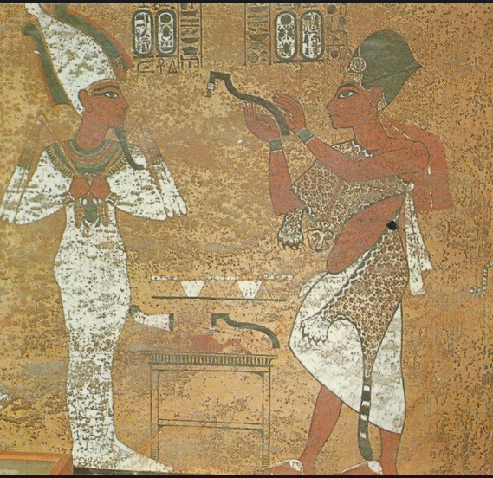
Rules must be followed to punish cheaters
Its easier for lawmakers to use the voice of a higher power

Slide 26
Is religion a by-product of Kinship or Brotherhood?
Gen 4:3-4
3In the course of time Cain brought to the LORD an offering of the fruit of the ground,
4and Abel also brought of the firstborn of his flock and of their fat portions. And the LORD had regard for Abel and his offering,

Slide 27
Is religion a by-product of ruling without consequences?
Gen 3:11-12
11He said, “Who told you that you were naked? Have you eaten of the tree of which I commanded you not to eat?”
12The man said, “The woman whom you gave to be with me, she gave me fruit of the tree, and I ate.”

Slide 28
Is religion a by-product of ruling without consequences?
No
Deviation comes after the Tower of Babel. Men set out to become their own gods and used original practices to shape their social structures.

Slide 29
Evolutionist “by-product” teaching on the origin of religion
Questions/Comments

Slide 30
Evolutionist “by-product” teaching on the origin of religion
Religion is a by-product of dealing with death
Religion is a by-product of communal living
Religion is a by-product of an attempt to fill in gaps

