Slide 2
Understanding Chronic Illness in the Church
Luke 10:30-36

Slide 3
Luke 10:30-36
30Then Jesus answered and said: “A certain man went down from Jerusalem to Jericho, and fell among thieves, who stripped him of his clothing, wounded him, and departed, leaving him half dead.
31Now by chance a certain priest came down that road. And when he saw him, he passed by on the other side.
32Likewise a Levite, when he arrived at the place, came and looked, and passed by on the other side.
33But a certain Samaritan, as he journeyed, came where he was. And when he saw him, he had compassion.
34So he went to him and bandaged his wounds, pouring on oil and wine; and he set him on his own animal, brought him to an inn, and took care of him.
35On the next day, when he departed, he took out two denarii, gave them to the innkeeper, and said to him, ‘Take care of him; and whatever more you spend, when I come again, I will repay you.’
36So which of these three do you think was neighbor to him who fell among the thieves?”

Slide 4
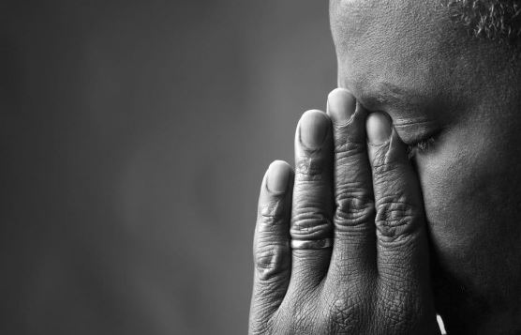
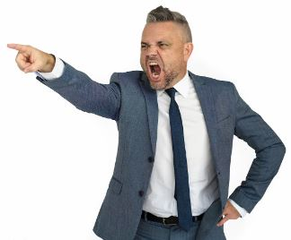

Slide 5
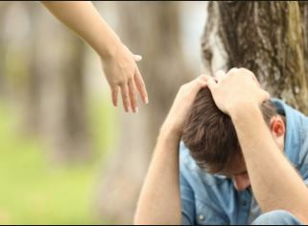

Slide 6
Chronically ill healed: Matthew 8
Leper Cleansed (1-4)
Centurion’s Servant (5-13)
Peter’s Mother-in-Law (14-15)
Many Others (16-17)

Slide 7
Chronically ill healed: Matthew 8
Leper Cleansed (1-4)
Centurion’s Servant (5-13)
Peter’s Mother-in-Law (14-15)
Many Others (16-17)
All suffering ended for these people

Slide 8
Chronically illness
First: Chronic illness does not end

Slide 9
Chronically illness
First: Chronic illness does not end
Second: Everyone suffers differently

Slide 10
Chronic illness
First: Chronic illness does not end
Second: Everyone suffers differently
Third: It’s never a private matter in the church

Slide 11
Chronic Illness leads to Mental and emotional stress

Slide 12
Chronic Mental Stress
First: Worry, mostly about the future

Slide 13
Chronic Mental Stress
Matt 6:34
34Therefore do not worry about tomorrow, for tomorrow will worry about its own things. Sufficient for the day is its own trouble.

Slide 14
Chronic Mental Stress
Matt 6:34
34Therefore do not worry about tomorrow, for tomorrow will worry about its own things. Sufficient for the day is its own trouble.
31“Therefore do not worry, saying, ‘What shall we eat?’ or ‘What shall we drink?’ or ‘What shall we wear?’

Slide 15
Chronic Mental Stress
First: Worry, mostly about the future
How will I pay for my new medicine?

Slide 16
Chronic Mental Stress
First: Worry, mostly about the future
I’ve been sick so much. How long before my job fires me?

Slide 17
Chronic Mental Stress
First: Worry, mostly about the future
How will I feel five years from now?

Slide 18
Chronic Mental Stress
First: Worry, mostly about the future
I need food but if I go out members might see me and use that against me next Sunday

Slide 19
Chronic Mental Stress
First: Worry, mostly about the future
Second: Anger=Limitations, People, and Financial Stress

Slide 20
Chronic Mental Stress
First: Worry, mostly about the future
Second: Anger=Limitations, People, and Financial Stress
Third: Depression=The biggest and deepest problem all suffer with.

Slide 21
Discouragements
Hi Stranger!!

Slide 22
Discouragements
Hi Stranger!!
Playful but basically means the speaker hasn’t made an attempt in a while to help

Slide 23
Discouragements
We pray for you

Slide 24
Discouragements
We pray for you
Power of prayer is needed but how deep are your prayers if you don’t make contact
Feeling like a list

Slide 25
Discouragements
How are you doing

Slide 26
Discouragements
How are you doing
Normally asked before services when time is limited

Slide 27
Discouragements
You’ve been missing too many services

Slide 28
Discouragements
You’ve been missing too many services
Almost always targeted at people between 18 – 50.
Chronic illness doesn’t care

Slide 29
Discouragements
I saw you out …..
Work
Shopping
Vacation

Slide 30
Discouragements
I saw you out …..
Work
Shopping
Vacation
Mentioning anything around this means you’re telling them they can’t leave their house without first asking the Church

Slide 31
Discouragements
If a bleeding woman (Luke 8:40-48) can make it to Jesus, you can make it to church.

Slide 32
Luke 8:40-48
40So it was, when Jesus returned, that the multitude welcomed Him, for they were all waiting for Him.
41And behold, there came a man named Jairus, and he was a ruler of the synagogue. And he fell down at Jesus’ feet and begged Him to come to his house,
42for he had an only daughter about twelve years of age, and she was dying. But as He went, the multitudes thronged Him.

Slide 33
Luke 8:40-48
43Now a woman, having a flow of blood for twelve years, who had spent all her livelihood on physicians and could not be healed by any,
44came from behind and touched the border of His garment. And immediately her flow of blood stopped.
45And Jesus said, “Who touched Me?” When all denied it, Peter and those with him said, “Master, the multitudes throng and press You, and You say, ‘Who touched Me?’ ”

Slide 34
Luke 8:40-48
46But Jesus said, “Somebody touched Me, for I perceived power going out from Me.”
47Now when the woman saw that she was not hidden, she came trembling; and falling down before Him, she declared to Him in the presence of all the people the reason she had touched Him and how she was healed immediately.
48And He said to her, “Daughter, be of good cheer; your faith has made you well. Go in peace.”

Slide 35
Discouragements
If a bleeding woman (Luke 8:40-48) can make it to Jesus, you can make it to church.
The woman made it to Jesus for a cure.

Slide 36
Discouragements
If John or Jane Doe can make it so can you
This is never an okay statement. Normally meant for the sufferer to view another's strength.
Individuals suffer differently

Slide 37
Luke 18:10-13
10“Two men went up to the temple to pray, one a Pharisee and the other a tax collector.
11The Pharisee stood and prayed thus with himself, ‘God, I thank You that I am not like other men—extortioners, unjust, adulterers, or even as this tax collector.
12I fast twice a week; I give tithes of all that I possess.’
13And the tax collector, standing afar off, would not so much as raise his eyes to heaven, but beat his breast, saying, ‘God, be merciful to me a sinner!’

Slide 38
Luke 10:36-37
36So which of these three do you think was neighbor to him who fell among the thieves?”
37And he said, “He who showed mercy on him. “Then Jesus said to him, “Go and do likewise.”

Slide 39
We are to …….
Carry their burdens – Gal. 6:1-5

Slide 40
We are to …….
Carry their burdens – Gal. 6:1-5
Uphold the weak – 1 Thess. 5:14

Slide 41
We are to …….
Carry their burdens – Gal. 6:1-5
Uphold the weak – 1 Thess. 5:14
Show love to each other – 1 Cor 13

Slide 42
To those who suffer…..
Your Brothers and Sisters love you. Forgive their misunderstandings
Your ailments do not and cannot define your faith
Your faith is you own. God knows when you can be here and choose not to

