Slide 2
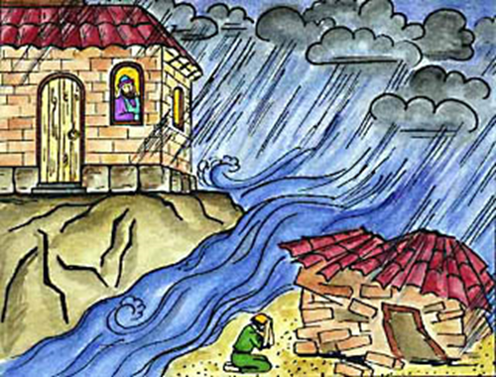
Two Builders
Matthew 7:24-27

Slide 3
Two Foundations vv. 24, 26
ROCK
Christ, His words and will (Mt. 7:21)
SAND
Self-righteousness (Mt. 5:20; 6:1)
Fleshly lusts (Mt. 5:27-28)
Worldly standards (Mt. 5:31-48)
Worldly wealth (Mt. 6:19-24)
False teaching/living (Mt. 7:15-23)
Two Builders
Matthew 7:24-27

Slide 4
Two Foundations vv. 24, 26
James 1:22-25
Which builder am I?
Two Builders
Matthew 7:24-27

Slide 5
One Storm vv. 25a, 27a
James 1:3, 13
“WHEN you encounter various trials…WHEN you are tempted”
Two Builders
Matthew 7:24-27

Slide 6
One Storm vv. 25a, 27a
VARIOUS STORMS
Longtime physical ailment (Mk. 5:25-26)
Unresolved family dispute (Lk. 12:13)
Prodigal son that hasn’t come home (Lk. 15:13)
Death of a dear loved one (Jn. 11:33)
Which builder am I?
Two Builders
Matthew 7:24-27

Slide 7
Two Results vv. 25b, 27b
1 Timothy 5:24-25
Two Builders
Matthew 7:24-27

Slide 8
Two Results vv. 25b, 27b
WISE BUILDER
“Could not shake it”
“Well built”
“Did not fall”
FOOLISH BUILDER
“Immediately it collapsed”
“The ruin of that house was great”; “and great was its fall”
Two Builders
Matthew 7:24-27

Slide 9
Two Results vv. 25b, 27b
Matthew 7:21-23
1 John 2:17
Which builder am I?
Two Builders
Matthew 7:24-27

