Slide 1
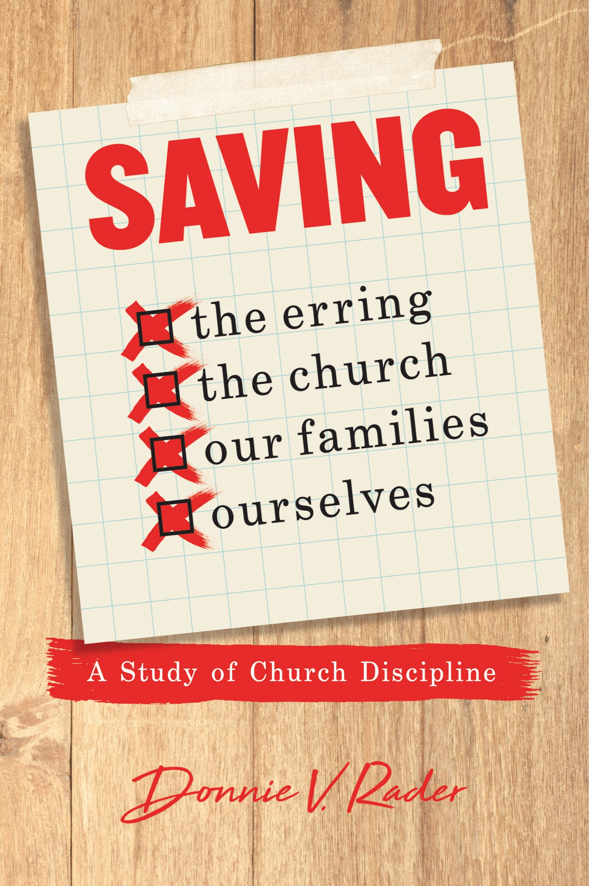

Slide 2
Contents
What is Discipline?
Personal Offenses
Public Offenses
The Forgotten & Misunderstood Command
The Purpose of Withdrawing & From Whom Should We Withdraw
The Case at Corinth (1 Cor. 5) – Part 1
The Case at Corinth (1 Cor. 5 & 2 Cor. 2, 7) – Part 2
The Case at Thessalonica (2 Thess. 3)
How to Treat those Disfellowshipped
Does it Apply to Family?
Can We Withdraw from the Withdrawn?
Procedure for Withdrawal
Objections to and Questions about Withdrawal

Slide 3
Saving the Erring, the Church, Our Families, and Ourselves
How to Treat Those Disfellowshipped
Two extremes:
Treat them like nothing is wrong – same as before
Treat them like have some disease – completely avoid and ignore
When discipline fails – often because members disregard Bible instructions on how to treat those disciplined

Slide 4
Saving the Erring, the Church, Our Families, and Ourselves
How to Treat Those Disfellowshipped
Let’s not forget: Discipline is to save the erring. Question is: What is best for the erring?
How the erring are treated after withdrawal – can make a world of difference in whether they come back!

Slide 5
Saving the Erring, the Church, Our Families, and Ourselves
How to Treat Those Disfellowshipped
Who Should Withdraw from the Disorderly?

Slide 6
The whole church
1 Cor. 5:4; 2 Cor. 2:6
Not just the elders, the men, or core element
Since the whole church is expected to agree & support the discipline – they are entitled to know the facts
Think of the power – if every member were to work toward restoring the erring (Gal. 6:1).
Who Should Withdraw from the Disorderly?

Slide 7
The whole church
Backed, supported, and upheld by all
Often there is an element (at times sizeable) that will not support withdrawal – which renders it ineffective
When one does not support church discipline:
That person does not respect the authority of Christ
That person does not really love the erring individual as he should.
That person is not interested in keeping the church pure
Who Should Withdraw from the Disorderly?

Slide 8
The whole church
Backed, supported, and upheld by all
Often there is an element (at times sizeable) that will not support withdrawal – which renders it ineffective
When one does not support church discipline:
That person is not interested in maintaining the respect of the world.
That person must feel that the other members of the congregation need no example or warning.
Who Should Withdraw from the Disorderly?
Five points taken from Royce DeBerry, Church Discipline, 60
Point: Since withdrawing is the action of the whole church – how each member treats them is very important.

