Slide 1
Creation vs Science

Slide 2
Evolution
Change in heritable traits of biological organisms over generations due to:
Natural Selection, Mutations, Gene Flow, and Genetic Drift.

Slide 3
Evolution
Microevolution- evolutionary change within a species or small group of organisms, especially over a short period.
Macroevolution-major evolutionary change. The term applies mainly to the evolution of whole taxonomic groups over long periods of time.

Slide 4
Evolution
Three Principles
The geological time scale must be supported
A species cannot rapidly evolve, but to genetically evolve they must breed the modification into their offspring
For natural genetics to continue to improve there must be an extinction of the parent species

Slide 5
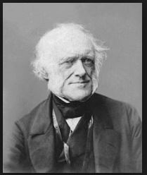
Evolution
Sir Charles Lyell
Principles of Geology
Originally believed the Earth to be 1.6 Billion years old

Slide 6
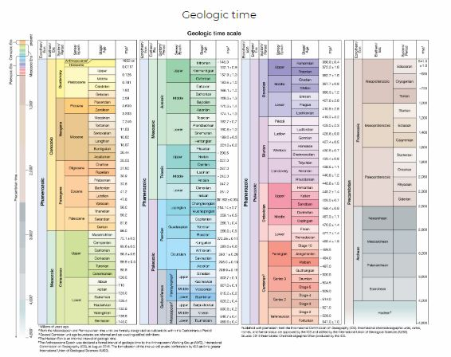
Evolution
Earth agreed upon in the 20th Century to be 4.5 Billion years old
Verified by Radiometric Dating

Slide 7
Evolution
Robert Lee
“Continuing use of the method depends on a 'fix-it-as-we-go' approach, allowing for contamination here, fractionation here, and calibration whenever possible. It should be no surprise, then, that fully half of the dates are rejected.”

Slide 8
Reminder
Scientist use what to verify Radiometric Dating?

Slide 9
Reminder
Scientist use what to verify Radiometric Dating?
Geological Time Scale

Slide 10
Reminder
Scientist use what to verify Radiometric Dating?
Scientist use what to verify the Geological time scale?
Geological Time Scale

Slide 11
Reminder
Scientist use what to verify Radiometric Dating?
Scientist use what to verify the Geological time scale?
Geological Time Scale
Radiometric Dating

Slide 12
Problems Along the Way

Slide 13
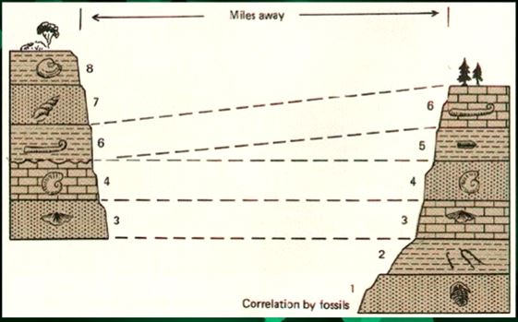
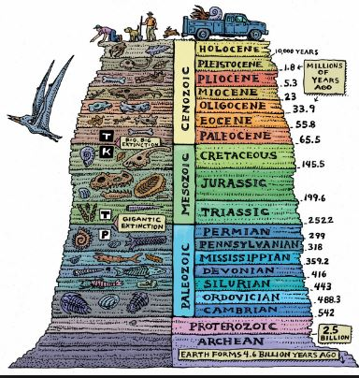
Problems Along the Way
Geological Column depicted wrong

Slide 14
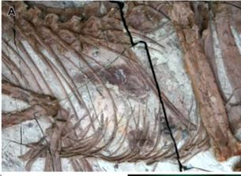
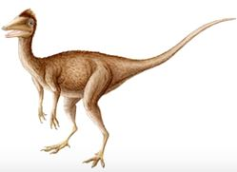
Problems Along the Way
Fossils dates don’t line up

Slide 15
Evolution
Three Principles
The geological time scale must be supported

Slide 16
Evolution
Question/Comments?

Slide 17
Evolution
Three Principles
2. A species cannot rapidly evolve, but to genetically evolve they must breed the modification into their offspring

Slide 18
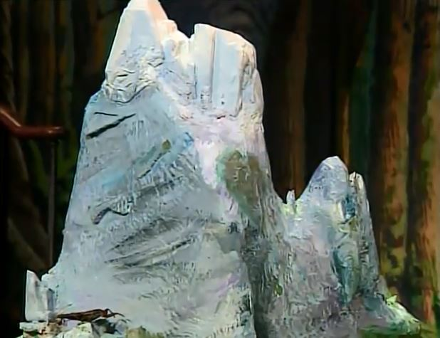
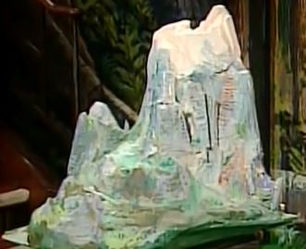
Dawkins: Growing up in the Universe

Slide 19
Richard Dawkins
Individuals don’t climb mount improbable its lineages groups of animals, species that climb it and they do it in evolutionary time. They and their descendants and their descendants, descendants. They do it by going through extremely large number of generations and we do have the time for an extremely large number of generations because we have the geological time at our disposal.

Slide 20
Richard Dawkins
Individuals don’t climb mount improbable its lineages groups of animals, species that climb it and they do it in evolutionary time. They and their descendants and their descendants, descendants. They do it by going through extremely large number of generations and we do have the time for an extremely large number of generations because we have the geological time at our disposal.

Slide 21
Evolution
Individual species are born higher on the mountain but do not themselves climb it.

Slide 22
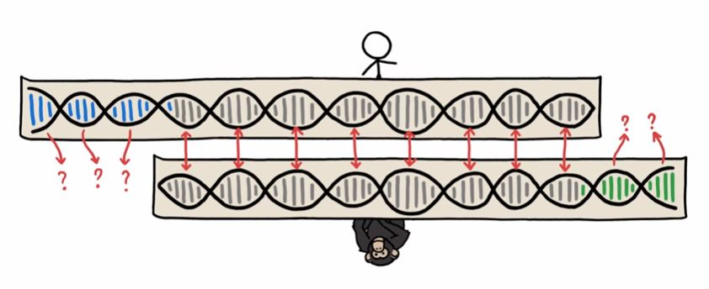
Problems Along the Way
DNA matches between species are made to fit.

Slide 23
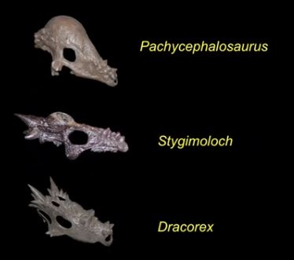
Problems Along the Way
Lack of aging dinosaurs

Slide 24
Evolution
Question/Comments?

Slide 25
Evolution
Three Principles
3. For natural genetics to continue to improve there must be an extinction of the parent species

Slide 26
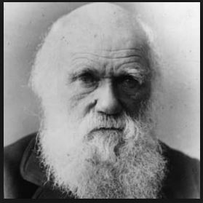
Charles Darwin
Published ‘The Origin of Species’ 1859
Student and friend of Sir Charles Lyell

Slide 27
Darwin: The Origin of Species
Natural selection acts solely through the preservation of variations in some way advantageous, which consequently endure. But as from the high geometrical powers of increase of all organic beings, each area is already fully stocked with inhabitants, it follows that as each selected and favored form increases in number, so will the less favored forms decrease and become rare. Rarity, as geology tells us, is the precursor to extinction.

Slide 28
Darwin: The Origin of Species
… [R]are species will be less quickly modified or improved within any given period, and they will consequently be beaten in the race for life by the modified descendants of the commoner species.

Slide 29
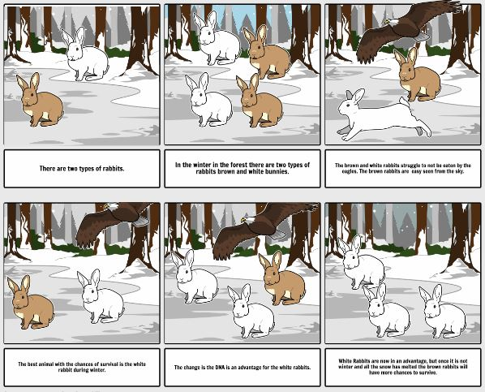
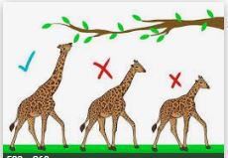
Natural Selection

Slide 30
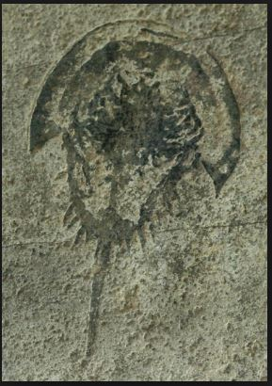
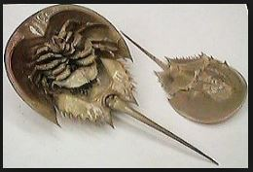
Problems Along the Way
Where are the modifications

Slide 31
Problems Along the Way
Artistic pictures are used for gaps

Slide 32
Evolution
Question/Comments?

Slide 33
Evolution
Three Principles
The geological time scale must be supported
A species cannot rapidly evolve, but to genetically evolve they must breed the modification into their offspring
For natural genetics to continue to improve there must be an extinction of the parent species

