Slide 2
Creation vs science

Slide 3
Radiometric dating

Slide 4
Radiometric dating
Support

Slide 5
Radiometric dating
Support
Science
Religious Scientist

Slide 6
Radiometric dating
Is a method used to date rocks and other objects based on the known decay rate of radioactive isotopes.

Slide 7
4 mainstream types

Slide 8
4 mainstream types
Radiocarbon
Potassium-Argon
Rubidium-Strontium
Uranium-Lead

Slide 9
4 mainstream types
Radiocarbon -- half-life 5,730 years
Potassium-Argon -- half-life 1.3 billion years
Rubidium-Strontium -- half-life 48.8 billion years
Uranium-Lead -- half-life 704 million years/4.47 billion years

Slide 10
Radiocarbon dating

Slide 11
Radiocarbon dating
Relies on the decay rate of Carbon 14 (C14)

Slide 12
Radiocarbon dating
Nitrogen 14 Makes up 78% of the earth’s atmosphere
Carbon 14 Makes up .0007655% of the earth’s atmosphere

Slide 13
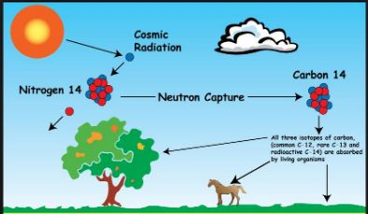
Radiocarbon dating

Slide 14
Radiocarbon dating

Slide 15
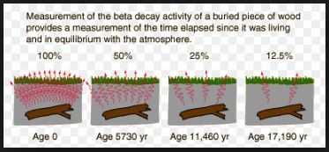
Radiocarbon dating

Slide 16
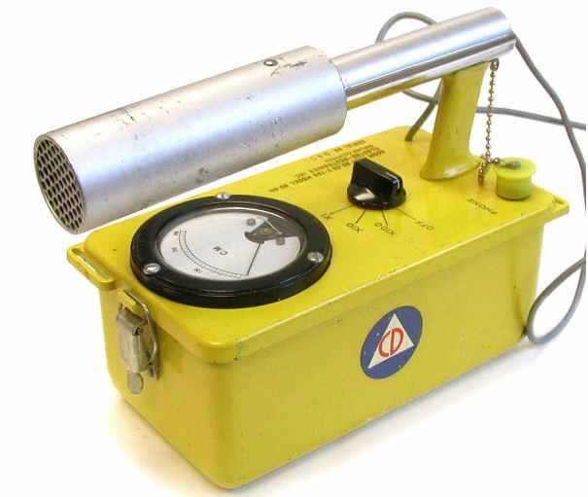
Radiocarbon dating
End-window Geiger-Muller Detector

Slide 17
Radiocarbon dating
Questions?

Slide 18
Radiocarbon dating
Support
Science
Beta decay is detectable
Religious Scientist
5,730 Half-life

Slide 19
Radiocarbon dating
.00078% of C14 must be equal throughout the world. < Equilibrium >

Slide 20
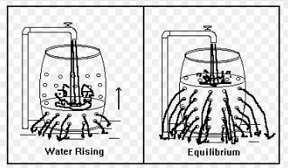
Radiocarbon dating

Slide 21
Radiocarbon dating
.00078% = Living or Recent Death
.000039% = 5,730 years old
.00002% = 11,460 years old

Slide 22
Radiocarbon dating
.00078% = Living or Recent Death
.000039% = 5,730 years old
.00002% = 11,460 years old
This is on the assumption that C14 has reach Equilibrium and is consistent over the years

Slide 23
Radiocarbon dating
.00078% of C14 must be equal throughout the world. < Equilibrium >

Slide 24
Radiocarbon dating
R.E. Taylor – Anthropologist (1985)
Radiocarbon is forming 30% faster than it is decaying

Slide 25
Radiocarbon dating
“Future carbon dating will not be so reliable because of changes in the carbon isotopic mix. Fossil fuels have no carbon-14 content, and the burning of those fuels over the past 100 years has diluted the carbon-14 content. On the other hand, atmospheric testing of nuclear weapons in the 1950s and 1960s increased the carbon-14 content of the atmosphere.” Krane, Kenneth S., Introductory Nuclear Physics, Wiley, 1987.

Slide 26
Radiocarbon dating
How do we know nothing else in the past effected the C14 in the Atmosphere?

Slide 27
Radiocarbon dating
Questions?

Slide 28
Radiocarbon dating
Support
Science
C14 in Atmosphere is measurable
Religious Scientist
5,730 Half-life

Slide 29
Radiocarbon dating
.00078% of C14 must be equal throughout the world. < Equilibrium >
C14 is accurate up to 60,000 years but limited to 250,000 years

Slide 30
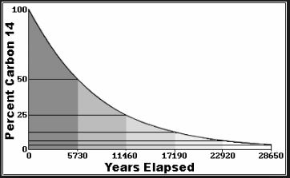
Radiocarbon dating
.00078% = Living or Recent Death
.000039% = 5,730 yrs
.00002% = 11,460 yrs
0 = 250,000 yrs

Slide 31
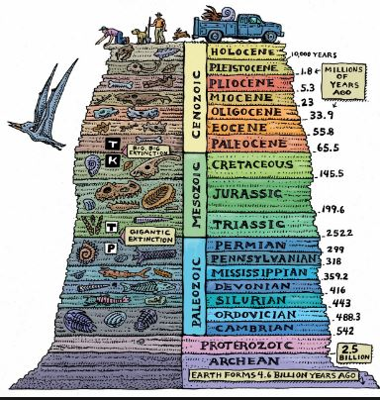
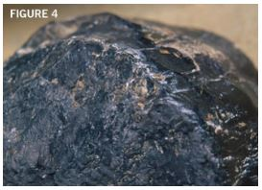
Radiocarbon dating

Slide 32
Radiocarbon dating
No Equilibrium
Inaccurate Readings

Slide 33
Robert Lee (1981)
The troubles of the radiocarbon dating method are undeniably deep and serious. Despite 35 years of technical refinement and better understanding, the underlying assumptions have been strongly challenged, and warnings are out that radiocarbon may soon find itself in a crisis situation.

Slide 34
Robert Lee (1981)
Continuing use of the method depends on a 'fix-it-as-we-go' approach, allowing for contamination here, fractionation here, and calibration whenever possible. It should be no surprise, then, that fully half of the dates are rejected. The wonder is, surely, that the remaining half come to be accepted.

Slide 35
Robert Lee (1981)
No matter how 'useful' it is, though, the radiocarbon method is still not capable of yielding accurate and reliable results. There are gross discrepancies, the chronology is uneven and relative, and the accepted dates are actually selected dates

Slide 36
Radiocarbon dating
Questions?

Slide 37
Radiocarbon dating
Support
Science
Beta decay is detectable
C14 in Atmosphere is measurable
Religious Scientist
5,730 Half-life

Slide 38
How did they choose half-life dates

Slide 39
How did they choose half-life dates
Radiocarbon -- half-life 5,730 years
Potassium-Argon -- half-life 1.3 billion years
Rubidium-Strontium -- half-life 48.8 billion years
Uranium-Lead -- half-life 704 million years/4.47 billion years

Slide 40
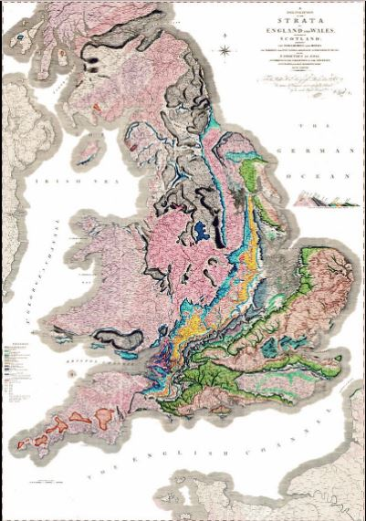
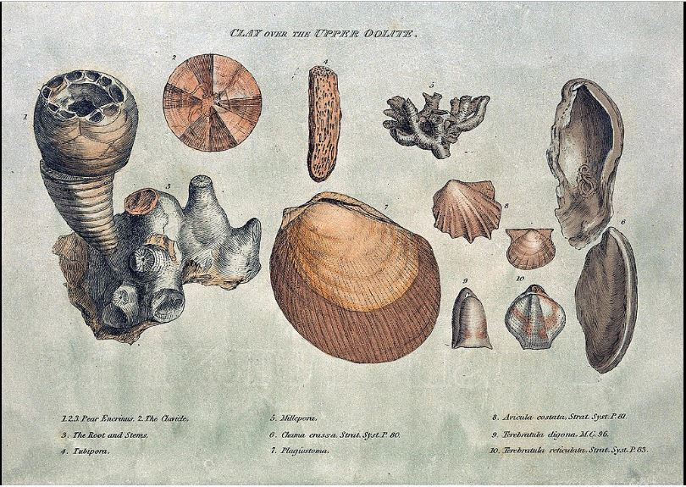
William Smith 1815

