Slide 2
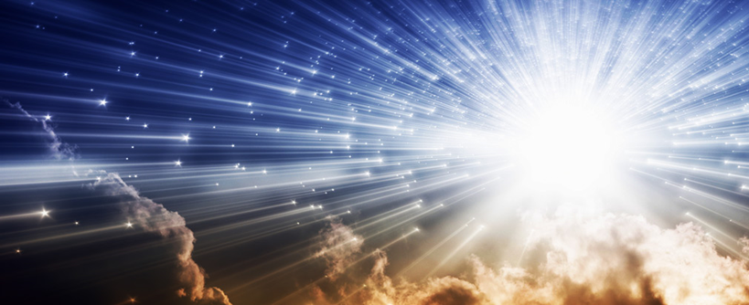
“The Light of the World”
John 8:12-30

Slide 3
Following “the Light of the World” Means That I…
…Believe His testimony is true (vv. 13-14)
John 16:28
John 8:16-18
John 20:30-31

Slide 4
Following “the Light of the World” Means That I…
…Am “from above”, not “from below” (v. 23)
John 8:15
John 17:14-17
Philippians 2:14-16
1 John 2:15-17

Slide 5
Following “the Light of the World” Means That I…
…Believe that He IS (v. 24)
John 8:28
John 12:32-36

