Slide 2
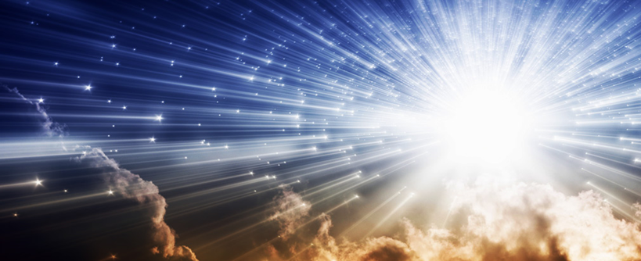
“The Light of the World”
John 1:1-18

Slide 3
As “the Light of the World”, Jesus Is…
…Eternal Deity (vv. 1-2)
1 John 1:5
John 1:4, 5, 7, 8, 9
Revelation 21:23; 22:5

Slide 4
As “the Light of the World”, Jesus Is…
…The Light of men that shines in darkness (vv. 4-5)
John 1:9
John 1:12-13
John 12:35-36
John 1:9-11
John 3:18-21

Slide 5
As “the Light of the World”, Jesus Is…
…The One who shows us God (vv. 14, 18)
Colossians 1:15
Hebrews 1:3
John 14:5-10

