Slide 2
Creation vs Science

Slide 3
Neil Tyson
is an American astrophysicist, author, and science communicator. Since 1996, he has been the Frederick P. Rose Director of the Hayden Planetarium at the Rose Center for Earth and Space in New York City.

Slide 4
Tyson Quote
“I don’t care what you believe provided it doesn’t hurt another human being. However, if what you believe is demonstrably false and you want to pass it off as true in a science classroom. I have an issue with that.”

Slide 5
Scientific Method
State Problem
Formulate Hypothesis
Design Experiment
Collect Data
Analyze Data
Draw Conclusion

Slide 7
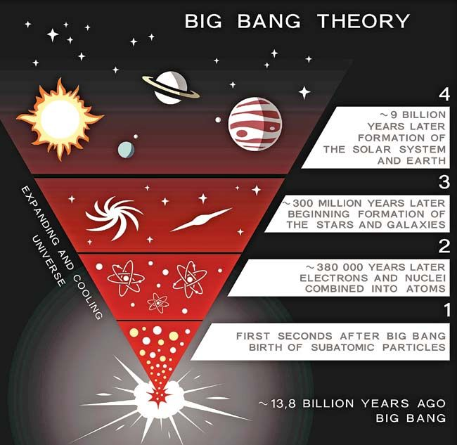

Slide 8
What laws are broken
Conservation of Angular Momentum - when no external torque acts on an object, no change of angular momentum will occur.
Conservation of Mass – Matter cannot be created nor destroyed.

