Slide 2
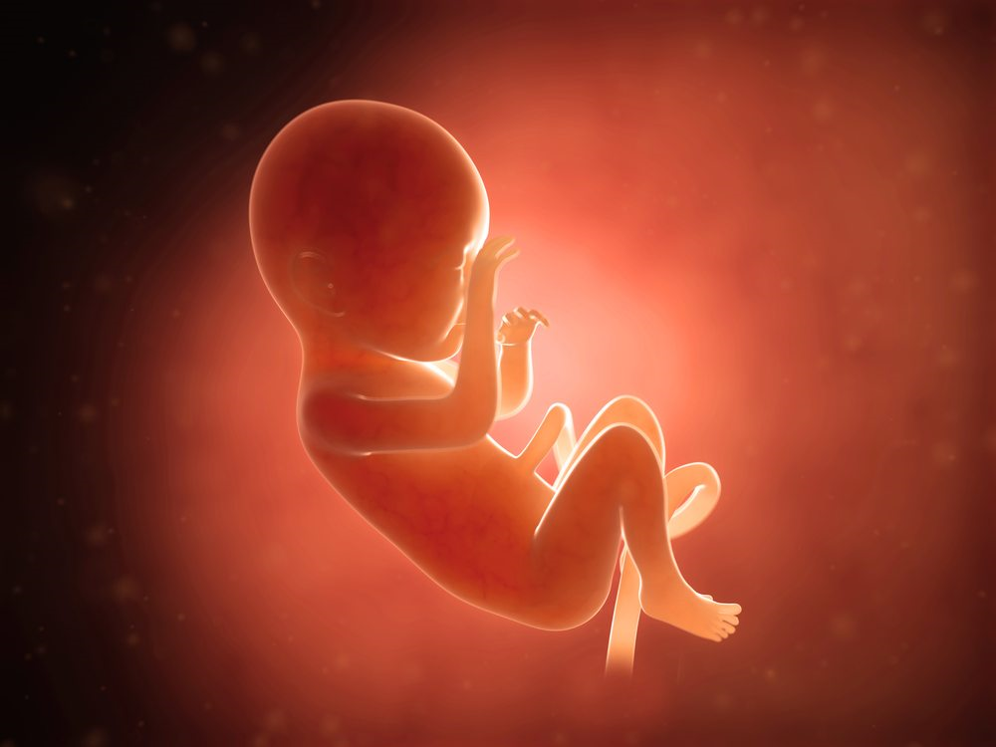
ABORTION
What
God
Says

Slide 3
Three Messages from God
“I value life…ALL life”
Genesis 2:7
Acts 17:24-25
Genesis 1:31

Slide 4
Three Messages from God
“I value life…ALL life”
Genesis 9:6
Genesis 9:1, 7
Deuteronomy 10:17-18
Psalm 10:14
Psalm 68:5-6

Slide 5
Three Messages from God
“I value life…ALL life”
Psalm 139:13-16

Slide 6
Three Messages from God
“I hate murder… ALL murder”
Genesis 9:5-6
Proverbs 6:16-19
Isaiah 1:14-15

Slide 7
Three Messages from God
“I hate murder… ALL murder”
Exodus 21:12-14
Numbers 35:10-34
Deuteronomy 19:1-13

Slide 8
Three Messages from God
“I demand action… from ALL people”
Isaiah 1:16-17a
1 Corinthians 6:9-11
1 John 1:9-2:2

Slide 9
Three Messages from God
“I demand action… from ALL people”
Matthew 7:12; 22:38
Isaiah 1:17b
Micah 6:8

