Slide 2
Notes:
Thankful for opportunity.
When Adam called me this past Sunday, I had an idea for my May sermon but didn’t have a sermon yet as I have been working with Levi on a subject for a sermon for when we go to the Philippines. He told me he wanted to preach about the Moon and how the Christian reflects the light of Christ and how he had been developing a Wednesday night invitation in preparation for it. Lord-willing, he will present that invitation on Wednesday night in a couple weeks.
But after our experience Monday before last, I decided I would help him by taking his idea, putting a twist on it, and now preaching on…

Slide 3
Lessons from the Eclipse
John 3:14-21

Slide 4
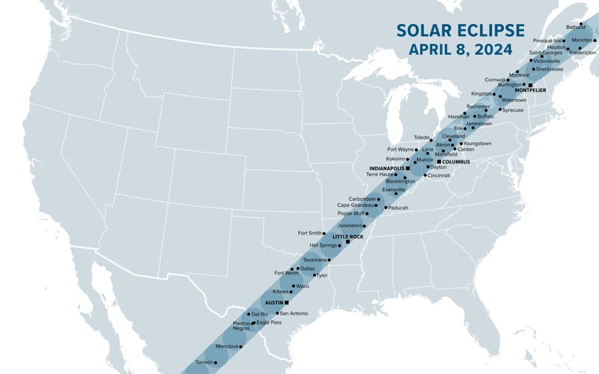
Introduction
On April 8, 2024, the world and especially the US experienced a solar eclipse and many drove or flew thousands of miles to be in the totality zone.

Slide 5
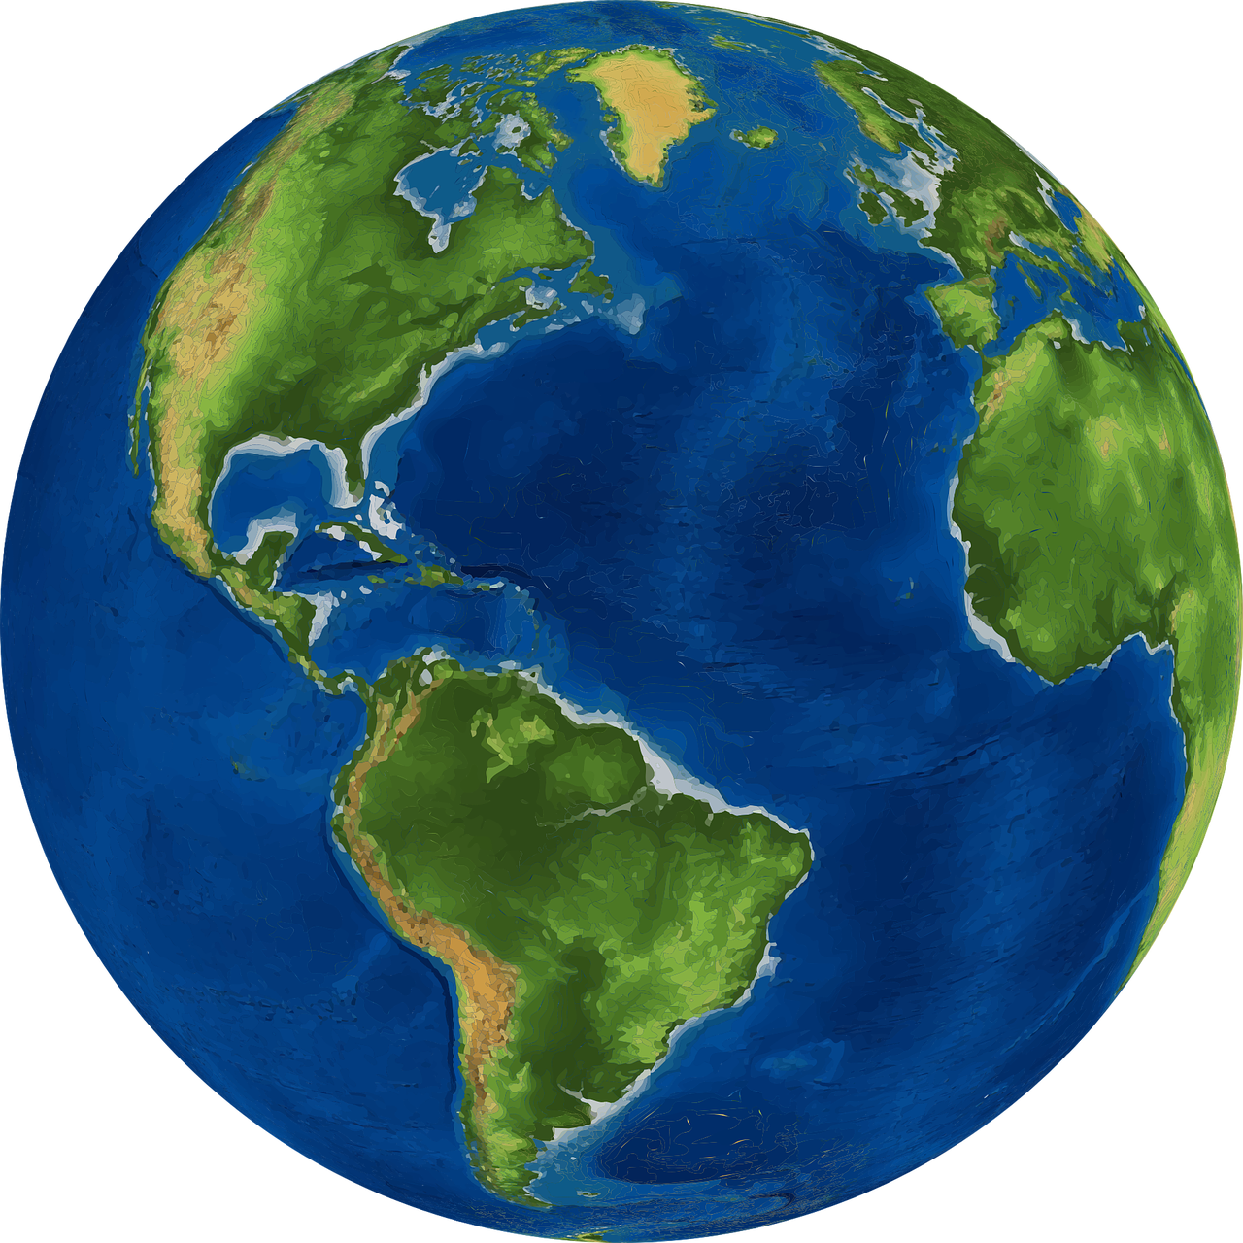
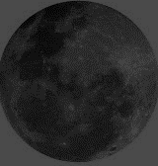
For Today’s Sermon, Let’s Consider A Different Kind of Eclipse
LUNAR ECLIPSE
CHRIST
WORLD
MAN
Notes:
The next total lunar eclipse for both the Pacific and the Americas is March 14, 2025 (total)

Slide 6
When Man Is In The World, He Is In Darkness Without God.
Eph. 2:1-3, 11-12

Slide 7
Eph. 2:1-3, 11-12
¹ And you He made alive, who were dead in trespasses and sins,
² in which you once walked according to the course of this world, according to the prince of the power of the air, the spirit who now works in the sons of disobedience, ³ among whom also we all once conducted ourselves in the lusts of our flesh, fulfilling the desires of the flesh and of the mind, and were by nature children of wrath, just as the others.

Slide 8
Eph. 2:1-3, 11-12
¹¹ Therefore remember that you, once Gentiles in the flesh—who are called Uncircumcision by what is called the Circumcision made in the flesh by hands— ¹² that at that time you were without Christ, being aliens from the commonwealth of Israel and strangers from the covenants of promise, having no hope and without God in the world.

Slide 9
When Man Is In The World, He Is In Darkness Without God.
Eph. 2:1-3, 11-12
The world of sin stands between man and God = NO LIGHT
When we were in darkness & sin, Christ died for us (Rom. 5:7-11)

Slide 10
Rom. 5:7-11
⁷ For scarcely for a righteous man will one die; yet perhaps for a good man someone would even dare to die. ⁸ But God demonstrates His own love toward us, in that while we were still sinners, Christ died for us.
⁹ Much more then, having now been justified by His blood, we shall be saved from wrath through Him.

Slide 11
Rom. 5:7-11
¹⁰ For if when we were enemies we were reconciled to God through the death of His Son, much more, having been reconciled, we shall be saved by His life. ¹¹ And not only that, but we also rejoice in God through our Lord Jesus Christ, through whom we have now received the reconciliation.

Slide 12
When Man Is In The World, He Is In Darkness Without God.
Eph. 2:1-3, 11-12
The world of sin stands between man and God = NO LIGHT
When we were in darkness & sin, Christ died for us (Rom. 5:7-11)
Christ came as light for man, John witnessed. (John 1:1-15)

Slide 13
John 1:1-15
¹ In the beginning was the Word, and the Word was with God, and the Word was God. ² He was in the beginning with God. ³ All things were made through Him, and without Him nothing was made that was made. ⁴ In Him was life, and the life was the light of men. ⁵ And the light shines in the darkness, and the darkness did not comprehend it. ⁶ There was a man sent from God, whose name was John.

Slide 14
John 1:1-15
⁷ This man came for a witness, to bear witness of the Light, that all through him might believe. ⁸ He was not that Light, but was sent to bear witness of that Light. ⁹ That was the true Light which gives light to every man coming into the world.
¹⁰ He was in the world, and the world was made through Him, and the world did not know Him. ¹¹ He came to His own, and His own did not receive Him.

Slide 15
John 1:1-15
¹² But as many as received Him, to them He gave the right to become children of God, to those who believe in His name: ¹³ who were born, not of blood, nor of the will of the flesh, nor of the will of man, but of God. ¹⁴ And the Word became flesh and dwelt among us, and we beheld His glory, the glory as of the only begotten of the Father, full of grace and truth. ¹⁵ John bore witness of Him and cried out, saying, “This was He of whom I said, He who comes after me is preferred before me, for He was before me.’ ”

Slide 16
When Man Is In The World, He Is In Darkness Without God.
Eph. 2:1-3, 11-12
The world of sin stands between man and God = NO LIGHT
When we were in darkness & sin, Christ died for us (Rom. 5:7-11)
Christ came as light for man, John witnessed. (John 1:1-15)
Jesus is the light of the world and those who follow him should not walk in darkness. (John 8:12)

Slide 17
John 8:12
¹² Then Jesus spoke to them again, saying, “I am the light of the world. He who follows Me shall not walk in darkness, but have the light of life.”

Slide 18
When Man Is In The World, He Is In Darkness Without God.
We are to cast off darkness and put on the armor of light by putting on Christ. (Rom. 13:11-14)

Slide 19
Rom. 13:11-14
¹¹ And do this, knowing the time, that now it is high time to awake out of sleep; for now our salvation is nearer than when we first believed.
¹² The night is far spent, the day is at hand. Therefore let us cast off the works of darkness, and let us put on the armor of light.
¹³ Let us walk properly, as in the day, not in revelry and drunkenness, not in lewdness and lust, not in strife and envy.
¹⁴ But put on the Lord Jesus Christ, and make no provision for the flesh, to fulfill its lusts.

Slide 20
When Man Is In The World, He Is In Darkness Without God.
We are to cast off darkness and put on the armor of light by putting on Christ. (Rom. 13:11-13)
Called “out of darkness into his marvelous light.” (1 Pet. 2:9)

Slide 21
1 Pet. 2:9
⁹ But you are a chosen generation, a royal priesthood, a holy nation, His own special people, that you may proclaim the praises of Him who called you out of darkness into His marvelous light;

Slide 22
When Man Is In The World, He Is In Darkness Without God.
We are to cast off darkness and put on the armor of light by putting on Christ. (Rom. 13:11-13)
Called “out of darkness into his marvelous light.” (1 Pet. 2:9)
We are called by the gospel. (2 Thes. 2:13-14)
Notes:
Not a miraculous calling….

Slide 23
2 Thes. 2:13-14
¹³ But we are bound to give thanks to God always for you, brethren beloved by the Lord, because God from the beginning chose you for salvation through sanctification by the Spirit and belief in the truth,
¹⁴ to which He called you by our gospel, for the obtaining of the glory of our Lord Jesus Christ.

Slide 24
When Man Is In The World, He Is In Darkness Without God.
We are to cast off darkness and put on the armor of light by putting on Christ. (Rom. 13:11-13)
Called “out of darkness into his marvelous light.” (1 Pet. 2:9)
We are called by the gospel. (2 Thes. 2:13-14)
Paul preached to turn man from darkness to light. (Acts 26:17-18)

Slide 25
Acts 26:17-18
¹⁷ I will deliver you from the Jewish people, as well as from the Gentiles, to whom I now send you,
¹⁸ to open their eyes, in order to turn them from darkness to light, and from the power of Satan to God, that they may receive forgiveness of sins and an inheritance among those who are sanctified by faith in Me.’

Slide 26
When Man Is In The World, He Is In Darkness Without God.
We are to cast off darkness and put on the armor of light by putting on Christ. (Rom. 13:11-13)
Called “out of darkness into his marvelous light.” (1 Pet. 2:9)
We are called by the gospel. (2 Thes. 2:13-14)
Paul preached to turn man from darkness to light. (Acts 26:17-18)
By obedience we are delivered from the power of darkness. (Col. 1:13)

Slide 27
Col. 1:13
¹³ He has delivered us from the power of darkness and conveyed us into the kingdom of the Son of His love,

Slide 28
When Man Is In The World, He Is In Darkness Without God.
We are to cast off darkness and put on the armor of light by putting on Christ. (Rom. 13:11-13)
Called “out of darkness into his marvelous light.” (1 Pet. 2:9)
We are called by the gospel. (2 Thes. 2:13-14)
Paul preached to turn man from darkness to light. (Acts 26:17-18)
By obedience, we are delivered from the power of darkness. (Col. 1:13)
Jesus is the light of the world (John 8:12) and by obedience, we the light of the world (Matt. 5:14-16)

Slide 29
Matt. 5:14-16
¹⁴ “You are the light of the world. A city that is set on a hill cannot be hidden.
¹⁵ Nor do they light a lamp and put it under a basket, but on a lampstand, and it gives light to all who are in the house.
¹⁶ Let your light so shine before men, that they may see your good works and glorify your Father in heaven.

Slide 30
Too Often The Christian Does Not Reflect Christ To The World:
What causes the reflection of some Christians to diminish?
The world comes between them and Christ; sin cuts off the reflection -- darkness again (i.e. waning,spiritual eclipse)
When the world becomes the main interest or desire, Christ is blotted out. (Jn. 3:19-20)

Slide 31
Jn. 3:19-20
¹⁹ And this is the condemnation, that the light has come into the world, and men loved darkness rather than light, because their deeds were evil.
²⁰ For everyone practicing evil hates the light and does not come to the light, lest his deeds should be exposed.

Slide 32
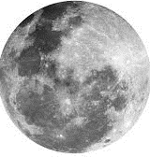
There Must Be A Distinction Between The Christian And The World
We are of the light, not of darkness. (1 Thes. 5:5)

Slide 33
1 Thes. 5:5
⁵ You are all sons of light and sons of the day. We are not of the night nor of darkness.

Slide 34
There Must Be A Distinction Between The Christian And The World
We are of the light, not of darkness. (1 Thes. 5:5)
What communion hath light with darkness? (2 Cor. 6:14)

Slide 35
2 Cor. 6:14
¹⁴ Do not be unequally yoked together with unbelievers. For what fellowship has righteousness with lawlessness? And what communion has light with darkness?

Slide 36
There Must Be A Distinction Between The Christian And The World
We are of the light, not of darkness. (1 Thes. 5:5)
What communion hath light with darkness? (2 Cor. 6:14)
Friendship with the world is enmity with God. (Jas. 4:4)

Slide 37
Jas. 4:4
⁴ Adulterers and adulteresses! Do you not know that friendship with the world is enmity with God? Whoever therefore wants to be a friend of the world makes himself an enemy of God.

Slide 38
There Must Be A Distinction Between The Christian And The World
We are of the light, not of darkness. (1 Thes. 5:5)
What communion hath light with darkness? (2 Cor. 6:14)
Friendship with the world is enmity with God. (Jas. 4:4)
While in the world, we must not be of the world. (Jn. 17:15-16)

Slide 39
Jn. 17:15-16
¹⁵ I do not pray that You should take them out of the world, but that You should keep them from the evil one.
¹⁶ They are not of the world, just as I am not of the world.

Slide 40
There Must Be A Distinction Between The Christian And The World
We are of the light, not of darkness. (1 Thes. 5:5)
What communion hath light with darkness? (2 Cor. 6:14)
Friendship with the world is enmity with God. (Jas. 4:4)
While in the world, we must not be of the world. (Jn. 17:15-16)
God demands that we "walk in the light" (1 Jn. 1:7)

Slide 41
1 Jn. 1:7
⁷ But if we walk in the light as He is in the light, we have fellowship with one another, and the blood of Jesus Christ His Son cleanses us from all sin.

Slide 42
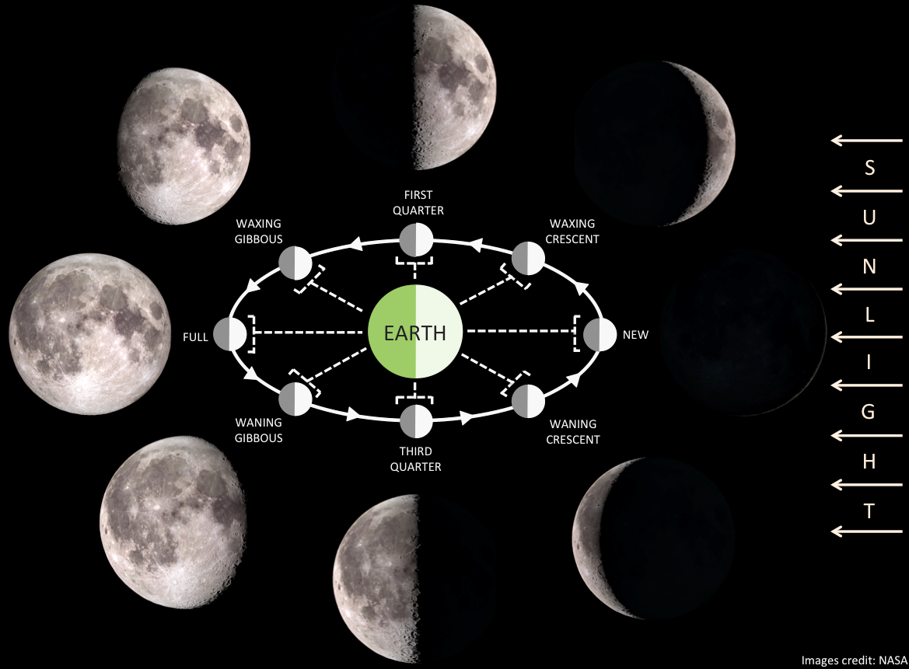
HOW MUCH OF CHRIST ARE YOU REFLECTING?

