Slide 3
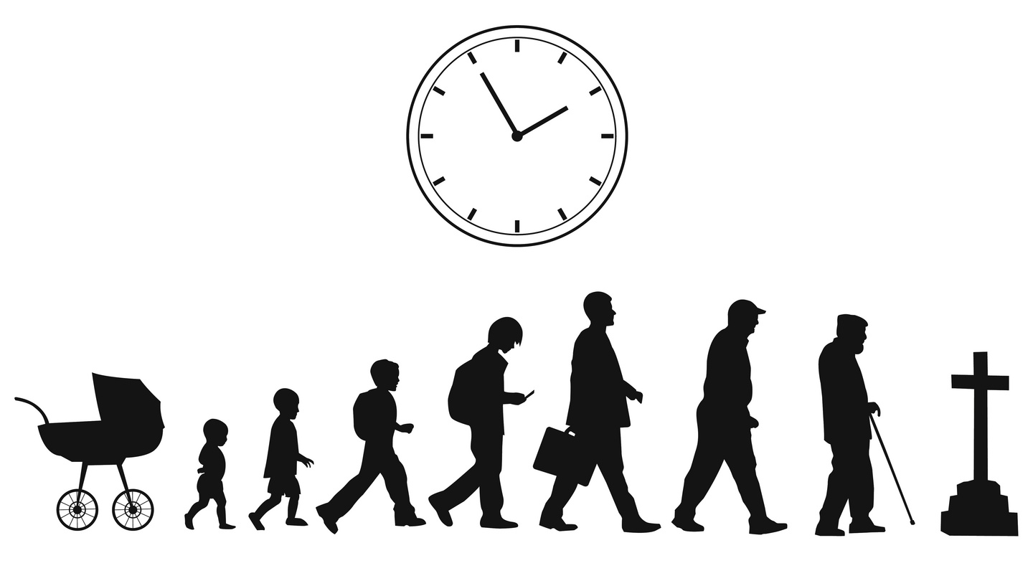
TIME
WHAT IS IT?
BIRTH………………………………….TO………………………………..DEATH

Slide 4
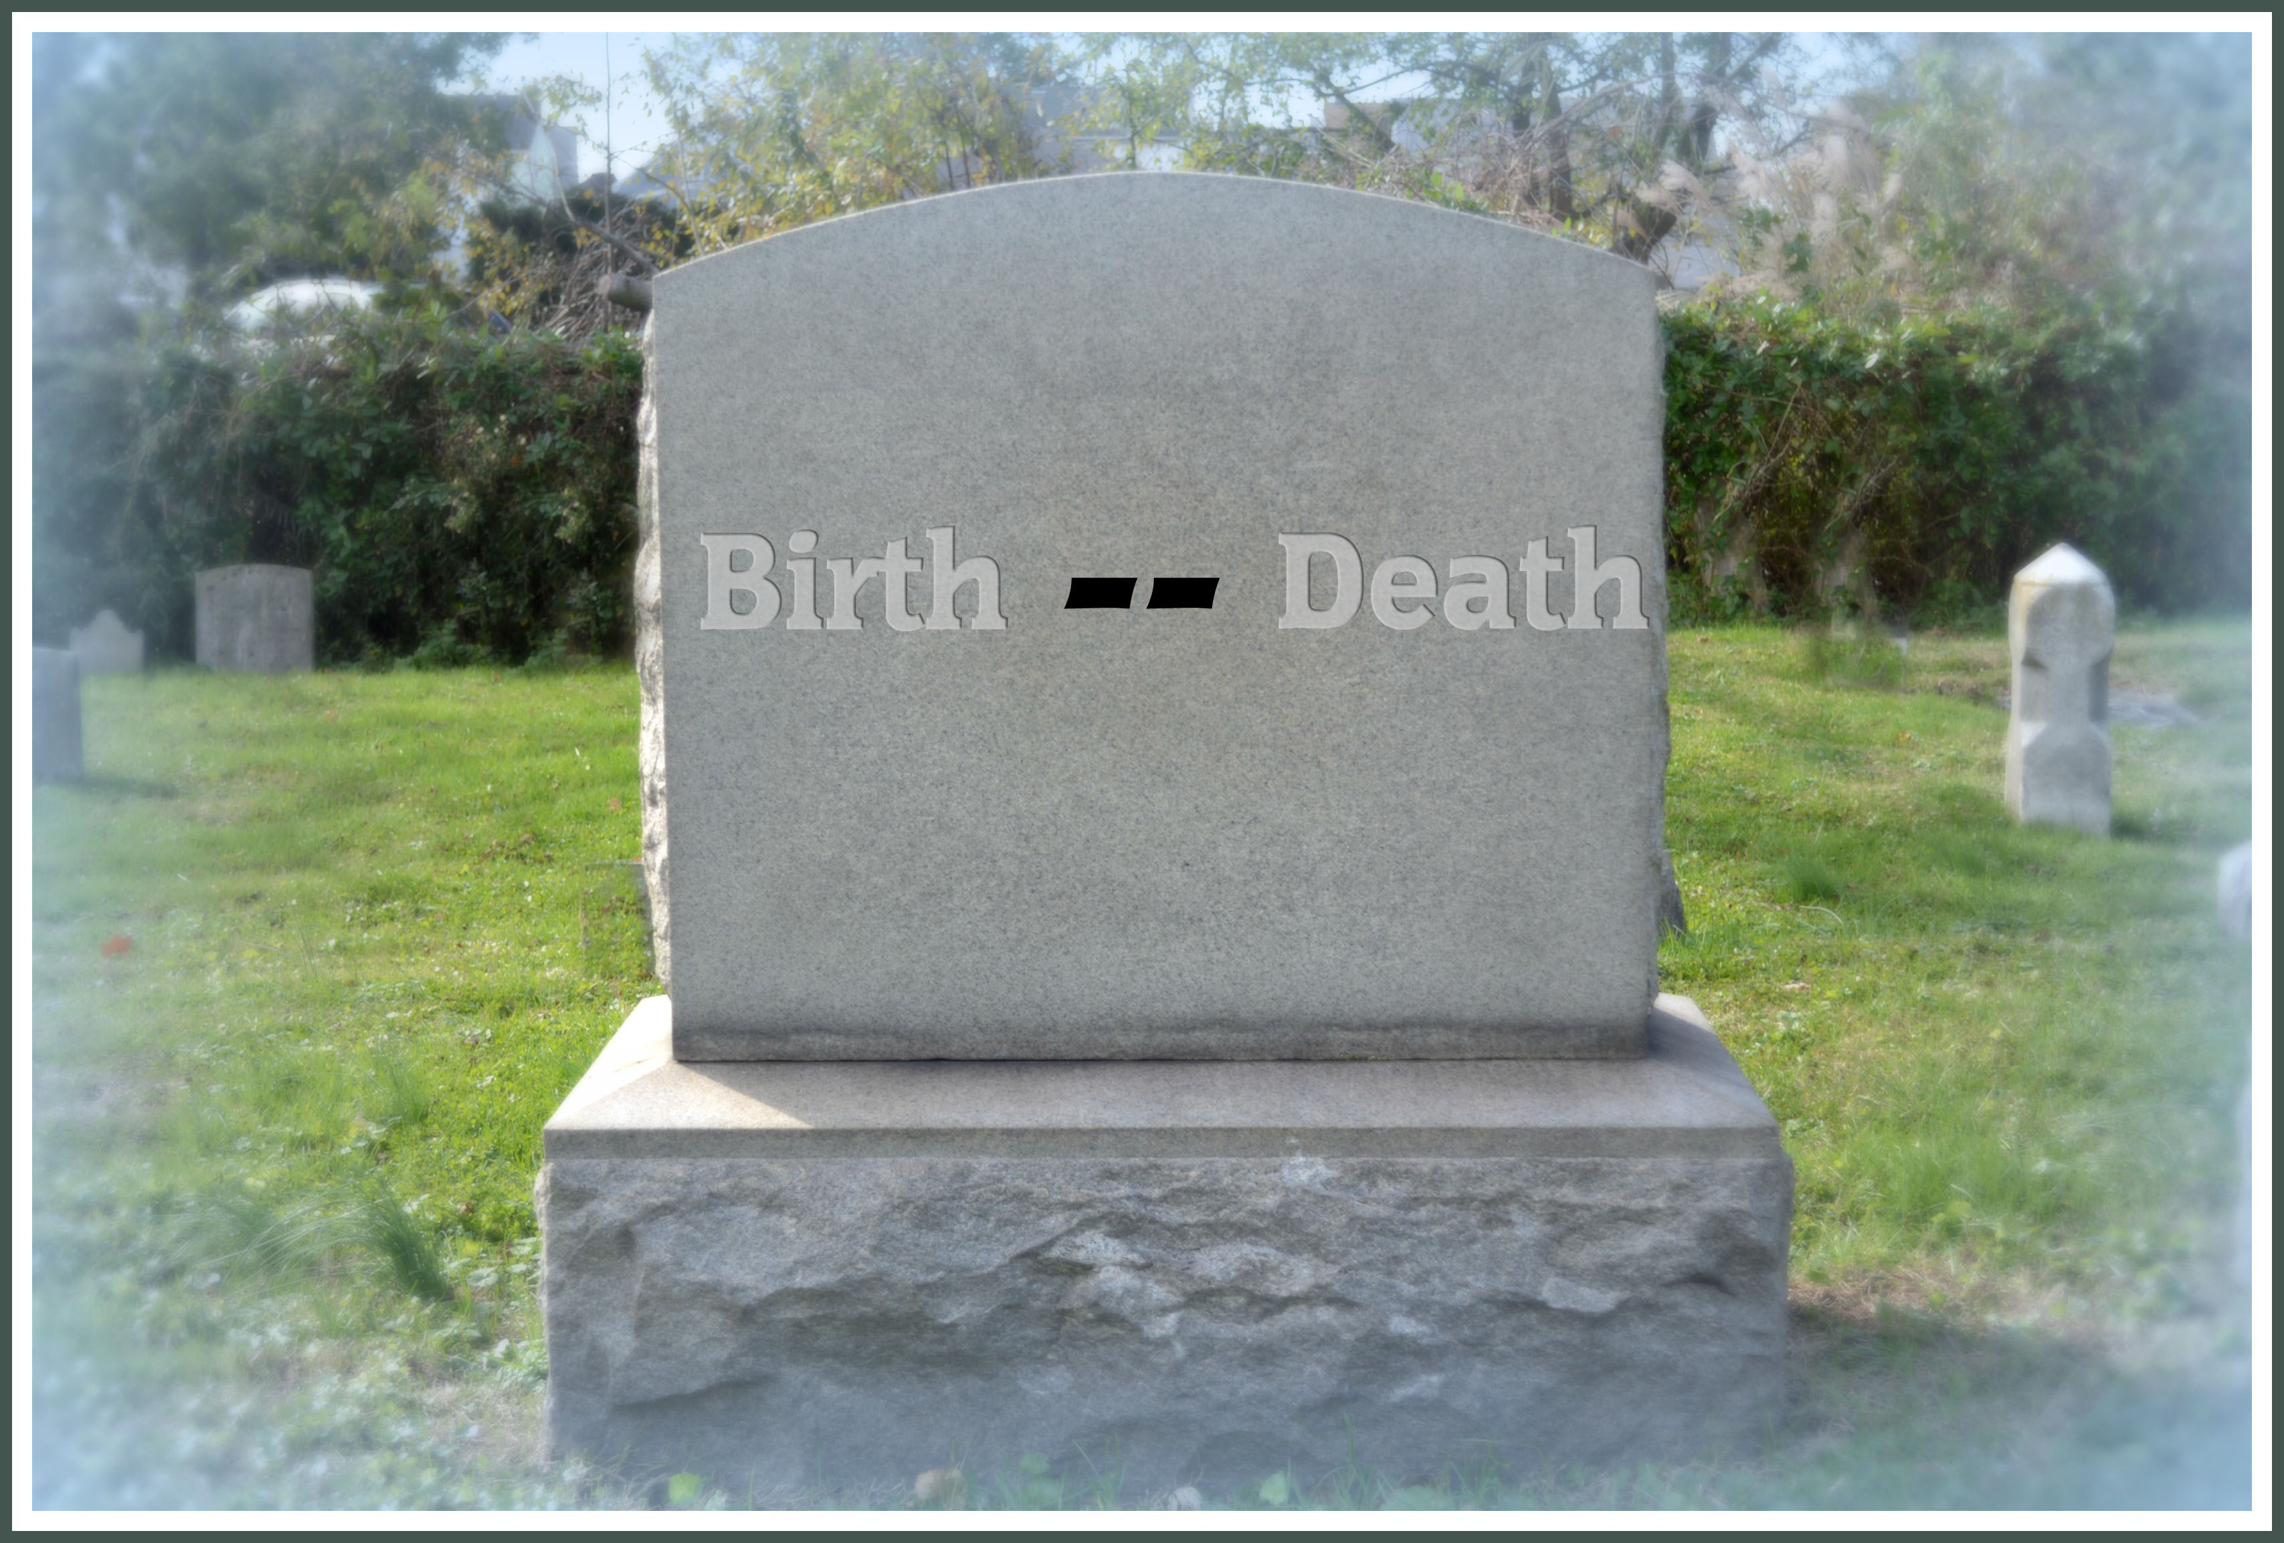
THE DASH
“I read of a man who stood to speak
at the funeral of a friend. He referred
to the dates on the tombstone from
the beginning to the end. He noted
that first came the date of birth and
spoke of the following date with tears,
but he said what mattered most of all
was the dash between those years.
For that dash represents all the time they spent alive on earth and now only those who loved them know what that little line is worth. For it matters not, how much we own, the cars…the house…the cash. What matters is how we live and love and how we spend our dash. This dash might last only a little while. So when your eulogy is read, and your actions they rehash, will you be proud of the things they say about how you lived your dash?” Linda Ellis

Slide 5
EVERYTHING IN THIS WORLD REQUIRES TIME

Slide 6
EVERYTHING IN THIS WORLD REQUIRES TIME
Whether work or play, sleep or TV…it all uses up time…That unique, irreplaceable, necessary resource…so often taken for granted.

Slide 7
“Walk in wisdom toward those who are outside, redeeming the time.” (Colossians 4:5)

Slide 8
“Walk in wisdom toward those who are outside, redeeming the time.” (Colossians 4:5)
“See then that you walk circumspectly, not as fools but as wise, redeeming the time, because the days are evil.” (Ephesians 5:15-16)

Slide 9
“Walk in wisdom toward those who are outside, redeeming the time.” (Colossians 4:5)
“See then that you walk circumspectly, not as fools but as wise, redeeming the time, because the days are evil.” (Ephesians 5:15-16)
exagorazō (ex-ag-or-ad’-zo) – “to buy up, that is, ransom; figuratively to rescue from loss redeem.” Strongs Dictionary

Slide 10
TIME
YESTERDAY = CANCELLED CHECK

Slide 11
TIME
YESTERDAY = CANCELLED CHECK
TOMORROW = PROMISORY NOTE
“But God said unto him, Thou fool, this night thy soul shall be required of thee: then whose shall those things be, which thou hast provided?” (Luke 12:20)

Slide 12
TIME
YESTERDAY = CANCELLED CHECK
TOMORROW = PROMISORY NOTE
TODAY = CASH

Slide 13
168 HOURS IN A WEEK – HOW DO WE SPEND THEM?
*ESTIMATE FOR A 70 YEAR LIFE SPAN (613,200 hours)
ACTIVITY YEARS HOURS % OF TIME
SLEEP 23 201,480 32.9%
WORK 16 140, 160 22.8%
TELEVISION 8 70,080 11.4%
EATING 6 52, 560 8.6%
TRAVEL 6 52,560 8.6%
ILLNESS 4 35,040 5.7%
DRESSING 2 17,520 2.8%
RELIGION 1. 25 10,950 0.18%
LEISURE 4.9 43,047 7.02%

Slide 14
“But seek first the kingdom of God and His righteousness, and all these things shall be added to you.” (Matthew 6:33)

Slide 15
What Does God Want Us To Do As Christians
Pray Without Ceasing
Study His Word
Forsake Not Assemblies
Teach The Lost
Edify One Another
Do Good To All Men

Slide 16
It is not how many days we have but how we prioritize those days!

Slide 17
We will only be judged for what He gives us, not for time we are never given.

Slide 18
IN THE END…
It is not about how LONG you live – But rather HOW you live!

Slide 19
“For this is the love of God, that we keep His commandments. And His commandments are not burdensome.” (1 John 5:3)

Slide 20
“whereas you do not know what will happen tomorrow. For what is your life? It is even a vapor that appears for a little time and then vanishes away.” (James 4:14)

Slide 21
REDEEMING THE TIME…

Slide 22
REDEEMING THE TIME…
Spend TIME to spread a little kindness.

Slide 23
REDEEMING THE TIME…
Spend TIME to spread a little kindness.
Spend TIME to Listen.

Slide 24
REDEEMING THE TIME…
Spend TIME to spread a little kindness.
Spend TIME to Listen.
Spend TIME to invite others to come.

Slide 25
REDEEMING THE TIME…
Spend TIME to spread a little kindness.
Spend TIME to Listen.
Spend TIME to invite others to come.
Spend TIME to visit some weak member.

Slide 26
IS REALLY MURDERING
OPPORTUNITY!

Slide 27
168 HOURS IN A WEEK – HOW DO WE SPEND THEM?
*ESTIMATE FOR A 70 YEAR LIFE SPAN 613,200 –DOLLARS???
ACTIVITY YEARS DOLLARS % OF MONEY
SLEEP 23 201,480 32.9%
WORK 16 140, 160 22.8%
TELEVISION 8 70,080 11.4%
EATING 6 52, 560 8.6%
TRAVEL 6 52,560 8.6%
ILLNESS 4 35,040 5.7%
DRESSING 2 17,520 2.8%
RELIGION 1. 25 10,950 0.18%
LEISURE 4.9 43,047 7.02%

Slide 28
IDLENESS IS A TOOL OF THE DEVIL
“And he went out about the third hour and saw others standing idle in the marketplace, and said to them, 'You also go into the vineyard, and whatever is right I will give you.' So they went. Again he went out about the sixth and the ninth hour, and did likewise. And about the eleventh hour he went out and found others standing idle, and said to them, 'Why have you been standing here idle all day?'” (Matthew 20:3-6)

Slide 29
“He also that is slothful in his work is brother to him that is a great waster.” (Proverbs 18:9)

Slide 30
IDLENESS IS A TOOL OF THE DEVIL
“And withal they learn to be idle, wandering about from house to house; and not only idle, but tattlers also and busybodies, speaking things which they ought not.” (1 Timothy 5:13)

Slide 31
* We are all authors…
- Writing our own book (our individual DASH).

Slide 32
* We are all authors…
- Writing our own book (our individual DASH).
WHAT ARE YOU USING YOUR DASH FOR?

Slide 33
* We are all authors…
- Writing our own book (our individual DASH).
WHAT ARE YOU USING YOUR DASH FOR?
“Keep my moments and my days; let them flow in CEASLESS PRAISE.” FRANCIS HAVERGAL

Slide 34
“Just a tiny little minute…
Only sixty seconds in it.
Forced upon me. Can’t refuse it.
Didn’t seek it, didn’t choose it,
I must suffer if I lose it,
Give account if I abuse it.
Just a tiny little minute,
But eternity is in it!”

