Slide 2
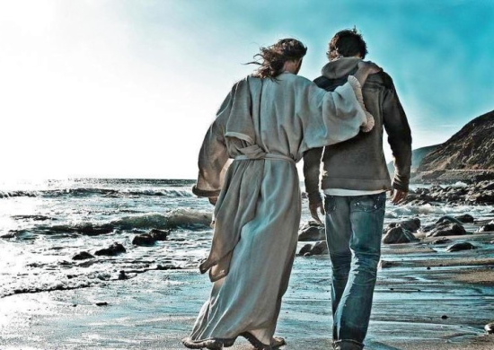
They Knew They Had Been With Jesus
Their Confidence/Boldness
Untrained & Uneducated Men
They Gave Glory to Jesus

Slide 3
How Do We Spend
Time With Jesus?
Be Trained and Educated
Constantly Communicate

