Slide 1
Ecclesiastes: Man’s Search for Meaning
What is an Ecclesiastes?
Who wrote the book?
Why is the author important?

Slide 2
Book Structure
Eccl 1:1-8:15 - Exploring Life’s Purposes
Eccl 8:16-12:14 - Explaining Life’s Variability

Slide 3
Key Themes
The Complexity of Human Experience
The Vanity of Existence
The Reality of Death
The Joys and Frustrations of Earthly Labor
The Enjoyment of God’s Gifts
The Role and Fear of God

Slide 4
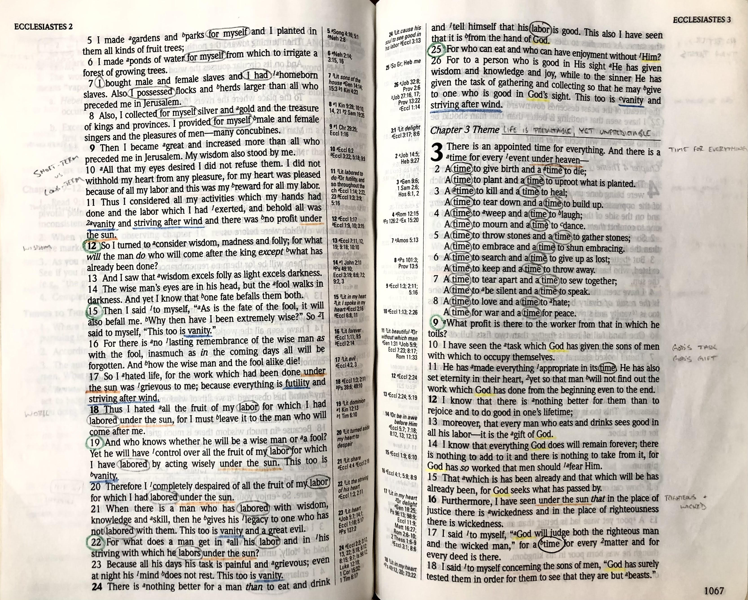
Marking Key:
God
Vanity/Futility/
Stiving after Wind
Under the sun
4. Questions

Slide 5
Ecclesiastes: Man’s Search for Meaning
Exploring Life’s Purposes
1. Life is meaningless
2. Wealth, wisdom, works
3. Life is predictable, but not always
4. Oppression, labor with companions, power
5. Tread softly in approaching God, government, and wealth
6. Riches, fulfillment, and reality of mankind
7. Who knows what is good for man? Suggestions
8. Dealing with government and God. The Verdict

Slide 6
Ecclesiastes: Man’s Search for Meaning
Explaining Life’s Variability
9. Death is certain, life is uncertain
10. Wisdom & folly/proverbs for everyday life
11. Financial wisdom and enjoying life
12. Aging, epilogue, and the conclusion

