Slide 2
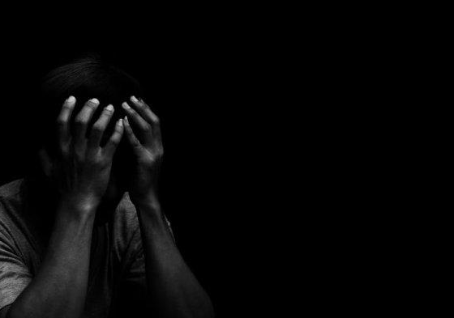
Is this God’s Plan?
Own Free Will
Others’ Free Will
God’s Promises

