Slide 1
Deuteronomy
A survey Of the Scriptures

Slide 2
Class Schedule
Lesson 1: Introduction, Chapters 1 & 2
Lesson 2: Chapters 3-5
Lesson 3: Chapters 6-9
Lesson 4: Chapters 10-12
Lesson 5: Chapters 13-15
Lesson 6: Chapters 16-18
Lesson 7: Chapters 19-21
Lesson 8: Chapters 22-25
Lesson 9: Chapters 26-28
Lesson 10: Chapters 29-34

Slide 3
Chapter 5 discussion
What does “face to face” mean?
Lev. 26:13-16 What does God provide first and then what does He command?

Slide 4
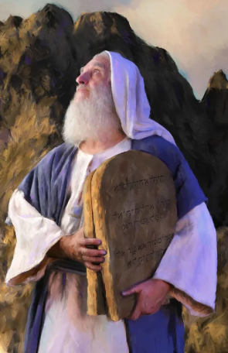
Chapter 5 discussion
v.7
‘You shall have no other gods before Me.

Slide 5
Chapter 5 discussion
v. 8-10
‘You shall not make for yourself a carved image
This commandment was necessary for at least three reasons:

Slide 6
Chapter 5 discussion
v. 8-10
‘You shall not make for yourself a carved image
This commandment was necessary for at least three reasons:
Any material (physical) representation of the LORD slanders Him.
By making and using images of God, the worshipper would gain a false and illegitimate sense of control and authority over Him
It is easy for anyone to confuse an object that represents a deity, with that deity.

Slide 7
Chapter 5 discussion
v. 11
‘You shall not take the name of the Lord your God in vain,
What is the intent of the third commandment?

Slide 8
Chapter 5 discussion
v. 12-15
‘Observe the Sabbath day,
What two reasons do we have for the command to keep the Sabbath day in Exodus 20:11 and Deuteronomy 5:15?

Slide 9
Chapter 5 discussion
v. 16
‘Honor your father and your mother,

Slide 10
Chapter 5 discussion
v.17
‘You shall not murder.
Hebrew word ratsah, translated "kill", refers specifically to "murder," as modern English translations have rendered it. An illegal killing , a homicide.

Slide 11
Chapter 5 discussion
v.18
‘You shall not commit adultery.
What Ten Commandment violation can we compare adultery to?

Slide 12
Chapter 5 discussion
7‘You shall have no other gods before Me.
8‘You shall not make for yourself a carved image
11 ‘You shall not take the name of the Lord your God in vain,
12 ‘Observe the Sabbath day,
16 ‘Honor your father and your mother,
17 ‘You shall not murder.
18 ‘You shall not commit adultery.
19 ‘You shall not steal.

Slide 13
Chapter 5 discussion
v.19
‘You shall not steal.

Slide 14
Chapter 5 discussion
v. 20
‘You shall not bear false witness against your neighbor.

Slide 15
Chapter 5 discussion
v. 21
‘You shall not covet

Slide 16
Chapter 5 discussion
7‘You shall have no other gods before Me.
8-10‘You shall not make for yourself a carved image
11 ‘You shall not take the name of the Lord your God in vain,
12-15 ‘Observe the Sabbath day,
16 ‘Honor your father and your mother,
17 ‘You shall not murder.
18 ‘You shall not commit adultery.
19 ‘You shall not steal.
20 ‘You shall not bear false witness against your neighbor.
21 ‘You shall not covet

Slide 17
Ten Commandments john Walton
Major Issues | Godward | Manward
Authority | Commandment 1 | Commandment 5
Dignity | Commandment 2 | Commandment 6,7,& 8
Commitment | Commandment 3 | Commandment 9
Rights and Privileges | Commandment 4 | Commandment 10

Slide 18
Chapter 6
V.1-3
Announce the commandments that follow and give what reason for obeying them?

Slide 19
Chapter 6
V. 4-5 Shema or Great Commandment

Slide 20
Chapter 6
V. 4-5 Shema or Great Commandment
Heart (leb)
Soul (nephesh)
Strength (me’od)

Slide 21
Chapter 6
V. 6-9 This section contains instructions for remembering and teaching these great truths to the following generations

Slide 22
Chapter 6
V. 6-9 This section contains instructions for remembering and teaching these great truths to the following generations
What does verse 7 indicate to the Israelites?
When are they to talk of the commandments, statutes, and judgments?

Slide 23
Chapter 6
V. 10-19 Prosperity (vv. 10-15) and adversity (vv. 16-19) would equally test the Israelites' devotion to God.

Slide 24
Chapter 6
V. 20-25 What is a major take away to parents today from verses 20-25?

Slide 25
Chapter 7
This chapter is a logical development of what Moses said in chapters 5 and 6. God had called on His people to acknowledge that He is the only true God and to be completely loyal to Him.

Slide 26
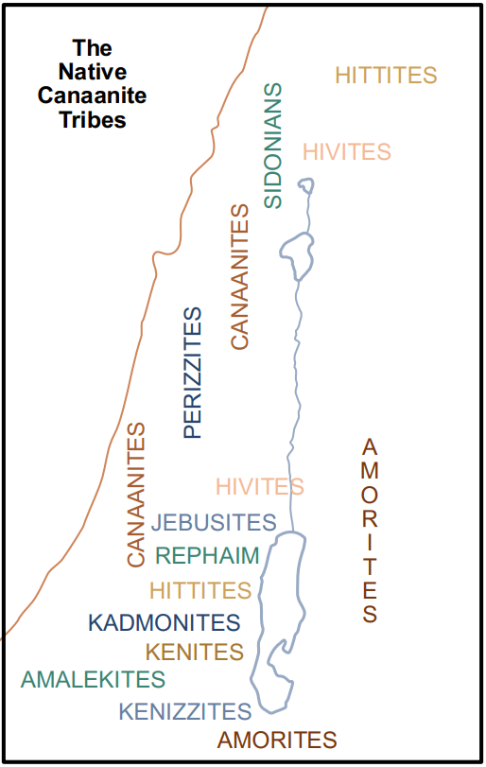
Chapter 7
V. 1-11 Moses mentioned seven nations that resided in Canaan here (v. 1), but as many as 10 appear in other passages.

Slide 27
Chapter 7
V. 12-26 What would bring blessings to the Israelites?

Slide 28
Chapter 7
V. 12-26 How swiftly would God drive out the Canaanites?

Slide 29
Chapter 7
V. 12-26 How swiftly would God drive out the Canaanites?
What are your thoughts on this time frame?

Slide 30
Chapter 7
V. 12-26 How swiftly would God drive out the Canaanites?
What are your thoughts on this time frame?
How can we compare this to us today?

Slide 31
Chapter 8
The Israelites were not only in danger of compromising with the Canaanites, but they were also in danger of becoming too self-reliant when they entered the land. Chapter 8 warns the Israelites to be humble.
Note the two double themes:
Remembering and Forgetting
The wilderness and the Promised Land.

Slide 32
Chapter 8
V. 1-6 God humbled the Israelites, in the sense that He sought to teach them to have a realistic awareness of their dependence on Himself for all their needs.

Slide 33
Chapter 8
V. 1-6 God humbled the Israelites, in the sense that He sought to teach them to have a realistic awareness of their dependence on Himself for all their needs.
What was the warning in verse 3?

Slide 34
Chapter 8
V. 7-20 What is the proper response to having plenty and why is it so hard for those who have plenty to be grateful to God?

Slide 35
Chapter 9 (9-10:11)
Chapters 9:1—10:11 are much like chapters1:6—3:29, as they both discuss a traveling narrative.
These verses contain an important lesson:
The lesson of humility through the LORD’s efforts.
Any success they might enjoy in the coming conquest was not to be interpreted as a mark of divine approval for their own righteousness.

Slide 36
Chapter 9
V. 1-6 What was the reason God was giving Canaan to the Israelites?

Slide 37
Chapter 9
V. 7-24 Moses called on the Israelites to remember their past. He gave their rebellion at Horeb extended attention in this address, because it was a very serious offense.
What is the difference between Moses’ call to remember the past and Paul’s advice in Philippians 3:13-14?

Slide 38
Chapter 9
V. 7-24 Explain the finger of God in verse 10?

Slide 39
Chapter 9
V. 7-24 (v. 14) 'blot out the name’ How does a person get blotted out?

Slide 40
Chapter 9
V. 25-29 Moses returned to the rebellion at Sinai, to further illustrate:
Israel had no basis for boasting of her own righteousness before God.
God had preserved Israel only because of His mercy and covenant faithfulness.

Slide 41
Chapter 9 (10:1-11)
10:1-11 What does God remaking the stone tablets say about His character?
What does the fact that God gave the same Ten Commandments again show about His character?

