Slide 1
Deuteronomy
A survey Of the Scriptures

Slide 2
Class Schedule
Lesson 1: Introduction, Chapters 1 & 2
Lesson 2: Chapters 3-5
Lesson 3: Chapters 6-9
Lesson 4: Chapters 10-12
Lesson 5: Chapters 13-15
Lesson 6: Chapters 16-18
Lesson 7: Chapters 19-21
Lesson 8: Chapters 22-25
Lesson 9: Chapters 26-28
Lesson 10: Chapters 29-34

Slide 3
Deuteronomy Break Down
Israel's Past Reviewed | Exposition of the Law |  |  | Mosaic Covenant | Moses Final Words and Death
 | Chapters 4:44-11
 | Ceremional Laws | Civil Laws | Social Laws
Chapters 1-4:43 | Chapters 12-16:17 | Chapters 16:18-21 | Chapters 22-26 | Chapters 27-30 | Chapters 31-34
PAST- What God has done. | PRESENT - What God expects of Israel |  |  | FUTURE - What God will do for Israel

Slide 4
Why Study Deuteronomy?
It’s a book about the Grace of God.
It gives us a clear understanding of the rest of the Old Testament.
There aren’t many differences between the children of God then (Israelites) and today (Christians)

Slide 5
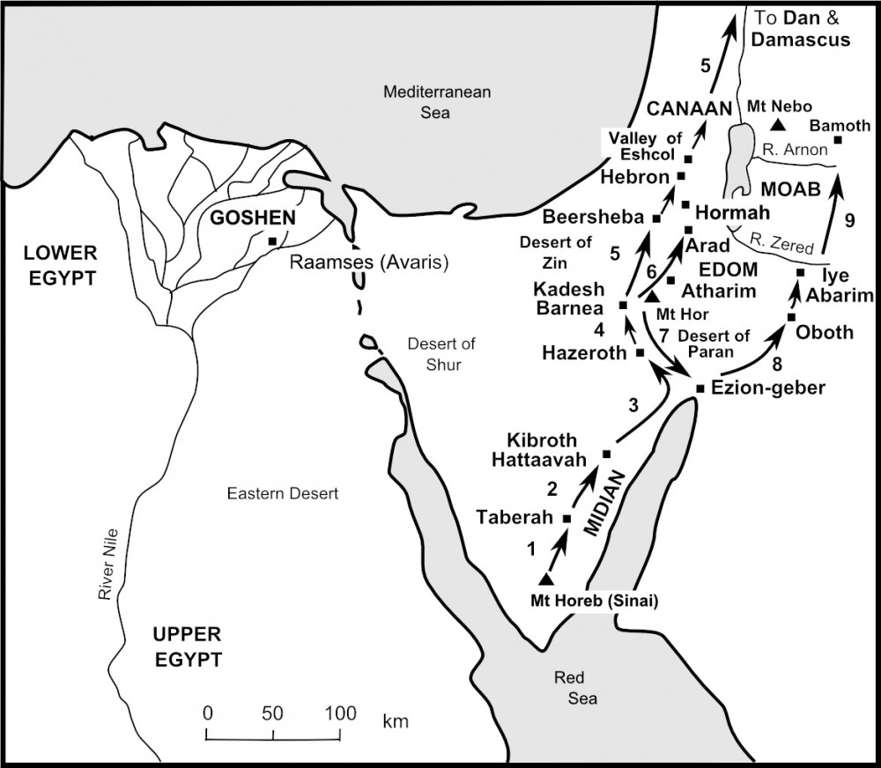

Slide 6
Chapter 1 & 2 discussion
The conquest of the kingdom of Sihon 2:24-37
Moses emphasizes an important thought in vv25,29,30,31,33,and 36?

Slide 7
Chapter 1 & 2 discussion
The conquest of the kingdom of Sihon 2:24-37
Moses emphasizes an important thought in vv25,29,30,31,33,and 36?
God’s Faithfulness

Slide 8
Chapter 1 & 2 discussion
Who or what are the Rephaim (2:11 and 3:11)?

Slide 9
Chapter 1 & 2 discussion
Who or what are the Rephaim (2:11 and 3:11)?
The Hebrew word Rephaim has two distinct meanings:
The First, “departed spirits whose dwelling place was Sheol.”
The Second “the terrible ones.”

Slide 10
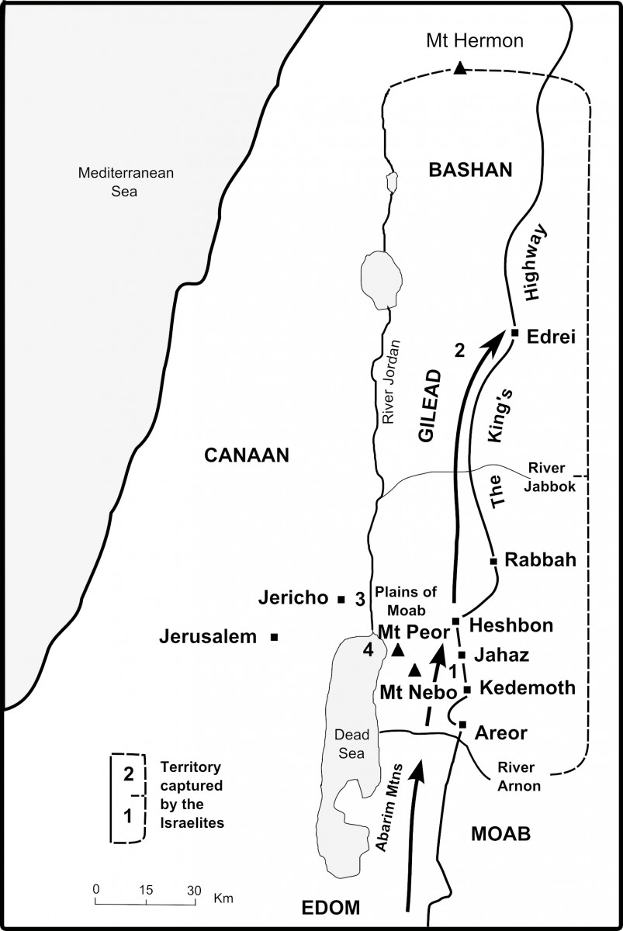

Slide 11
Chapter 3 discussion
What command did God give to the Israelites in verse 2?
How do we compare verse 3:2 with 2:31 and 2:25?
How does Psalms 2:1-4 compare to the verses just discussed?
Why is the size of Og’s bed or casket important?
Numbers 13:31-14:4
Do we see any resemblance to Christians today?

Slide 12
Chapter 3 discussion
The destruction of King Sihon and Og’s territories brings a question to many minds. Deuteronomy 2:33 and 3:6.
Why does God allow the killing of children?
Job 1:21 Genesis 4:10 1 Samuel 28:15-19 Matthew 27:50-53
Death is only our judgement not the end

Slide 13
Chapter 3 discussion
What happened to the two kingdoms? (v.12-17)

Slide 14
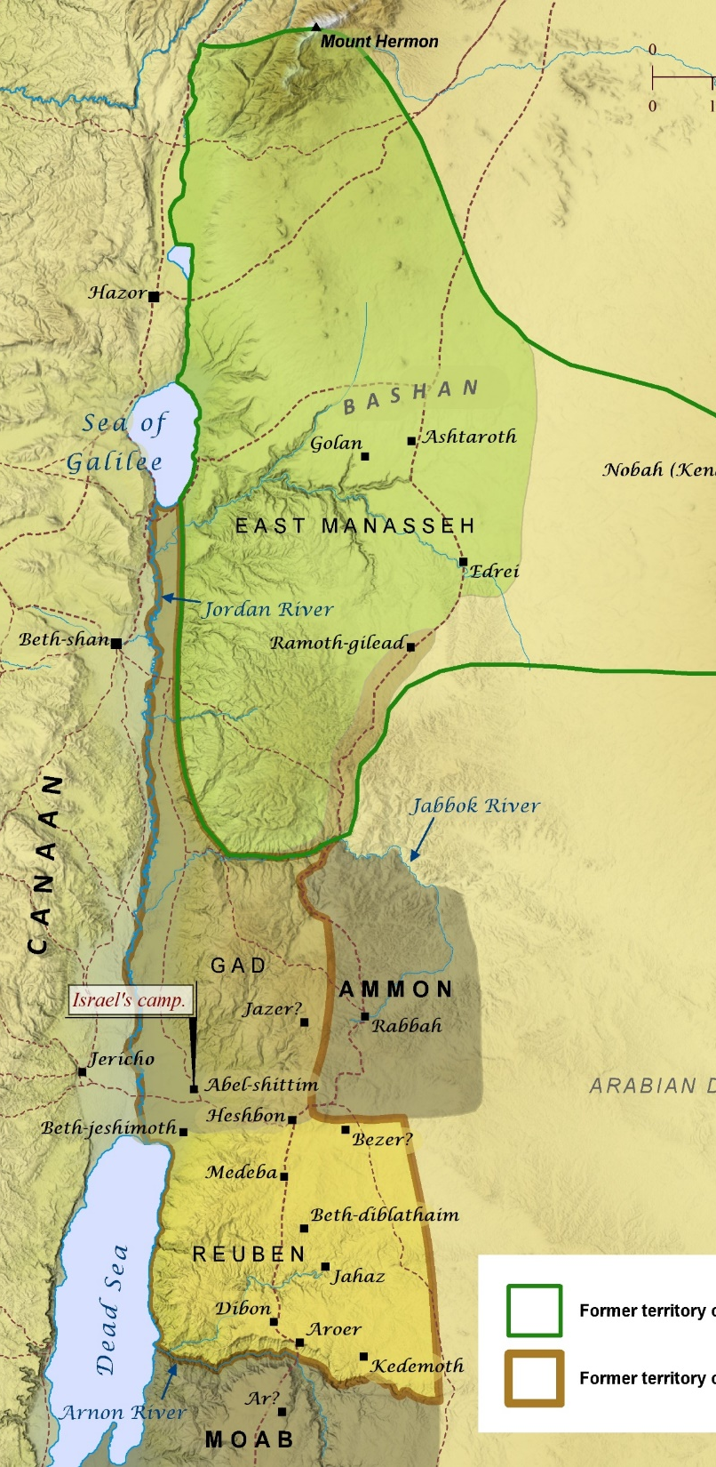
Chapter 3 discussion
What happened to the two kingdoms?

Slide 15
Chapter 3 discussion
What happened to the two kingdoms?
What was the command given to the Reubenites, Gadites, and the half-tribe of Manasseh?

Slide 16
Chapter 4 discussion
Chief ideas of Chapter 4:
The Torah as wisdom (vv. 1-14),
Warning against idolatry (vv. 15-24),
The possibility of exile (vv. 25-31),
God's presence with Israel (vv. 32-40).

Slide 17
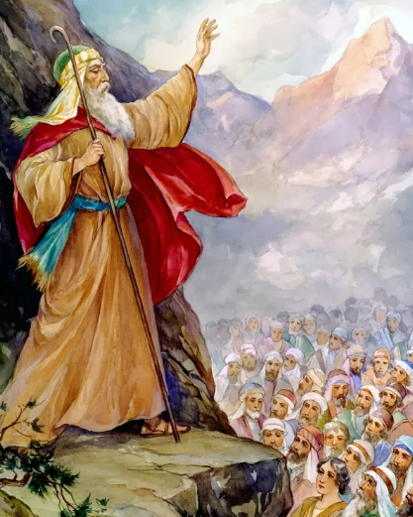
Chapter 4 discussion
• What was Moses going to be teaching them about (verse 1)?
“Now, O Israel, listen to the statutes and the judgments which I teach you to observe, that you may live, and go in and possess the land which the Lord God of your fathers is giving you.

Slide 18
Chapter 4 discussion
What is the theme of the first fourteen verses of this chapter?
“Now, O Israel, listen to the statutes and the judgments which I teach you to observe, that you may live, and go in and possess the land which the Lord God of your fathers is giving you.
2 You shall not add to the word which I command you, nor take from it, that you may keep the commandments of the Lord your God which I command you…
4 But you who held fast to the Lord your God are alive today, every one of you.
5 “Surely I have taught you statutes and judgments, just as the Lord my God commanded me, that you should act according to them in the land which you go to possess.
6 Therefore be careful to observe them; for this is your wisdom and your understanding in the sight of the peoples who will hear all these statutes, and say, ‘Surely this great nation is a wise and understanding people.’
14 And the Lord commanded me at that time to teach you statutes and judgments, that you might observe them in the land which you cross over to possess.

Slide 19
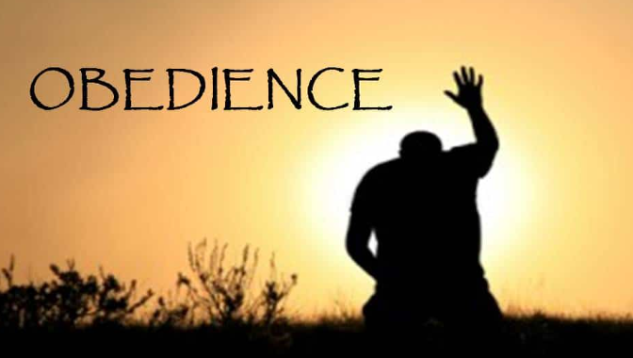
Chapter 4 discussion
What is the theme of the first fourteen verses of this chapter?

Slide 20
Chapter 4 discussion
What would be the results of obedience? (v1)

Slide 21
Chapter 4 discussion
What would be the results of obedience? (v1)

Slide 22
Chapter 4 discussion
What were the results of disobedience? (v3)

Slide 23
Chapter 4 discussion
What were the results of disobedience? (v3)
Numbers 25:1-9

Slide 24
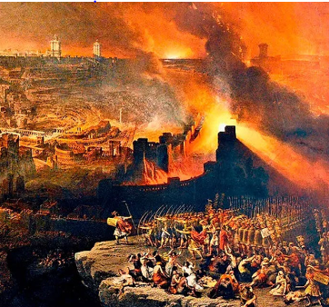
Chapter 4 discussion
What were the results of disobedience? (v3)
Numbers 25:1-9

Slide 25
Chapter 4 discussion
What encouragement does Moses use in verse 6 to follow God’s statutes and rules?

Slide 26
Chapter 4 discussion
What encouragement does Moses use in verse 6 to follow God’s statutes and rules?
How does this relate to us today? How is our earthly prosperity different from the Israelites?

Slide 27
Chapter 4 discussion
What reason does Moses give for not creating images of God (v15)?

Slide 28
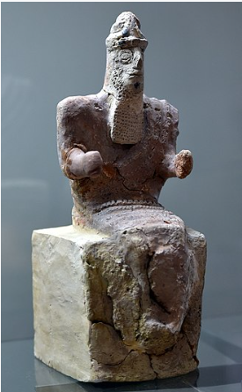
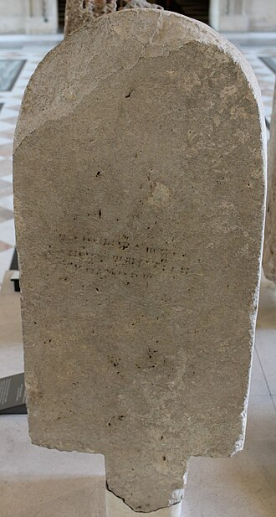
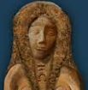
Chapter 4 discussion
What reason does Moses give for not creating images of God (v15)?

Slide 29
Chapter 4 discussion
Who had responsibility toward spiritually guiding the next generation?

Slide 30
Chapter 4 discussion
What is Moses’ warning between verses 25-31?

Slide 31
Chapter 4 discussion
What is Moses recording about God in verses 32-40?

Slide 32
Chapter 4 discussion
Does being a Christian guarantee salvation?

Slide 33
Chapter 4 discussion
Does being a Christian guarantee salvation?
1 Timothy 4:1
Falling away is possible

Slide 34
Chapter 4 discussion
Does being a Christian guarantee salvation?
1 Timothy 4:1
Hebrews 10:26-30
What mercy is there for those that fall away and never return?

Slide 35
Chapter 4 discussion
Deuteronomy 4:41-49
Prepares the child of God for the covenant in chapter 5.

Slide 36
Chapter 4 discussion
Deuteronomy 4:41-49
Prepares the child of God for the covenant in chapter 5.
41-43 Speaks of the building of “Safe Towns” or “Cities of Refuge”

Slide 37
Chapter 4 discussion
Deuteronomy 4:41-49
Prepares the child of God for the covenant in chapter 5.
41-43 Speaks of the building of “Safe Towns” or “Cities of Refuge”
44-49 Is the introduction to the Law.

