Slide 1
Deuteronomy
A survey Of the Scriptures

Slide 2
Class Schedule
Lesson 1: Introduction, Chapters 1 & 2
Lesson 2: Chapters 3-5
Lesson 3: Chapters 6-9
Lesson 4: Chapters 10-12
Lesson 5: Chapters 13-15
Lesson 6: Chapters 16-18
Lesson 7: Chapters 19-21
Lesson 8: Chapters 22-25
Lesson 9: Chapters 26-28
Lesson 10: Chapters 29-34

Slide 3
Deuteronomy Break Down
Israel's Past Reviewed | Exposition of the Law |  |  | Mosaic Covenant | Moses Final Words and Death
 | Chapters 4:44-11
 | Ceremional Laws | Civil Laws | Social Laws
Chapters 1-4:43 | Chapters 12-16:17 | Chapters 16:18-21 | Chapters 22-26 | Chapters 27-30 | Chapters 31-34
PAST- What God has done. | PRESENT - What God expects of Israel |  |  | FUTURE - What God will do for Israel

Slide 4
Why Study Deuteronomy?
It’s an old dusty book of Laws
This Photo by Unknown Author is licensed under CC BY

Slide 5
Why Study Deuteronomy?
Actually, Deuteronomy is a book about grace. It’s written in light of God’s gracious promises to Abraham, Isaac, and Jacob, and states that God is about to act on these promises and give them the promised land!
It’s an old dusty book of Laws

Slide 6
Why Study Deuteronomy?
It does not apply to us anymore.
This Photo by Unknown Author is licensed under CC BY-SA

Slide 7
Why Study Deuteronomy?
It’s true that Christians are no longer under the Old Covenant, and we need to account for the differences between the Old and the New Covenants. But Deuteronomy is still authoritative revelation about the same God whom Christians love and worship.
Deuteronomy 6:5 – Matthew 22:37
It does not apply to us anymore.

Slide 8
Why Study Deuteronomy?
Without Deuteronomy, books of the Old Testament will be unclear.

Slide 9
Why Study Deuteronomy?
Without Deuteronomy, books of the Old Testament will be unclear.
Why does God send drought, foreign raiders, and eventually exile to his people in 1–2 Kings?

Slide 10
Why Study Deuteronomy?
Without Deuteronomy, books of the Old Testament will be unclear.
Why does God send drought, foreign raiders, and eventually exile to his people in 1–2 Kings?
Deuteronomy 28

Slide 11
Why Study Deuteronomy?
Without Deuteronomy, books of the Old Testament will be unclear.
Why does God send drought, foreign raiders, and eventually exile to his people in 1–2 Kings?
Why does God put his words in Jeremiah’s mouth, rebuke his people with white-hot anger, and then announce a new covenant which has the law written on the heart?
Deuteronomy 28

Slide 12
Why Study Deuteronomy?
Without Deuteronomy, books of the Old Testament will be unclear.
Why does God send drought, foreign raiders, and eventually exile to his people in 1–2 Kings?
Why does God put his words in Jeremiah’s mouth, rebuke his people with white-hot anger, and then announce a new covenant which has the law written on the heart?
Deuteronomy 28
Deuteronomy 18, 29, and 30

Slide 13
Why Study Deuteronomy?
Without Deuteronomy, books of the Old Testament will be unclear.
Israel in Deuteronomy is facing the same core temptations that you are.

Slide 14
Why Study Deuteronomy?
Israel in Deuteronomy is facing the same core temptations that you are.
Do you sometimes doubt whether God is for real, or does a close friend make you doubt?
Deuteronomy 13

Slide 15
Why Study Deuteronomy?
Israel in Deuteronomy is facing the same core temptations that you are.
Do you sometimes doubt whether God is for real, or does a close friend make you doubt?
Do you struggle with pride when you think about your successes?
Deuteronomy 9

Slide 16
Why Study Deuteronomy?
Israel in Deuteronomy is facing the same core temptations that you are.
Do you sometimes doubt whether God is for real, or does a close friend make you doubt?
Do you struggle with pride when you think about your successes?
How often have your possessions taken precedence over prayer?
Deuteronomy 8 & 31

Slide 17
Why Study Deuteronomy?
Israel in Deuteronomy is facing the same core temptations that you are.
Do you wish God were more manageable, and not so complex and hard to understand
Deuteronomy 4

Slide 18
Why Study Deuteronomy?
Israel in Deuteronomy is facing the same core temptations that you are.
Do you wish God were more manageable, and not so complex and hard to understand
Do you struggle against cutting corners in your work or with money?
Deuteronomy 4
Deuteronomy 16

Slide 19
Why Study Deuteronomy?
Israel in Deuteronomy is facing the same core temptations that you are.
Do you wish God were more manageable, and not so complex and hard to understand
Do you struggle against cutting corners in your work or with money?
Do you have very exacting standards for others and struggle to have patience with them?
Deuteronomy 4
Deuteronomy 16 Deuteronomy 24

Slide 20
Why Study Deuteronomy?
Israel in Deuteronomy is facing the same core temptations that you are.
Do you wish God were more manageable, and not so complex and hard to understand
Do you struggle against cutting corners in your work or with money?
Do you have very exacting standards for others and struggle to have patience with them?
Are you timid around people when God calls you to be brave?
Deuteronomy 4
Deuteronomy 16 Deuteronomy 24
Deuteronomy 1

Slide 21
Overview of Deuteronomy

Slide 22
What does Deuteronomy mean?

Slide 23
What does Deuteronomy mean?
Deuteronomium Latinized form of the Septuagint (Greek) translation title. Deuteronomy means "second law" in Greek.

Slide 24
What does Deuteronomy mean?
Deuteronomium Latinized form of the Septuagint (Greek) translation title. Deuteronomy means "second law" in Greek.
‘Elleh Haddebarim’ “These are the words” (1:1)

Slide 25
Date and Author?
500-800 BC / Anonymous author or authors
1400s BC / Moses

Slide 26
Date and Author?
500-800 BC / Anonymous author or authors
Ex 34:28 assumed that Moses himself engraved the Ten Commandments onto the second set of tablets.
Deuteronomy leaves no doubt that God himself inscribed them also the second time around (9:9-17 and 10:1-5).

Slide 27
Date and Author?
500-800 BC / Anonymous author or authors
Ex 34:28 assumed that Moses himself engraved the Ten Commandments onto the second set of tablets.
Deuteronomy leaves no doubt that God himself inscribed them also the second time around (9:9-17 and 10:1-5).
We’ll discuss this as we open the to chapters 1-4

Slide 28
Christ Believed Moses was Author Matt. 19:7-8; Mark 10:3-5; 12:19; John 5:46-47
“
”
Moses Is Author

Slide 29
Peter (Acts 3:22) Stephen (Acts 7:37-38) Paul (Rom. 10:19; 1 Cor. 9:9) Hebrews (Heb. 10:28)
“
”
Moses Is Author

Slide 30
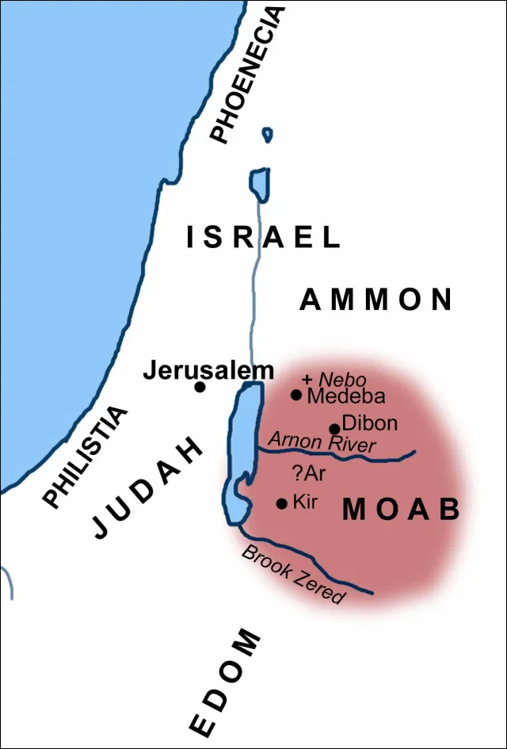
The Scope of Deuteronomy
Deuteronomy is similar to Leviticus in that both books consist, almost entirely, of instructions and speeches.
The scope of history covered in Deuteronomy is very brief. All the events recorded took place on the plains of Moab, probably within a few weeks, just before Israel's entrance into Canaan

Slide 31
Chapter 1 & 2 discussion
What can we assume from verse 1:1 and 2:10-11?
Why is this important for us during our study?
Both chapters cover a lot of information in a short essay. Why does Moses cover things in such an abbreviated form?
1:6-18 What does Moses call Mount Sinai?

Slide 32
Chapter 1 & 2 discussion
1:19-46 Deal with Israel's failure at Kadesh-barnea (also called Kadesh), its causes, and its consequences.
Who can we relate these Israelites to?
V39 What is Moses nodding to when he speaks of the children?

Slide 33
Chapter 1 & 2 discussion
Chapter 2:1- 6 Speaks of the 40 Year Journey of the Israelites. Although this punishment seems cruel, what does verse 7 reveal to us?
What does Verse 5, 9 and 19 reveal to us?
Verse 14 The crossing of the Zered Wadi was a benchmark event for the Israelites. What is the significance of this crossing?

Slide 34
Chapter 1 & 2 discussion
The conquest of the kingdom of Sihon 2:24-37
Moses emphasizes an important thought in vv25,29,30,31,33,and 36?

