Slide 2
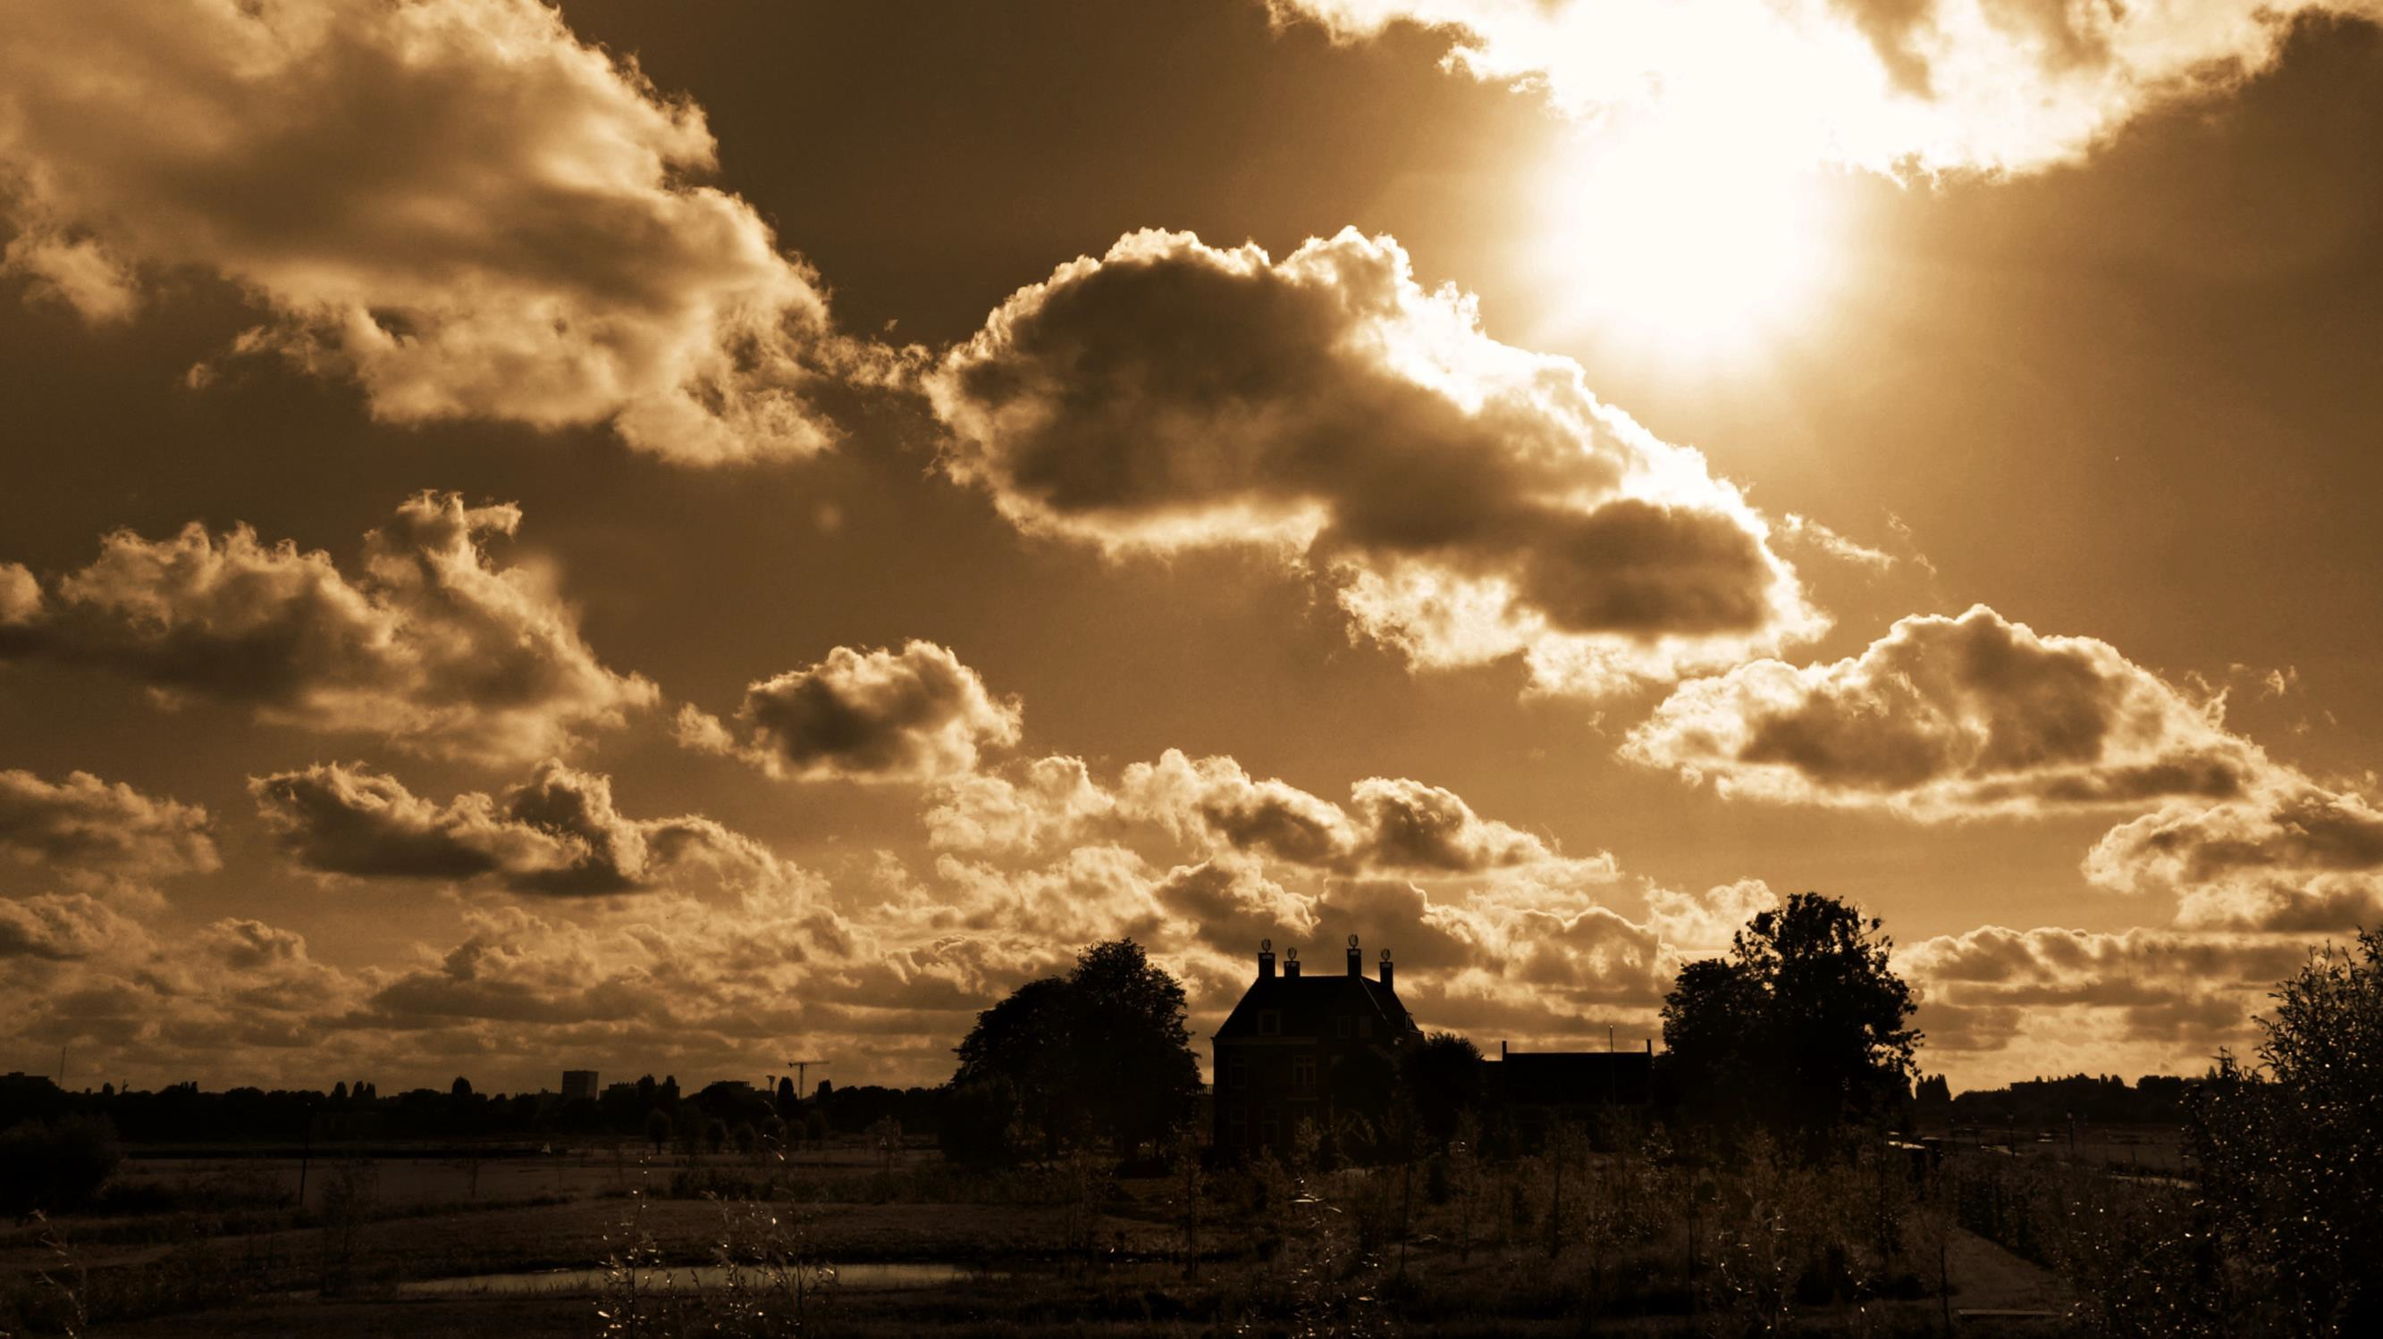
Sing To Me of Heaven
Rev. 22:14

Slide 3
Heaven is Perfectly Prepared for Us
Chapter 21:
The light is from the glory of God and it is clear as crystal
The walls are great and high, measuring 144 cubits
Gates that are made of pearl are 3 on each side
Heaven has 12 foundations adorned with many precious stones
Streets are made of gold

Slide 4
Heaven is Perfectly Prepared for US
An Empty Mansion (198)
Jn. 14:2
Where The Roses Never Fade (199)
Rev. 22:2
Wonderful City (250)
Heb. 11:2

Slide 5
In Heaven there will be No Darkness
Beyond This Land of Parting (202)
Rev. 21:23
No Night There (220)
Rev. 21:16,25
The Unclouded Day (221)
Rev. 22:2

Slide 6
In Heaven there will be No Pain
Where The Soul Never Dies (245)
Rev. 21:4
Never Grow Old (204)
Rev. 21:4

Slide 7
In Heaven there will be No Sadness
God Shall Wipe Away All Tears (238)
Rev. 7:17
No Tears In Heaven (214)
Rev. 21:4
How Beautiful Heaven Must Be (196)
Rev. 21:4;23

Slide 8
Sing To Me of Heaven
(208)
When people talk about Heaven …
They're happy
They're smiling
They're joyful
Why?
Heaven is an eternal, unclouded, marvelous day.

