Slide 2
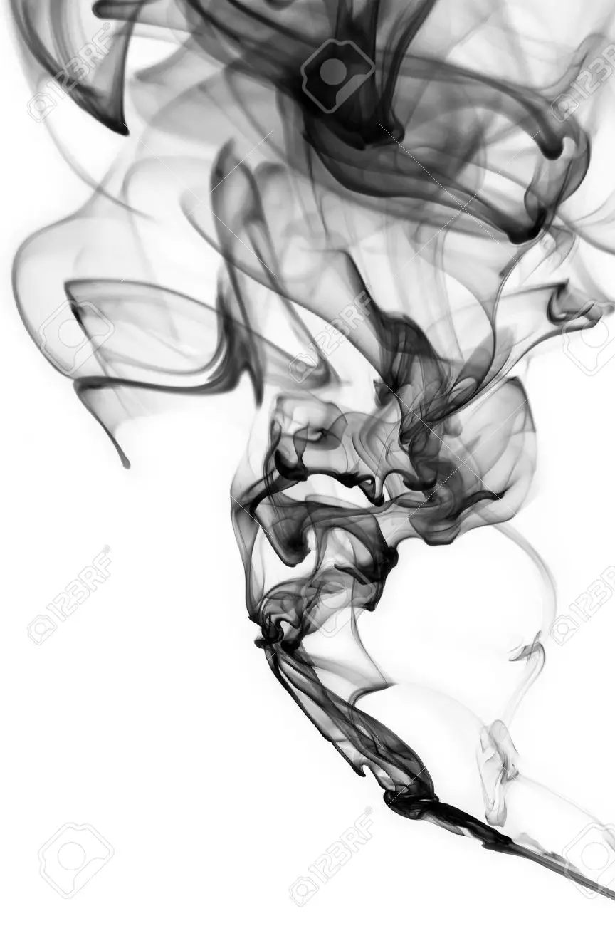
Do you have the faith
of a demon?
Know Who Jesus Is
Believe In His Deity
Showed Reverence
Obeyed Him

