Slide 1
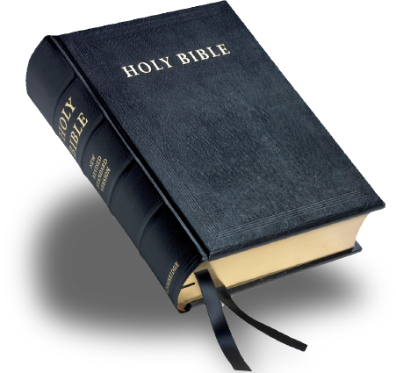
Let Us Worship Together
“God is Spirit, and Those Who Worship Him Must Worship in Spirit and Truth.”
John 4:24

Slide 2
2023 Theme: Examine Your Way
Sermon Title:
“Do I conduct myself in a
manner worthy of the gospel of Christ?”

Slide 3
“Do I conduct myself in a
manner worthy of the gospel of Christ?”
“Only conduct yourselves in a manner worthy of the gospel of Christ, so that whether I come and see you or remain absent, I will hear of you that you are standing firm in one sprit, with one mind striving together for the faith of the gospel;”
Philippians
1:27

Slide 4
“Do I conduct myself in a
manner worthy of the gospel of Christ?”
J Will
When Christ called His Disciples, He summoned them to Follow Me!
The United States Army Infantry Motto is “Follow-Me”
Jesus referenced the cross when he told His Disciples to follow Him. Luke 9:23, Luke 14:27, Matthew 10:38-39
I am sure that the disciples were wondering what Jesus was talking about and why was He referencing the cruelest form of death to describe what it required to be His disciple.
The World will hate and persecute Disciples! Dissciples will not win many popularity contests. Matthew 10:22

Slide 5
Disciples (Followers of Christ)
J Will
Discipleship is Costly: Matthew 16:24-27
Disciples make Disciples: Matthew 28:19-20
God is glorified when His disciples bear fruit. John 15:8
The Gospel is worth my sacrifice because it is what saves me and the lost! Paul said, in Philippians 1:21 “For to me, to live is Christ and to die is gain.”
The highest priority of every Disciple/Christian is to make it to Heaven. We have to want that more than anything else in this world. If not, we are not going to make it!
This World is Not our Home! Here we are just weary Pilgrims!

Slide 6
Disciples (Followers of Christ)
J Will
Paul warned the Church at Philippi that MANY walk in a way that is not worthy of the Gospel and that they are enemies of the cross of Christ. They did not take up their Cross and follow Jesus! Philippians 3:18-21
There may be some here today, that take part in all the Worship Services, and wear the name of Christ but are not conducting themselves in a manner that is worthy of the Gospel!
There may be some here today that has never rendered Obedience to the Gospel.
If this is your situation, you are lost and your name is not written in the Book of Life! You do not have Blessed Assurance of Salvation!

Slide 7
Only True Disciples will find their name written in the Book of Life!
J Will
Only those that love God with all their Heart, Soul, mind, and strength.
Those that love their neighbor more than themselves! Do you love your neighbor enough to share the Good News! If the News is so good, you want to share it with others Right?
Those who walked with God and in a manner that is worthy of the Gospel.
Those who counted the cost, denied themselves, and who took up their cross and followed Christ. Where He Leads, I’ll Follow! Will You?
There will not be any selfish people in heaven. Philippians 2:2-4
People that make it will be those who stood firm in one spirit, one mind, striving together for the faith of the gospel. Philippians 1:27
And those who not only believe in Christ, but also suffer for His sake. Philippians 1:29

Slide 8
Satan promises us the world!
J Will
Satan promises man that he can find happiness in Sin, pleasing himself, by doing what makes you feel good! Being who and what you want to be!
That is a lie but that is how Satan operates that is his modus operandi!
What Satan and Sin offers kills, steals, and destroys the peace and happiness of most of the world. It is a travesty!
James 4:4 If we are a friend of the world, we are an enemy of God!
I John 2:15-17 If we love the world, we cannot love the Father!
The pleasures of the world and the desire to please ourself will cost us our Soul! I Corinthians 6:9-11

Slide 9
Hard Times make us Stronger!
J Will
Our circumstances on earth or from a physical standpoint should never hinder us and in our responsibility to spread the Gospel! Philippians 1:12-14
How do we respond to the following: False Teaching, Persecution, and Sin
A few and one Disciple can make a difference!
What about Gamliel? Acts 5:33-42
Jesus is always looking for a few good men who will take up their cross daily and follow Him!

Slide 10
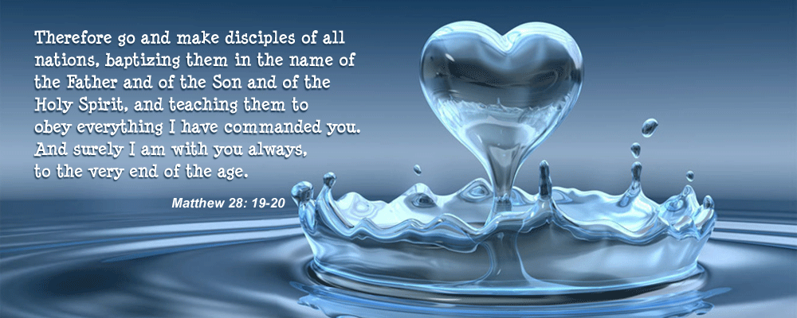
Disciples Have a Responsibility
J Will

Slide 11
Can you Say?
J Will
For me to live is Christ and to die is gain.
That you are conducting yourself in a way that is worthy of the Gospel.
That you are committed to Christ and that you take up your cross daily and fight as a good Soldier of Christ.
That your main goal is to get to Heaven.
That you look for ways to share the Gospel with the lost, with your family, friends, neighbors, as you are going about on your way! Doors do not open by themselves! You can pray for open doors, but you must open them!
That you always do things that are pleasing to Him (The Father) John 8:29

Slide 12
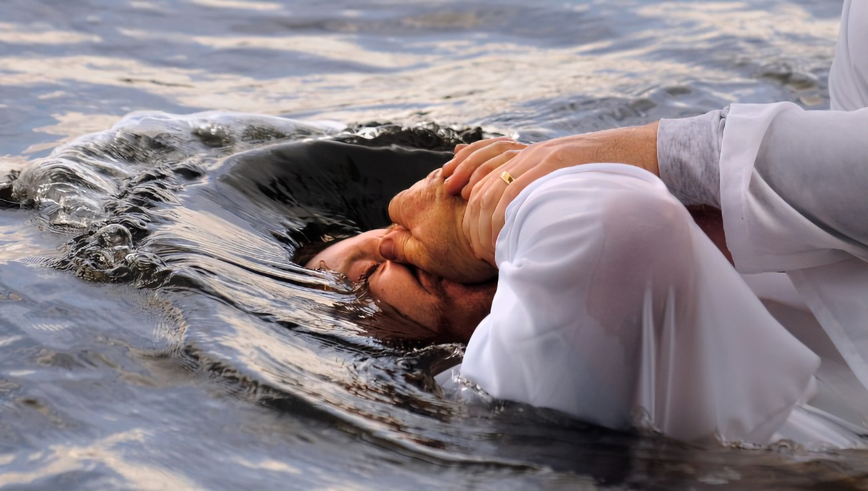
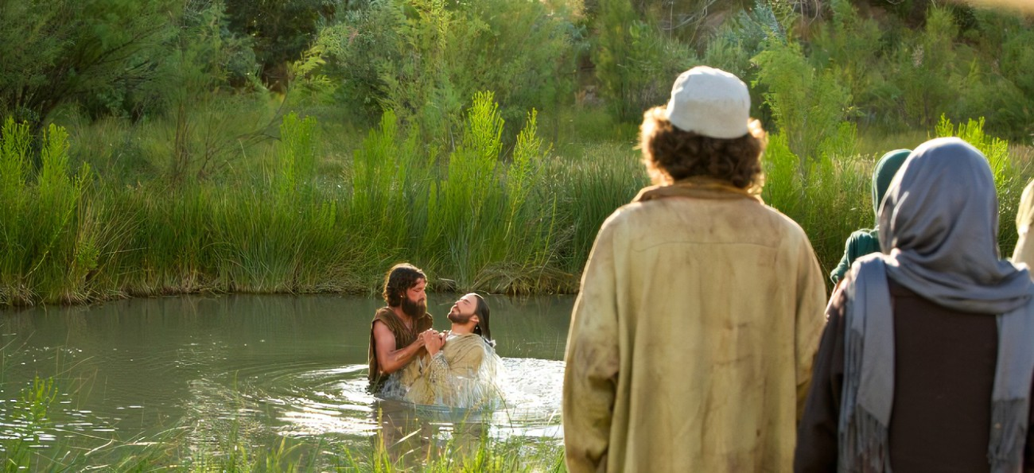
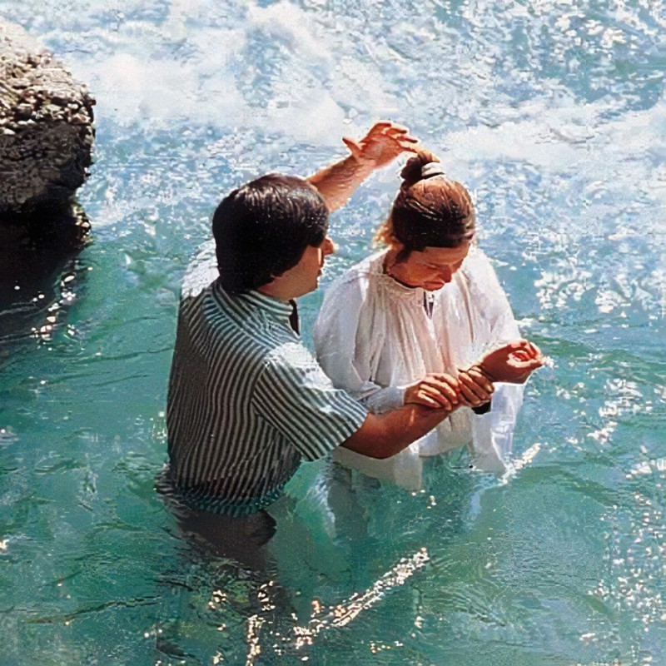
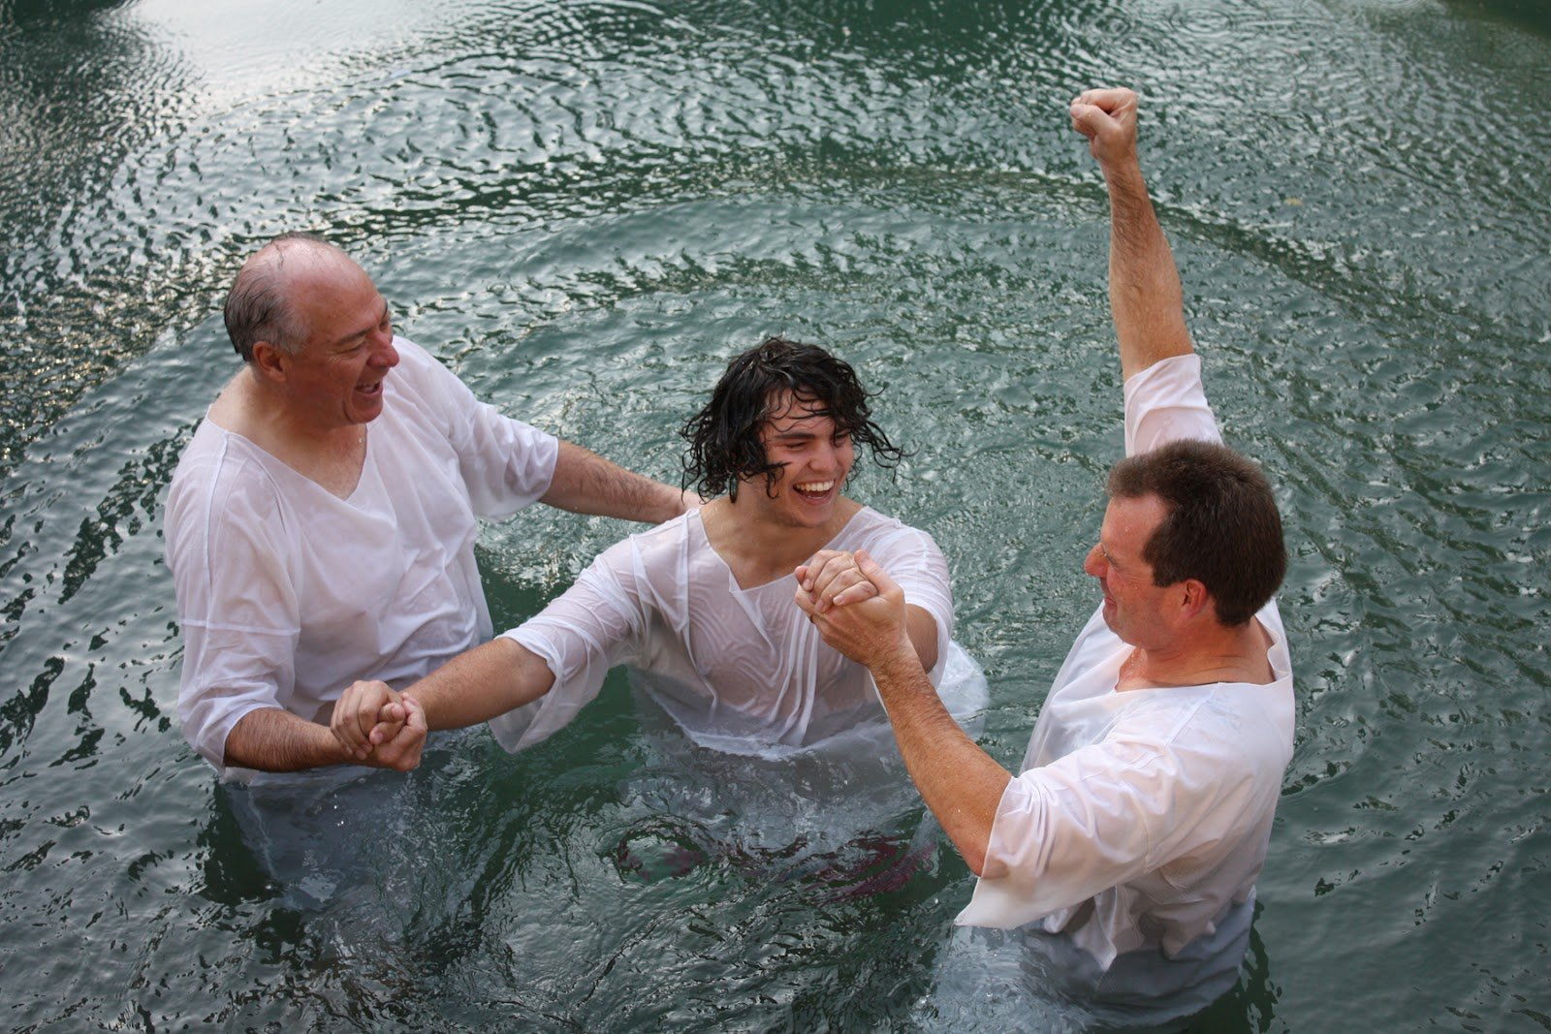
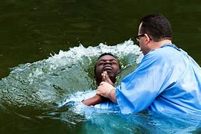
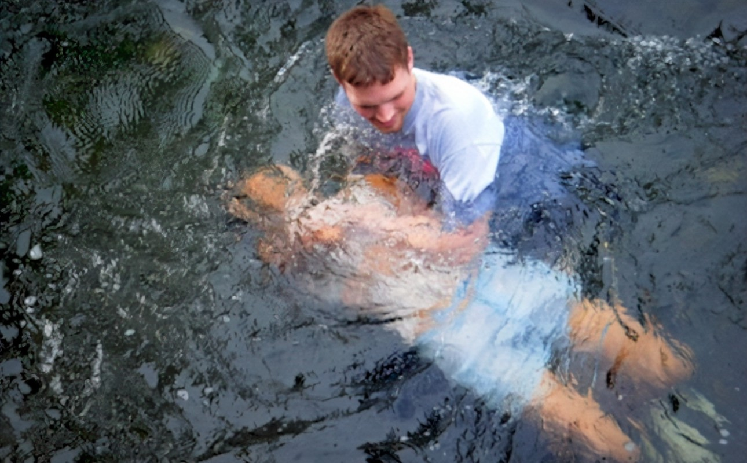
Why do you Wait?
Arise
Be Baptized
Wash Away your Sins
Acts 22:16
Do you want peace and rest for your weary Soul?
Do you want to win a crown of life and defeat Satan through Christ?
Join the Army of the Lord and Never Fight Alone!
Blessed Assurance!

