Slide 1
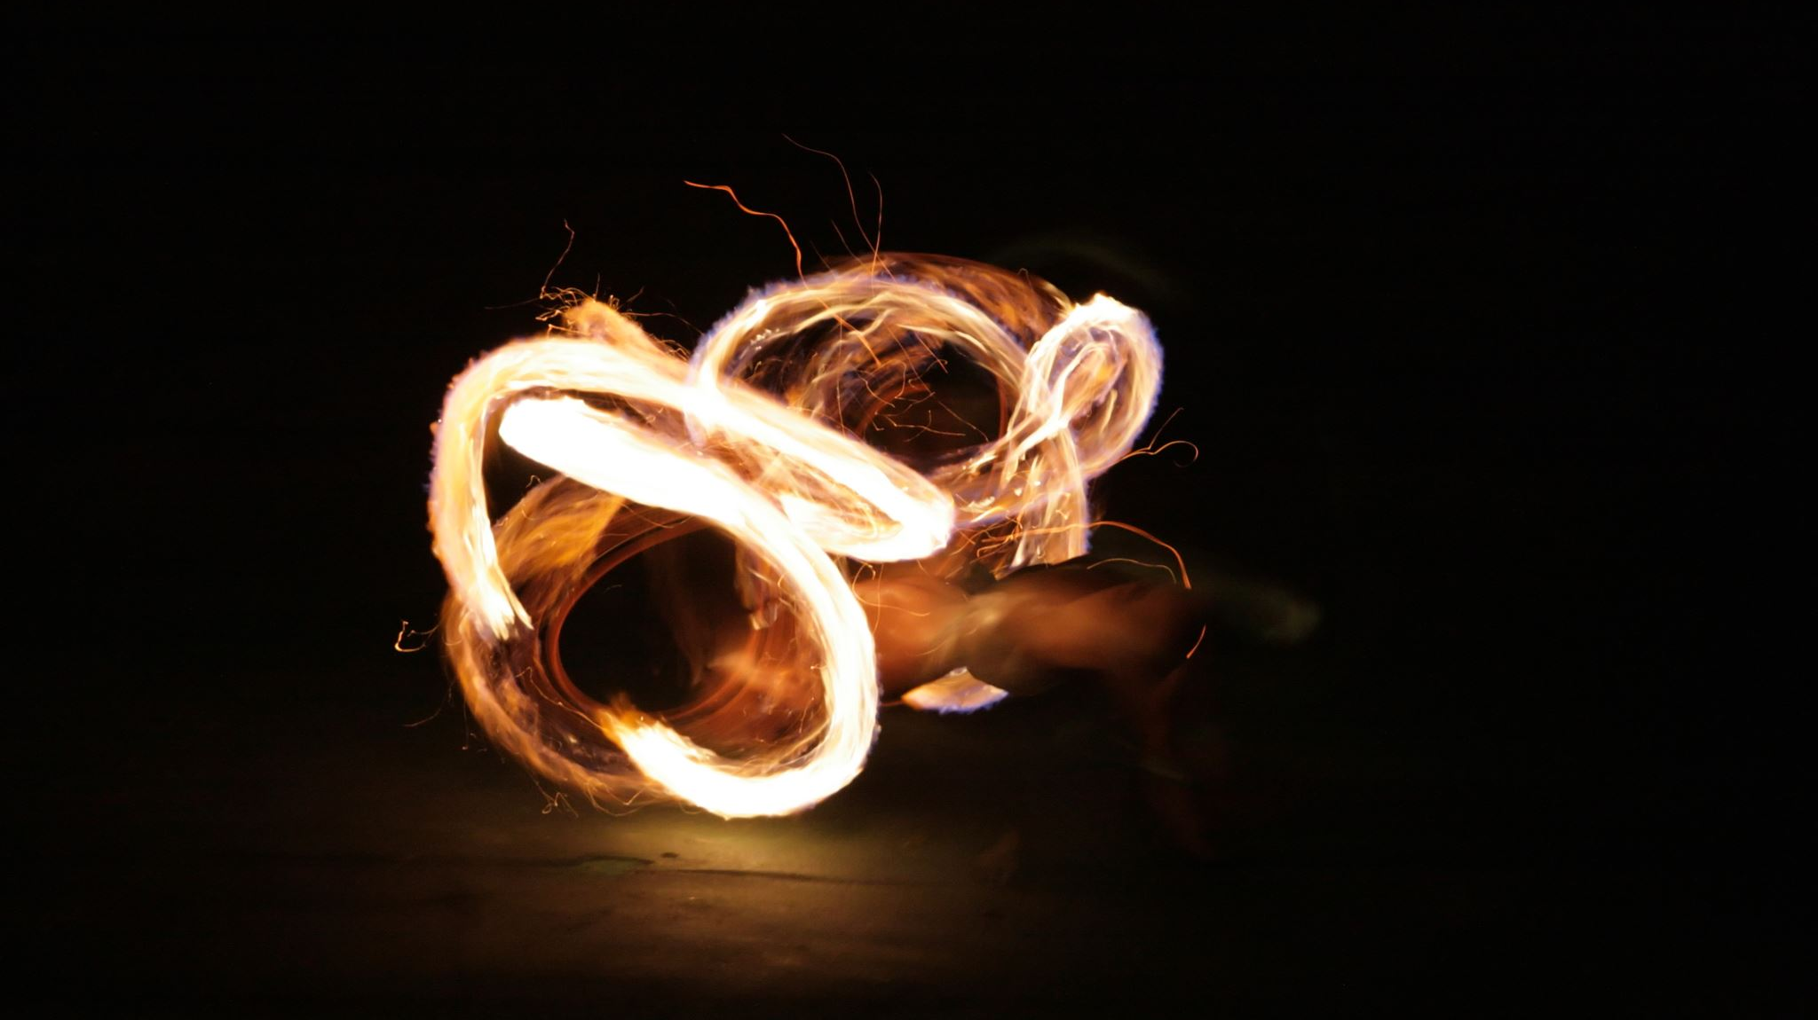
Lighting the Fire
Spreading Our Fire

Slide 2
Our Fire Must Be the Right Fire
Physically, there are 6 types of fire. Four of these six are harmful and dangerous.
Spiritually, there are many wrong fires too!
Ones that bring attention to ourselves (Matthew 5:14-16).
Fires that do not go through Christ when bringing others to God (John 14:6).
Fires that do not lead to God (1 John 1:5-7).

Slide 3
Find the Right Time
We must be in the world for our lights to shine.
Matthew 5:14-16
John 17:13-19
We must know when to speak up and when to let our actions do the talking.
Acts 9:36-40
There are times when we need to speak up (Acts 4:19-20; 5:27-29).

Slide 4
Attract Others To Your Fire
Our fire needs to be burning so bright that people come from all over to watch!
We should be different. People should notice a difference in us.
We should be transformed (Romans 12:1-2).
We should be shining bright (Matthew 5:16).
We should be set apart (1 Corinthians 6:11).

Slide 6
Light the Fire
Verse 1
I stand to praise you(All)
but I fall on my knees(All)
My spirit is willing(All)
but my flesh is so weak(All)

Slide 7
Chorus
(Men) (Women)
So light the fire Light the fire
In my soul In my weary soul
Fan the flame Fan the flame
Make me whole Make my spirit whole
Lord you know Lord you know
Just where I've been Where I've been
So, light the fire in my heart again

Slide 8
Verse 2
I feel your arms around me (All)
as the power of your healing begins (All)
You breathe new life right through me (All)
like a mighty rushing wind (All)
*Repeat Chorus 2 times*

Slide 9
Chorus
(Men) (Women)
So light the fire Light the fire
In my soul In my weary soul
Fan the flame Fan the flame
Make me whole Make my spirit whole
Lord you know Lord you know
Just where I've been Where I've been
So, light the fire in my heart again

