Slide 1
The seals, trumpets, and bowls are all means for God to give time for man to repent BEFORE judgment falls.
Notice how the amount of the earth affected grows with each warning.

Slide 2
Background of Symbolism
⁸ I saw by night, and behold, a man riding on a red horse, and it stood among the myrtle trees in the hollow; and behind him were horses: red, sorrel, and white. ⁹ Then I said, “My lord, what are these?” So the angel who talked with me said to me, “I will show you what they are.” ¹⁰ And the man who stood among the myrtle trees answered and said, “These are the ones whom the Lord has sent to walk to and fro throughout the earth.” ¹¹ So they answered the Angel of the Lord, who stood among the myrtle trees, and said, “We have walked to and fro throughout the earth, and behold, all the earth is resting quietly.”

Slide 3
More Background Material
Zechariah’s horses seem to be symbolic, as in other places (Jer 49:36; Dan 7:7; 8:8) of agents of Judgment
Judgment then comes for a purpos
All seals deal with ROME in an attempt to get them to repent
Christians are also effected by the judgments on Rome. (It rains on the just and unjust.)

Slide 4
Purpose of the Seals, Trumpets and Bowls
When we view Revelation and Daniel together, we have an overall picture of how God deals with the nations
God gives all time to repent (3:21)
Nations are given time to repent before God brings judgment (6:15,16; 9:20,21; 16:21)

Slide 5
Now I saw when the Lamb opened one of the seals; and I heard one of the four living creatures saying with a voice like thunder, “Come and see.” ² And I looked, and behold, a white horse. He who sat on it had a bow; and a crown was given to him, and he went out conquering and to conquer.
The image is of a Parthian warrior
White is a holy color
Jesus is here pictured as an enemy of Rome with His kingdom conquering the final kingdom of Daniel
Rome feared the Parthians after the battle of Carrhae (53 BC)

Slide 6
Battle of Carrhae
Crassius led the Roman army into Parthia
7 Legions strong (35,000 men)
Parthains had 10,000 men (2000 calvary and 8000 mounted archers)
All 35,000 Romans were killed
Parthians used the head of Cassius as a prop in a play for the next 10 years
The Parthian Shot: as the archers passed the enemy, they would turn and shoot at a gallop. We now get the phrase “the parting shot” from their practice.

Slide 7
Now I saw when the Lamb opened one of the seals; and I heard one of the four living creatures saying with a voice like thunder, “Come and see.” ² And I looked, and behold, a white horse. He who sat on it had a bow; and a crown was given to him, and he went out conquering and to conquer.
Daniel 2 MUST come to the minds of the readers
God’s kingdom conquering the final earthly kingdom as well as judgment is being portrayed.
Psalms 7:11-13
God is a just judge, And God is angry with the wicked every day. ¹² If he does not turn back, He will sharpen His sword; He bends His bow and makes it ready. ¹³ He also prepares for Himself instruments of death; He makes His arrows into fiery shafts.

Slide 8
³ When He opened the second seal, I heard the second living creature saying, “Come and see.” ⁴ Another horse, fiery red, went out. And it was granted to the one who sat on it to take peace from the earth, and that people should kill one another; and there was given to him a great sword.
Red indicates blood or persecution
Power was given from Christ
Some sort of conflict that sweeps the earth is here possibly indicated (Eze 14:21)
Challenging seal, I am not sure about
For thus says the Lord God: “How much more it shall be when I send my four severe judgments on Jerusalem – the sword and famine and wild beasts and pestilence – to cut off man and beast from it?”

Slide 9
⁵ When He opened the third seal, I heard the third living creature say, “Come and see.” So I looked, and behold, a black horse, and he who sat on it had a pair of scales in his hand. ⁶ And I heard a voice in the midst of the four living creatures saying, “A quart of wheat for a denarius, and three quarts of barley for a denarius; and do not harm the oil and the wine.”
Black seems to indicate famine
Black is also the color of distress and the portent of terror in the approaching calamity.
Prices listed, were a full day’s pay equivalent

Slide 10
⁶ And I heard a voice in the midst of the four living creatures saying, “A quart of wheat for a denarius, and three quarts of barley for a denarius; and do not harm the oil and the wine.”
Oil and wine were luxuries
Food was available, IF one had the price/money
Many Christians were slaves or very poor, many would be hard pressed to have the money to eat.

Slide 11
⁷ When He opened the fourth seal, I heard the voice of the fourth living creature saying, “Come and see.” ⁸ So I looked, and behold, a pale horse. And the name of him who sat on it was Death, and Hades followed with him. And power was given to them over a fourth of the earth, to kill with sword, with hunger, with death, and by the beasts of the earth.
Power is again given by Christ
¼ seems to indicate a larger sphere of operation than the black horse
This seems to indicate a military action of some sort.
Each of these follow in logical order one after another
“Sword, famine, pestilence, and wild beasts are often grouped together as ordinary means of death in an unstable society (Lev 26:22ff; Eze 14:21;)” (Roberts)

Slide 12
Overview of the Seals, Trumpets, and Bowls
Notice how these increase – 1/4th to 1/3rd to the entire earth is impacted
Rev 16:9 – “⁹ And men were scorched with great heat, and they blasphemed the name of God who has power over these plagues; and they did not repent and give Him glory.”
These are done to cause sinful man to repent of his evil ways (2 Pet 3:9)
These are designed to humble and show the world their need for God

Slide 13
Overview of the Seals, Trumpets, and Bowls
We see two impacts
The first was on the world
The second will be on Christians
Also, don’t overlook the phrase that is used often, “power was given” this shows that God and Christ are in control
Vision now switches from an earthly view to a heavenly view.

Slide 14
⁹ When He opened the fifth seal, I saw under the altar the souls of those who had been slain for the word of God and for the testimony which they held. ¹⁰ And they cried with a loud voice, saying, “How long, O Lord, holy and true, until You judge and avenge our blood on those who dwell on the earth?” ¹¹ Then a white robe was given to each of them; and it was said to them that they should rest a little while longer, until both the number of their fellow servants and their brethren, who would be killed as they were, was completed.
Key Verse in Revelation! The rest of the book answers this question – HOW LONG?
Summers says that verse 9 indicates why judgment must come upon Rome.
Not crying for revenge, but justice.
How long before judgment is passed on those who killed God’s people.
This group will be seen again in 20:4 remember.

Slide 15
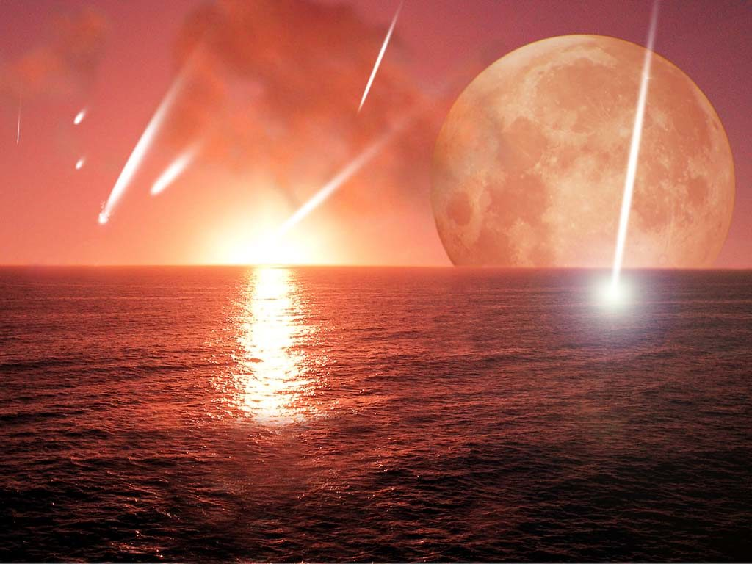
¹² I looked when He opened the sixth seal, and behold, there was a great earthquake; and the sun became black as sackcloth of hair, and the moon became like blood. ¹³ And the stars of heaven fell to the earth, as a fig tree drops its late figs when it is shaken by a mighty wind. ¹⁴ Then the sky receded as a scroll when it is rolled up, and every mountain and island was moved out of its place.
Rome WILL fall is the answer to the last question
Isaiah used the same imagery of ancient Babylon (Is 13:10)
Joel had used the imagery to describe judgment against Jerusalem (Joel 2:31)
Jesus used the same imagery to describe the destruction of Jerusalem by the Romans (Matt 24:29ff)

Slide 16
¹³ And the stars of heaven fell to the earth, as a fig tree drops its late figs when it is shaken by a mighty wind.
Stars many times represent
Rulers – Num 24:17
Stars falling normally indicate and illustrate fall and passing of a great national power when judged by Jehovah.
Same description is used when describing the fall of Babylon – Isa 34:4:
⁴ All the host of heaven shall be dissolved, And the heavens shall be rolled up like a scroll; All their host shall fall down As the leaf falls from the vine, And as fruit falling from a fig tree.
God’s people are said to shine as stars forever – Dan 12:3:
³ Those who are wise shall shine Like the brightness of the firmament, And those who turn many to righteousness Like the stars forever and ever.

Slide 17
¹³ And the stars of heaven fell to the earth, as a fig tree drops its late figs when it is shaken by a mighty wind.
Islands and Mountains – mountains denoted places of authority in a kingdom (Amos 4:1):
“Hear this word, you cows of Bashan, who are on the mountain of Samaria, . . .”
Islands denoted the inhabitants of the sea; the prophets referred to Gentile peoples as “isles in the sea”

Slide 18
¹⁵ And the kings of the earth, the great men, the rich men, the commanders, the mighty men, every slave and every free man, hid themselves in the caves and in the rocks of the mountains, ¹⁶ and said to the mountains and rocks, “Fall on us and hide us from the face of Him who sits on the throne and from the wrath of the Lamb! ¹⁷ For the great day of His wrath has come, and who is able to stand?”
What is the purpose of the seals?
Give Rome time to repent.
The result? They did NOT humble themselves in the sight of God and repent. They recognized Him, but NOTE, no repentance!
God wants our hearts and we MUST humble ourselves and submit!

Slide 19
How does this chapter help the churches who are facing the problems/challenges of:
In three churches false teaching was an issue.
In three churches persecutions were an issue of some sort.
In two churches a problem with their works was an issue
(Possibly 3 if you count Ephesus as having this problem)
In one church they lost a cornerstone member.
In one congregation they were materially poor.
In one congregation, they were small in number (Few members)
In one congregation, they were in a loveless relationship with Christ.
In on congregation, they were reliant on themselves (wealth) and not Christ.

