Slide 1
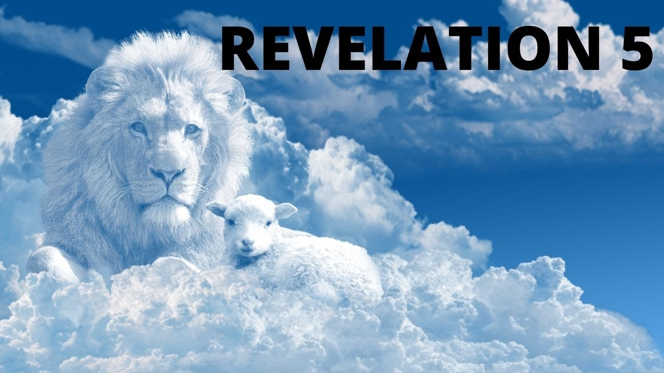
The affairs of man rest NOT in the hands of man, but in the hands of the THRONE OCCUPANT!
ALL THINGS ARE GOVERNED BY GOD!!

Slide 2
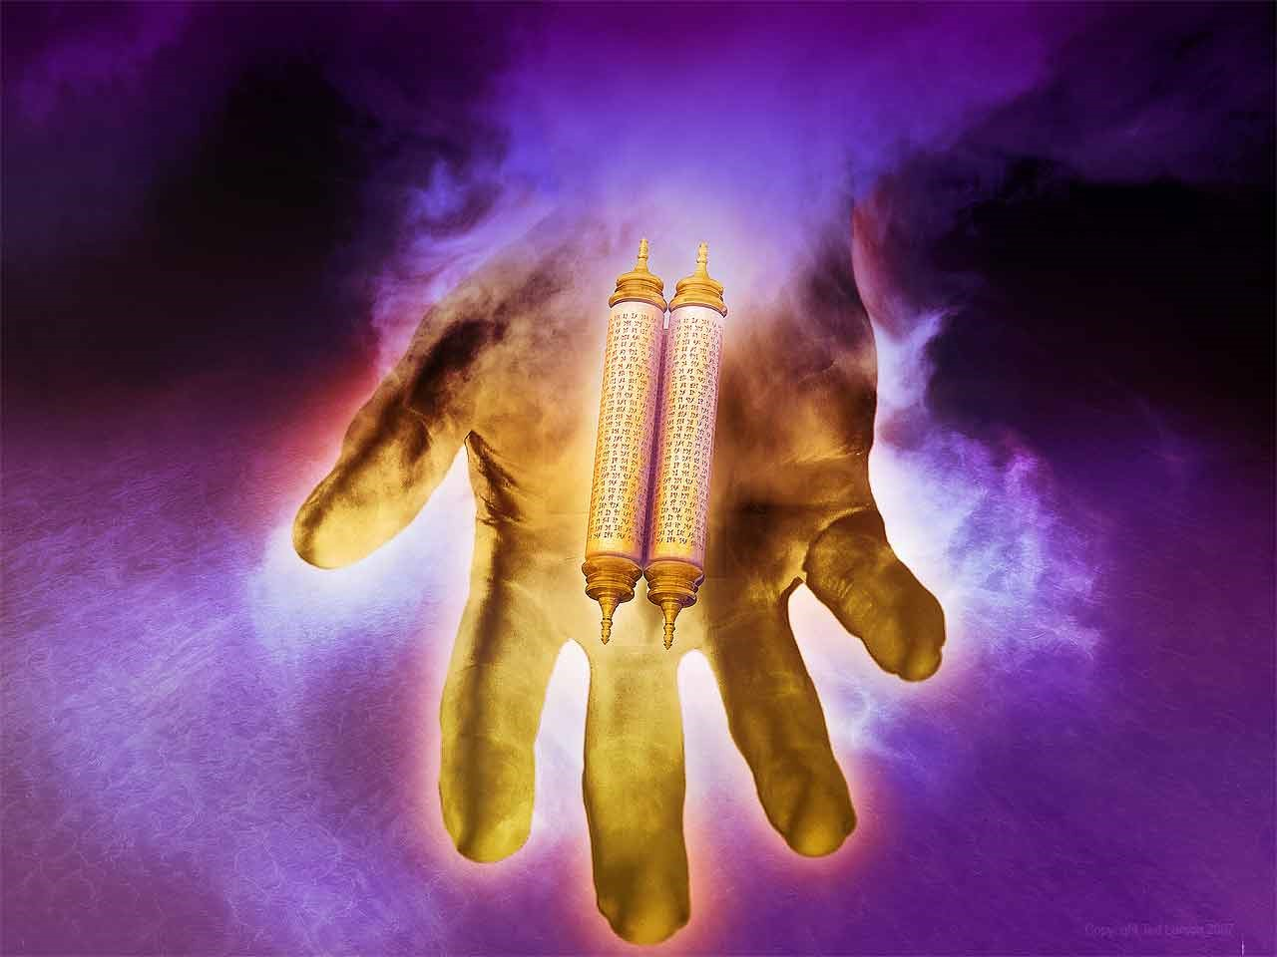
5 And I saw in the right hand of Him who sat on the throne a scroll written inside and on the back, sealed with seven seals.
Scroll represents God’s plan concerning the judgements placed upon Rome
Ezekiel sees a similar scroll in Ezekiel: 2:8,9: ⁸ But you, son of man, hear what I say to you. Do not be rebellious like that rebellious house; open your mouth and eat what I give you.” ⁹ Now when I looked, there was a hand stretched out to me; and behold, a scroll of a book was in it.
Seals protect so no one can add or subtract from what is going to be revealed

Slide 3
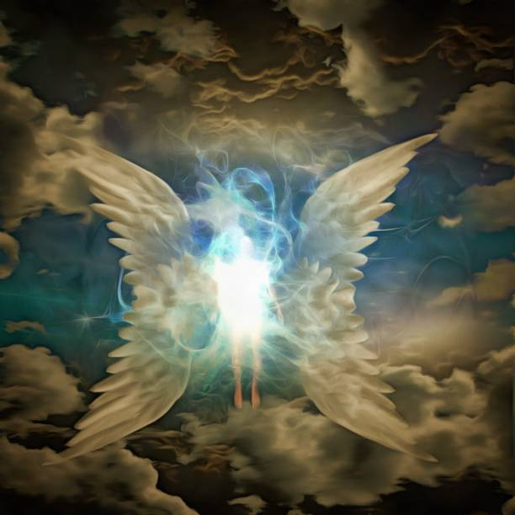
² Then I saw a strong angel proclaiming with a loud voice, “Who is worthy to open the scroll and to loose its seals?” ³ And no one in heaven or on the earth or under the earth was able to open the scroll, or to look at it. ⁴ So I wept much, because no one was found worthy to open and read the scroll, or to look at it.
Strong lends significance to who is able to open it.
“Man” is not in the original Greek in verse 3
So, then in the original, no one in the entire universe, man or angel could open and read it.
John’s distress shows the matter is of great distress. He had been promised to be shown what would shortly take place.

Slide 4

⁵ But one of the elders said to me, “Do not weep. Behold, the Lion of the tribe of Judah, the Root of David, has prevailed to open the scroll and to loose its seven seals.”
Lion . . . Tribe of Judah – Jacob calls the tribe of Judah a Lion in Gen 49:9.
Like Christians of the day, seems like a lamb but actually lions
Lion indicates ferociousness
Root of David – The illusion is to Isa 11:1, 10 and Rom 1:3,4

Slide 5
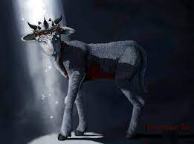
⁶ And I looked, and behold, in the midst of the throne and of the four living creatures, and in the midst of the elders, stood a Lamb as though it had been slain, having seven horns and seven eyes, which are the seven Spirits of God sent out into all the earth.
The central thrust of God’s dominion is carried out by the loving sacrifice of Christ.
7 horns – horns are the power and might of sheep
Hannah’s prayer (1 Samuel 2:10):
Psalmist quotes God as saying:
“… “He will give strength to His king,
And exalt the horn of His anointed.”
“All the horns of the wicked I will cut off, but the horns of the righteous shall be exalted.”

Slide 6
⁶ And I looked, and behold, in the midst of the throne and of the four living creatures, and in the midst of the elders, stood a Lamb as though it had been slain, having seven horns and seven eyes, which are the seven Spirits of God sent out into all the earth.
Eyes – He is all seeing, possibly as an all seeing law (2 Chron 16:9):
Sent forth: possibly the gospel, is sent through the Holy Spirit to the world (Matt 28:19):
“For the eyes of the Lord run to and fro throughout the whole earth, to show Himself strong on behalf of those whose heart is loyal to Him. In this you have done foolishly; therefore from now on you shall have wars.”
“Go ye therefore, and teach all nations, baptizing them in the name of the Father . . . “

Slide 7
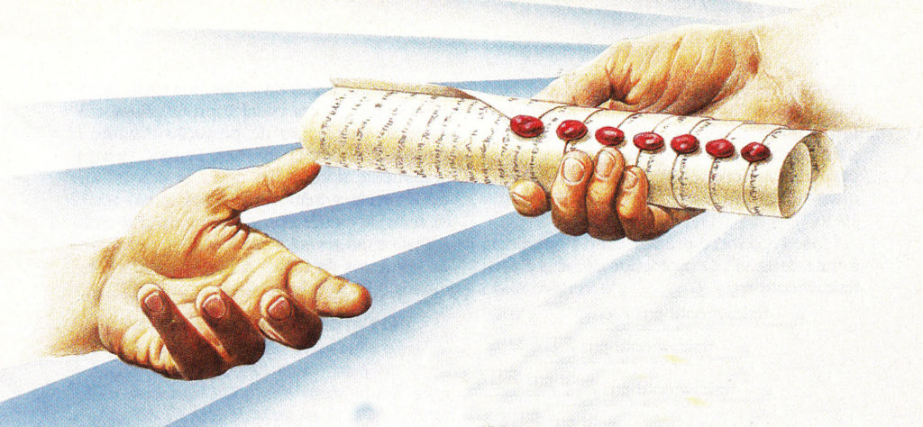
⁷ Then He came and took the scroll out of the right hand of Him who sat on the throne.
Such a short verse, but so important and so powerful!!
God governs the universe through the LAMB!!
Jesus will carry out the judgment on Rome!

Slide 8
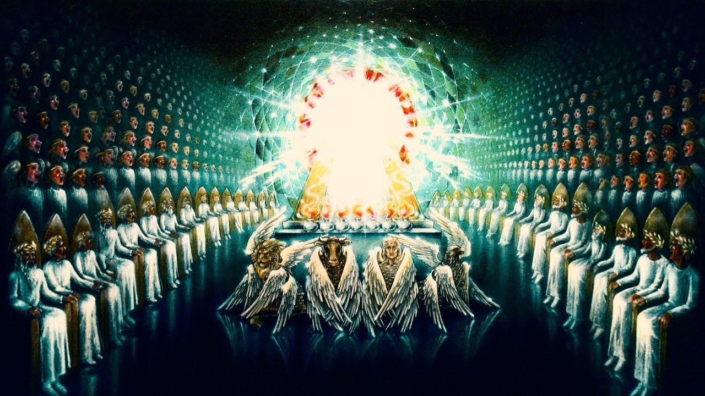
⁸ Now when He had taken the scroll, the four living creatures and the twenty-four elders fell down before the Lamb, each having a harp, and golden bowls full of incense, which are the prayers of the saints. ⁹ And they sang a new song, saying: “You are worthy to take the scroll, And to open its seals; or You were slain, And have redeemed us to God by Your blood Out of every tribe and tongue and people and nation,
As soon as the Lamb takes the scroll there is celebration!
Harps are representative of PRAISE
The golden bowls of incense, the text says “are the prayers of the saints” (V 8)
Prayer and praise COMBINED!
Redemption is universal “out of every tribe and tongue and people of every nation.

Slide 9
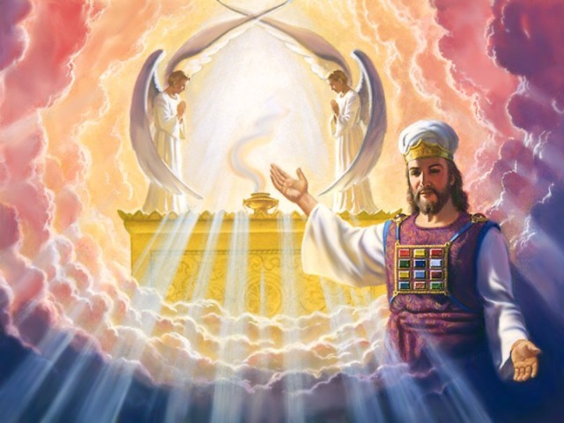
¹⁰ And have made us kings and priests to our God; And we shall reign on the earth.”
He has made us:
KINGS
PRIESTS
WE SHALL REIGN
Huge important point here. We shall and will triumph over our challenges and problems here on the earth!!

Slide 10
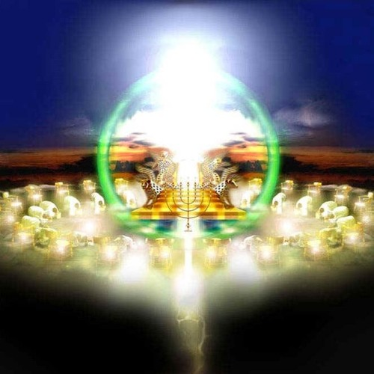
¹¹ Then I looked, and I heard the voice of many angels around the throne, the living creatures, and the elders; and the number of them was ten thousand times ten thousand, and thousands of thousands,
Number indicates fulness of praise!!
In Greek, these words mean nothing more than an infinite number
100,000,000 plus thousands and thousands
Compare to Hebrews 12:22
²² But you have come to Mount Zion and to the city of the living God, the heavenly Jerusalem, to an innumerable company of angels,

Slide 11
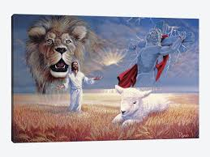
¹² saying with a loud voice: “Worthy is the Lamb who was slain To receive power and riches and wisdom, And strength and honor and glory and blessing!”
The number of the attributes is 7
Perfect and complete is the LAMB!!!
Each is different, there is NO overlapping
He is deserving of Philippians 2:10!!
¹⁰ that at the name of Jesus every knee should bow, of those in heaven, and of those on earth, and of those under the earth,

Slide 12
13 And every creature which is in heaven and on the earth and under the earth and such as are in the sea, and all that are in them, I heard saying:
“Blessing and honor and glory and power
At the beginning of chapter 4, God is worshipped because of His creation.
Now the Lamb is worshipped because of His redemption!

Slide 13
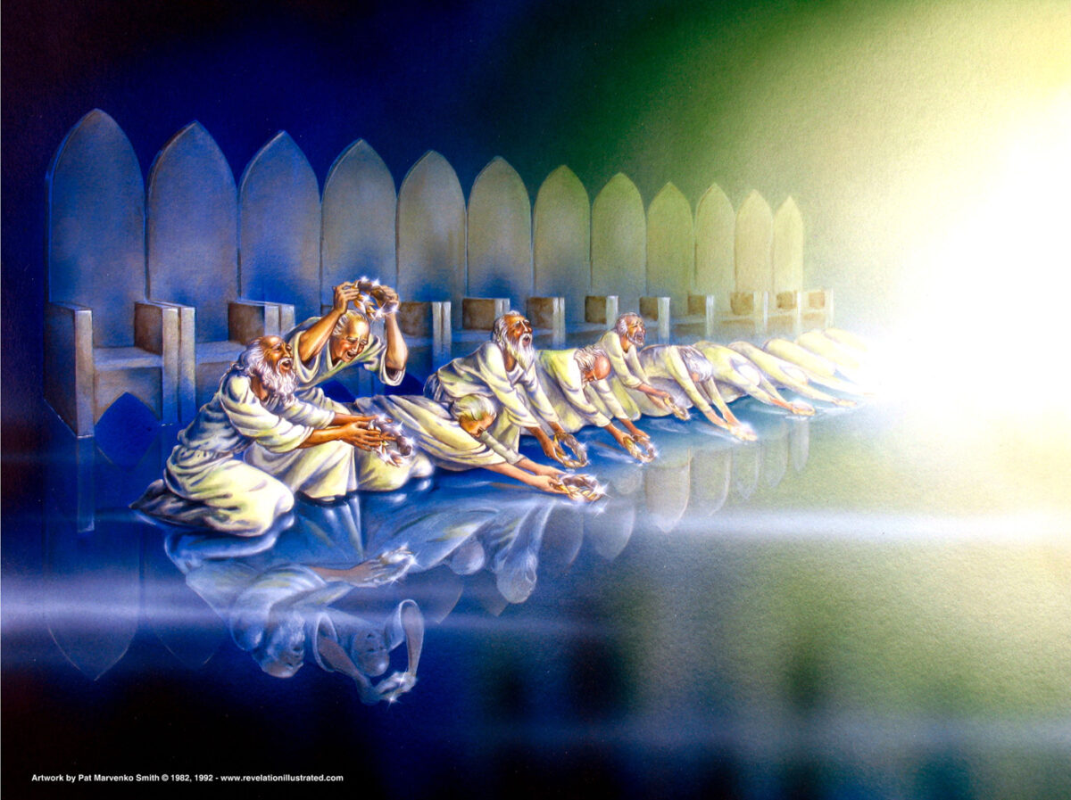
“AMEN”
¹⁴ Then the four living creatures said, “Amen!” And the twenty-four elders fell down and worshiped Him who lives forever and ever.
All things ultimately must glorify God. His will is carried out in the universe. The throne rules, the Lamb reigns!
Hence believers need not fear in times of tribulation, persecution, and anguish.
LET THE TRIALS BEGIN!!

Slide 14
How does this chapter help the churches who are facing the problems/challenges of:
In three churches false teaching was an issue.
In three churches persecutions were an issue of some sort.
In two churches a problem with their works was an issue
(Possibly 3 if you count Ephesus as having this problem)
In one church they lost a cornerstone member.
In one congregation they were materially poor.
In one congregation, they were small in number (Few members)
In one congregation, they were in a loveless relationship with Christ.
In on congregation, they were reliant on themselves (wealth) and not Christ.

