Slide 1
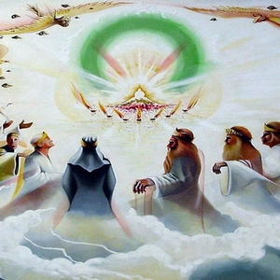
Revelation 4

Slide 2
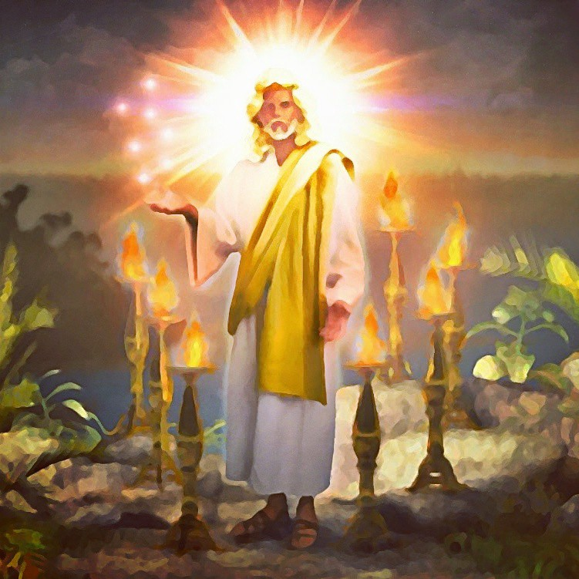
Review first:
Chapter 1 = Telling us about the writer (John) and the Author (Christ)
Chapters 2 and 3 = Who the letter was written to and what was going on and about to happen to these folks (Persecutions)

Slide 3
How does this chapter help the churches who are facing the problems/challenges of:
In three churches false teaching was an issue.
In three churches persecutions were an issue of some sort.
In two churches a problem with their works was an issue
(Possibly 3 if you count Ephesus as having this problem)
In one church they lost a cornerstone member.
In one congregation they were materially poor.
In one congregation, they were small in number (Few members)
In one congregation, they were in a loveless relationship with Christ.
In one congregation, they were reliant on themselves (wealth) and not Christ.

Slide 4
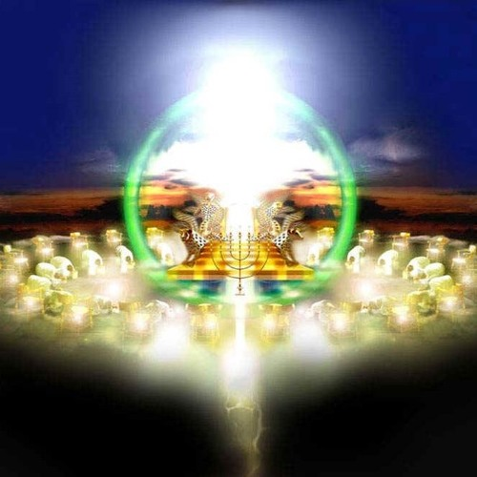
Psalms 99:1: “Jehovah reigns; let the people tremble! He site above the cherubim, let the earth be moved.”
The vision of the universe governed by the THRONE proceeds the symbolic description of the trials through which the church must pass – beginning in chapter 6

Slide 5
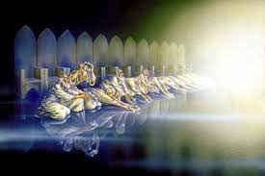
Worship in Revelation
To say worship in Revelation is NOT a key image, would be misguided.
Worship of God and His Son is almost in EVERY CHAPTER
How important then is gathering and worshipping in this life?

Slide 6
Chapter 4
4 After these things I looked, and behold, a door standing open in heaven. And the first voice which I heard was like a trumpet speaking with me, saying, “Come up here, and I will show you things which must take place after this.” ² Immediately I was in the Spirit; and behold, a throne set in heaven, and One sat on the throne. ³ And He who sat there was like a jasper and a sardius stone in appearance; and there was a rainbow around the throne, in appearance like an emerald. ⁴ Around the throne were twenty-four thrones, and on the thrones I saw twenty-four elders sitting, clothed in white robes; and they had crowns of gold on their heads. ⁵ And from the throne proceeded lightnings, thunderings, and voices. Seven lamps of fire were burning before the throne, which are the seven Spirits of God. ⁶ Before the throne there was a sea of glass, like crystal. And in the midst of the throne, and around the throne, were four living creatures full of eyes in front and in back. ⁷ The first living creature was like a lion, the second living creature like a calf, the third living creature had a face like a man, and the fourth living creature was like a flying eagle. ⁸ The four living creatures, each having six wings, were full of eyes around and within. And they do not rest day or night, saying:
“Holy, holy, holy, Lord God Almighty, Who was and is and is to come!”
⁹ Whenever the living creatures give glory and honor and thanks to Him who sits on the throne, who lives forever and ever, ¹⁰ the twenty-four elders fall down before Him who sits on the throne and worship Him who lives forever and ever, and cast their crowns before the throne, saying:
¹¹ “You are worthy, O Lord, To receive glory and honor and power; For You created all things, And by Your will they exist and were created.”

Slide 7
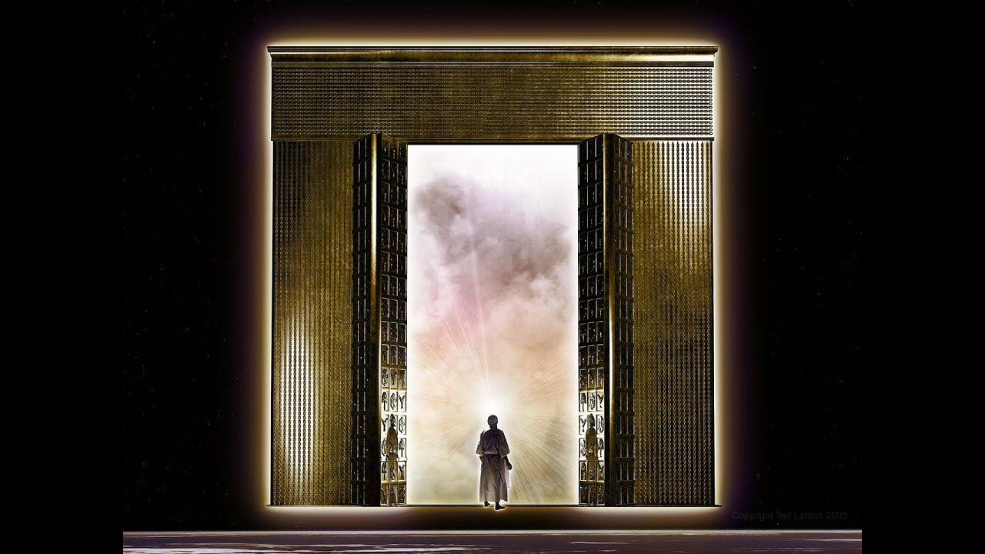
After these things I looked, and behold, a door standing open in heaven. And the first voice which I heard was like a trumpet speaking with me, saying, “Come up here, and I will show you things which must take place after this.”
The door is open to invite John into viewing what was about to take place.
Being in the spirit again reemphasizes this is not literal.
Throne mentioned 38 times in the book. In chapters 4 and 5, it is mentioned 17 times.

Slide 8
³ And He who sat there was like a jasper and a sardius stone in appearance; and there was a rainbow around the throne, in appearance like an emerald.
Jasper stone – Clear stone, diamond, God’s glory and holiness
Sardis Stone – Blood red indicating holy nature of God in judgment
Rainbow – Covenant keeper
What does all this portray about God to those John is writing to?

Slide 9
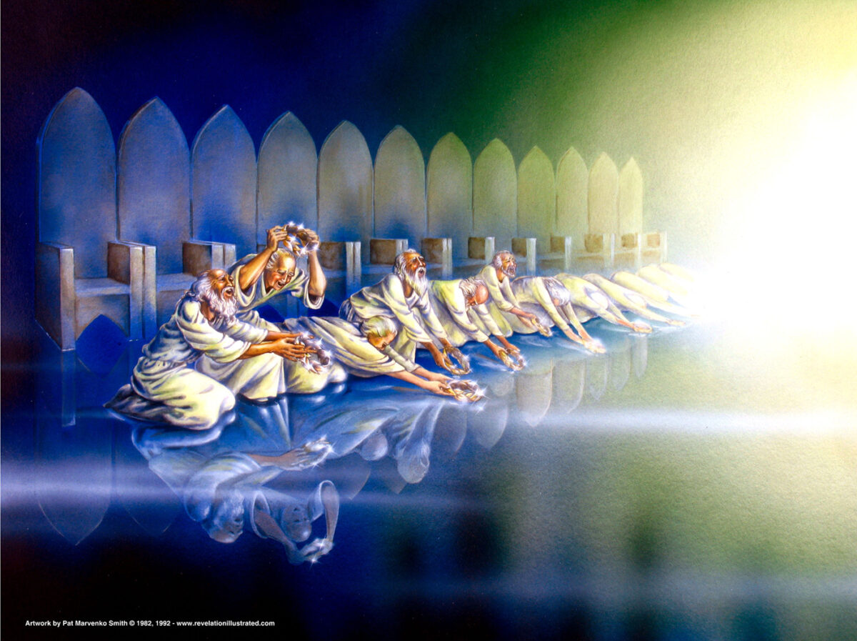
⁴ Around the throne were twenty-four thrones, and on the thrones I saw twenty-four elders sitting, clothed in white robes; and they had crowns of gold on their heads. ⁵ And from the throne proceeded lightnings, thunderings, and voices. Seven lamps of fire were burning before the throne, which are the seven Spirits of God.
Elders represent the personification of Old Testament worship and the throne would stand for the reign of acceptable worshippers (1 Chron 25)
Two 12s which would stand for the 12 tribes of Israel and the 12 apostles (Matt 19:28; Luke 12:22-30). In the New Jerusalem, there were 12 foundations and 12 gates with the names of the 12 tribes of Israel written on the gates and the names of the 12 apostles on the foundations.

Slide 10
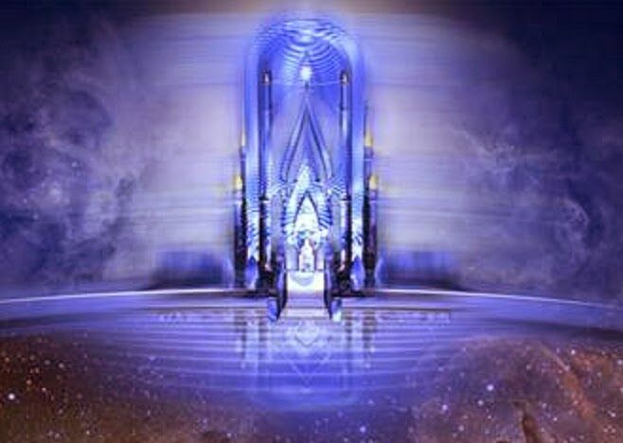
⁶ Before the throne there was a sea of glass, like crystal. And in the midst of the throne, and around the throne, were four living creatures full of eyes in front and in back.
Sea of Glass – Sea of Solomon’s temple (2 Chron 4:2-6) signifying separation. Separation exits between God and man at this point.
In Revelation 21:1, there is NO MORE SEA. No more separation exists at that point in time.
Be honest with you, this is a hard one for me.

Slide 11
The Cheribum are introduced here to enhance the significance of the
throne occupant. These angelic beings ascribe “glory and honor and
thanksgiving” to the ever-lasting one who sits on the throne. They are
constantly repeating the words, “Holy, Holy, Holy, Lord God almighty
which was, and is, and is to come.

Slide 12
Higher order of angelic beings
Guarded Eden (Gen 3:24)
They were at the Mercy Seat (Ex 25:18-20)
They are similar to Ezekiel’s Cheribum (Ez 1:5; 10:20)
Ezekiel and Revelation:
1. Called living Creatures (Ez 1:5; Rev 4:6
2. Same number – 4
3. Four faces of lion, calf, man and eagle (In Ezekiel
all faces are on each creature; in Revelation, four
faces are on four creatures
4. Winged (Ezekiel has four; in Revelation they have 6
5. Full of eyes

Slide 13
⁷ The first living creature was like a lion, the second living creature like a calf, the third living creature had a face like a man, and the fourth living creature was like a flying eagle.
Swiftness
Meekness or
Endurance
Intelligence
Symbol of Authority

Slide 14
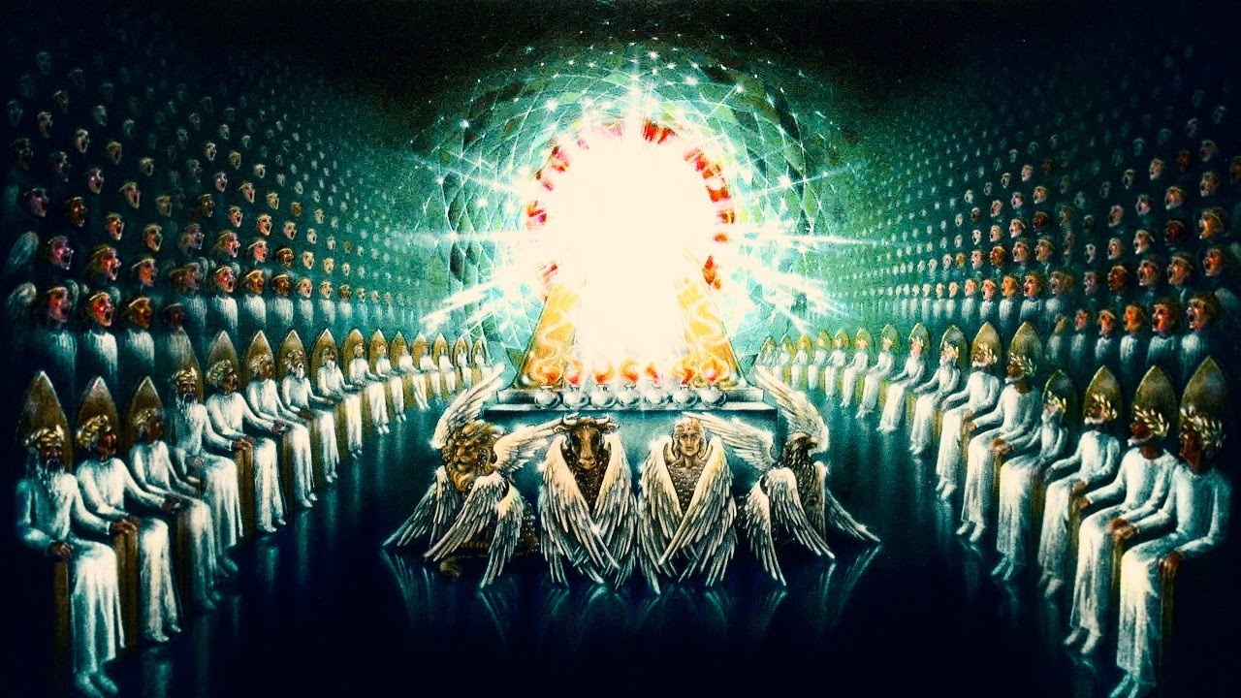
¹⁰ the twenty-four elders fall down before Him who sits on the throne and worship Him who lives forever and ever, and cast their crowns before the throne, saying: ¹¹ “You are worthy, O Lord, To receive glory and honor and power; For You created all things, And by Your will they exist and were created.”
What an impressive way to end with the elders and cherubs all bowing before the GREAT I AM giving HIM all honor and glory!

