Slide 2
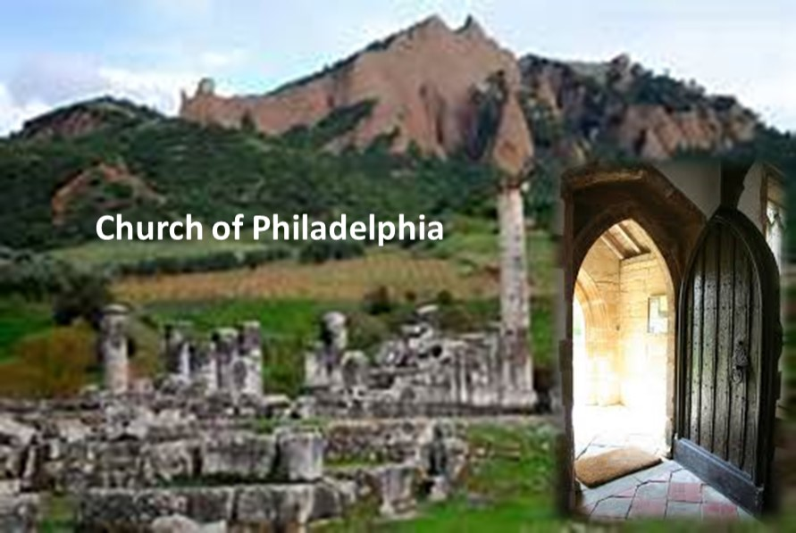

Slide 3
The city’s position on the trade route easily conjures up the image of a doorway. Philadelphia prospered through agriculture and related industries. It was a big producer of grapes/wine.

Slide 4
Philadelphia
⁷ “And to the angel of the church in Philadelphia write, ‘These things says He who is holy, He who is true, “He who has the key of David, He who opens and no one shuts, and shuts and no one opens”: ⁸ “I know your works. See, I have set before you an open door, and no one can shut it; for you have a little strength, have kept My word, and have not denied My name. ⁹ Indeed I will make those of the synagogue of Satan, who say they are Jews and are not, but lie—indeed I will make them come and worship before your feet, and to know that I have loved you. ¹⁰ Because you have kept My command to persevere, I also will keep you from the hour of trial which shall come upon the whole world, to test those who dwell on the earth. ¹¹ Behold, I am coming quickly! Hold fast what you have, that no one may take your crown. ¹² He who overcomes, I will make him a pillar in the temple of My God, and he shall go out no more. I will write on him the name of My God and the name of the city of My God, the New Jerusalem, which comes down out of heaven from My God. And I will write on him My new name. ¹³ “He who has an ear, let him hear what the Spirit says to the churches.” ’

Slide 5
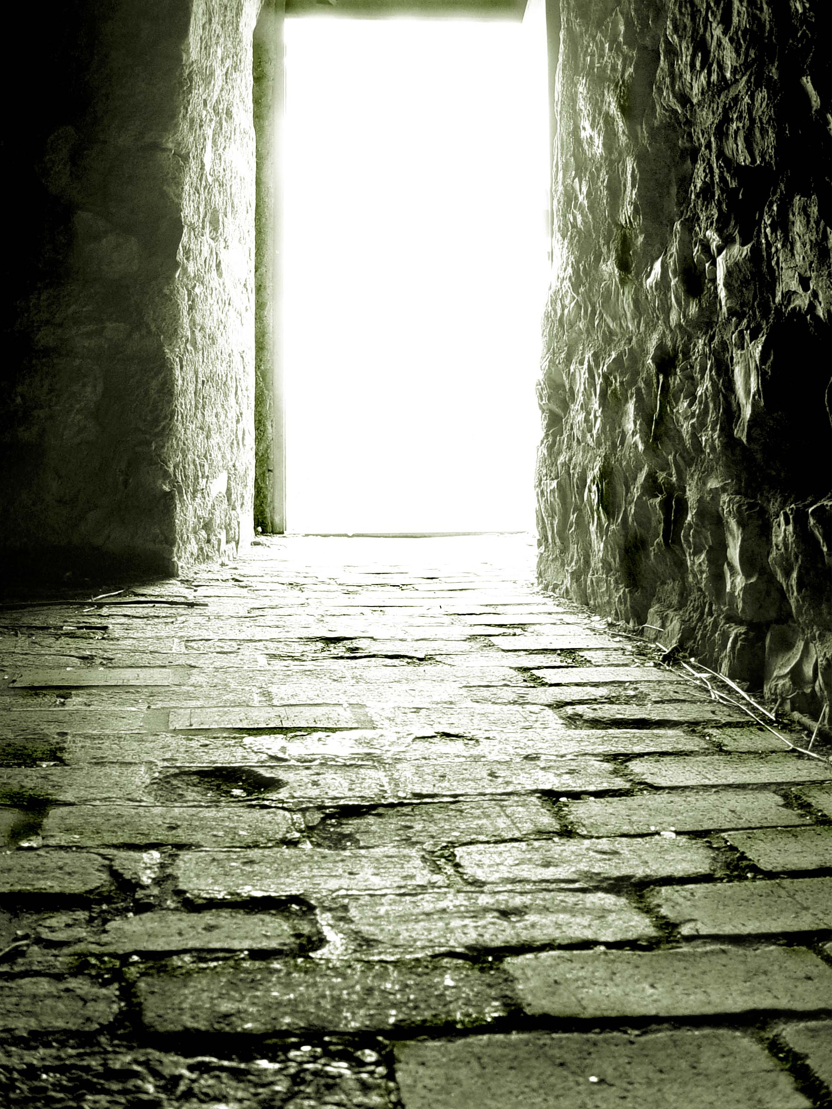
⁸ “I know your works. See, I have set before you an open door, and no one can shut it; for you have a little strength, have kept My word, and have not denied My name.
The little strength is probably in reference to the fact they were a small group and/or they had no political strength to stand against the Jews in the city
It is obvious that it is NOT in reference to their faith as they had great power faith wise.

Slide 6
How can being few in number be a challenge?
Doing work for Christ
Singing not great.
Few who are interested in God can be discouraging.
Revelation 7:9 -⁹ ”After these things I looked, and behold, a great multitude which no one could number, of all nations, tribes, peoples, and tongues, standing before the throne and before the Lamb, clothed with white robes, with palm branches in their hands,”
Satan tries to make us feel isolated (Elijah). So many pictures of heaven with thousands and thousands of inhabitants!
There are always more of us!!

Slide 7
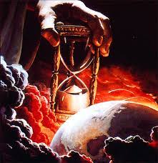
¹⁰ Because you have kept My command to persevere, I also will keep you from the hour of trial which shall come upon the whole world, to test those who dwell on the earth.
This is probably not in reference to an abstaining from a physical persecutions or death. From what is said in the rest of the book, Christ is not talking about EXEMPTION but PRESERVATION.
Homer Hailey

Slide 8
Problems | Challenges
Left first love (Ephesus) – 2:4,5 | False Teachers (Ephesus) – 2:2,6
Not fighting false doctrine (Pergamum) – 2:14,15 | Poor congregation (Smyrna) – 2:9
Permitting False Teaching (Thyatira) – 2:20-23 | Persecuted (Smyrna) – 2:9
Spiritually DEAD congregation (Sardis) – 3:1 | Persecuted (Pergamum) – 2:13
Works NOT perfect (Sardis) – 3:2 | Lost a faithful member (Pergamum) – 2:13
 | Needed to Fight False Teaching – (Thyatira) – 2:24
 | Being Persecuted (Philadelphia) – 3:9
 | Small Congregation (Philadelphia) – 3:10

Slide 9
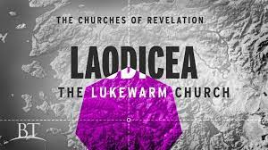

Slide 10
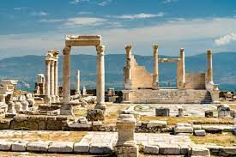
The city was VERY rich. In 60 AD, a great earthquake leveled the city. The elders of the city refused Roman help or money for they were rich and had no need of anyone’s help. It was a HUGE banking community.

Slide 11
Laodicea
¹⁴ “And to the angel of the church of the Laodiceans write, ‘These things says the Amen, the Faithful and True Witness, the Beginning of the creation of God: ¹⁵ “I know your works, that you are neither cold nor hot. I could wish you were cold or hot. ¹⁶ So then, because you are lukewarm, and neither cold nor hot, I will vomit you out of My mouth. ¹⁷ Because you say, ‘I am rich, have become wealthy, and have need of nothing’—and do not know that you are wretched, miserable, poor, blind, and naked— ¹⁸ I counsel you to buy from Me gold refined in the fire, that you may be rich; and white garments, that you may be clothed, that the shame of your nakedness may not be revealed; and anoint your eyes with eye salve, that you may see. ¹⁹ As many as I love, I rebuke and chasten. Therefore be zealous and repent. ²⁰ Behold, I stand at the door and knock. If anyone hears My voice and opens the door, I will come in to him and dine with him, and he with Me. ²¹ To him who overcomes I will grant to sit with Me on My throne, as I also overcame and sat down with My Father on His throne. ²² “He who has an ear, let him hear what the Spirit says to the churches.” ’ ”

Slide 12
¹⁵ “I know your works, that you are neither cold nor hot. I could wish you were cold or hot.
This group of Christians were spiritually lethargic/complacent. Sort of like:
Peace after War
Allowing others to do our work
Being concerned with “other things”

Slide 13
¹⁵ “I know your works, that you are neither cold nor hot. I could wish you were cold or hot.
HOW IS LUKEWARMNESS SEEN IN THE LIVES OF CHRISTIANS?

Slide 14
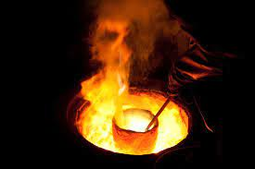
¹⁸ I counsel you to buy from Me gold refined in the fire, that you may be rich; and white garments, that you may be clothed, that the shame of your nakedness may not be revealed; and anoint your eyes with eye salve, that you may see.
1 Peter 1:6,7 – this sure looks like a reference to asking for persecutions.
So, do we need to be asking for persecutions in our lives?
Be careful what you ask for . . .

Slide 15
What is the REAL Problem?
What is the real problem with the Laodiceans?
Not the symptoms, but the root problem?
Wealth and comfort was keeping them from working for God
How CAN wealth and comfort keep a Christians from focusing on the spiritual?
¹⁷ Because you say, ‘I am rich, have become wealthy, and have need of nothing . . . .

