Slide 1
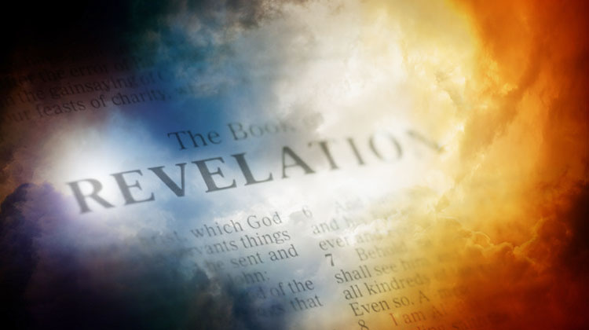
The Book of Revelation

Slide 2
The Book of Revelation
“When the student of the New Testament
embarks upon the study of the REVELATION
he feels himself projected into a new and
different world. Here is something quite unlike
the rest of the New Testament. Not only is
it different, but notoriously difficult.
- Barkley

Slide 3
The Book of Revelation
“No one can shut his eyes to the difficulty
of the Revelation. It is THE most difficult
book in the New Testament; but it is infinitely
worth studying for it contains the blazing
faith of the church in the days when life was
an agony, when men expected the end of the
heavens and the earth as they knew them and
when they still believed that beyond the
terror there was the glory, and that above
the reigning of men was the power of Almighty
God.
- Barkley

Slide 4
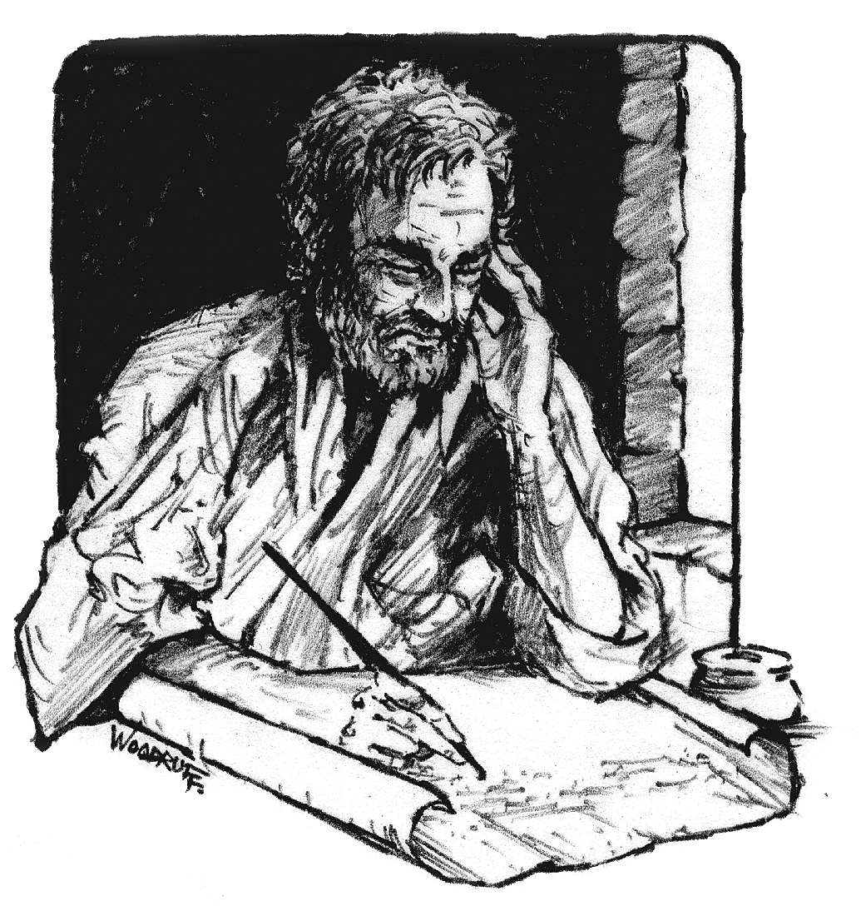
Purpose and Occasion
Christians in Asia had grown strong and started falling away
Rejecting Nicolations
Facing or getting ready to face persecutions
A great struggle with paganism
Writes to kindle hope and strengthen faith

Slide 5

Rules for Interpretation
Normally, it is a must to take anything as literal unless the context demands otherwise.
BUT, with this book, we need to take everything as figurative unless the context demands it to be taken literal.

Slide 6
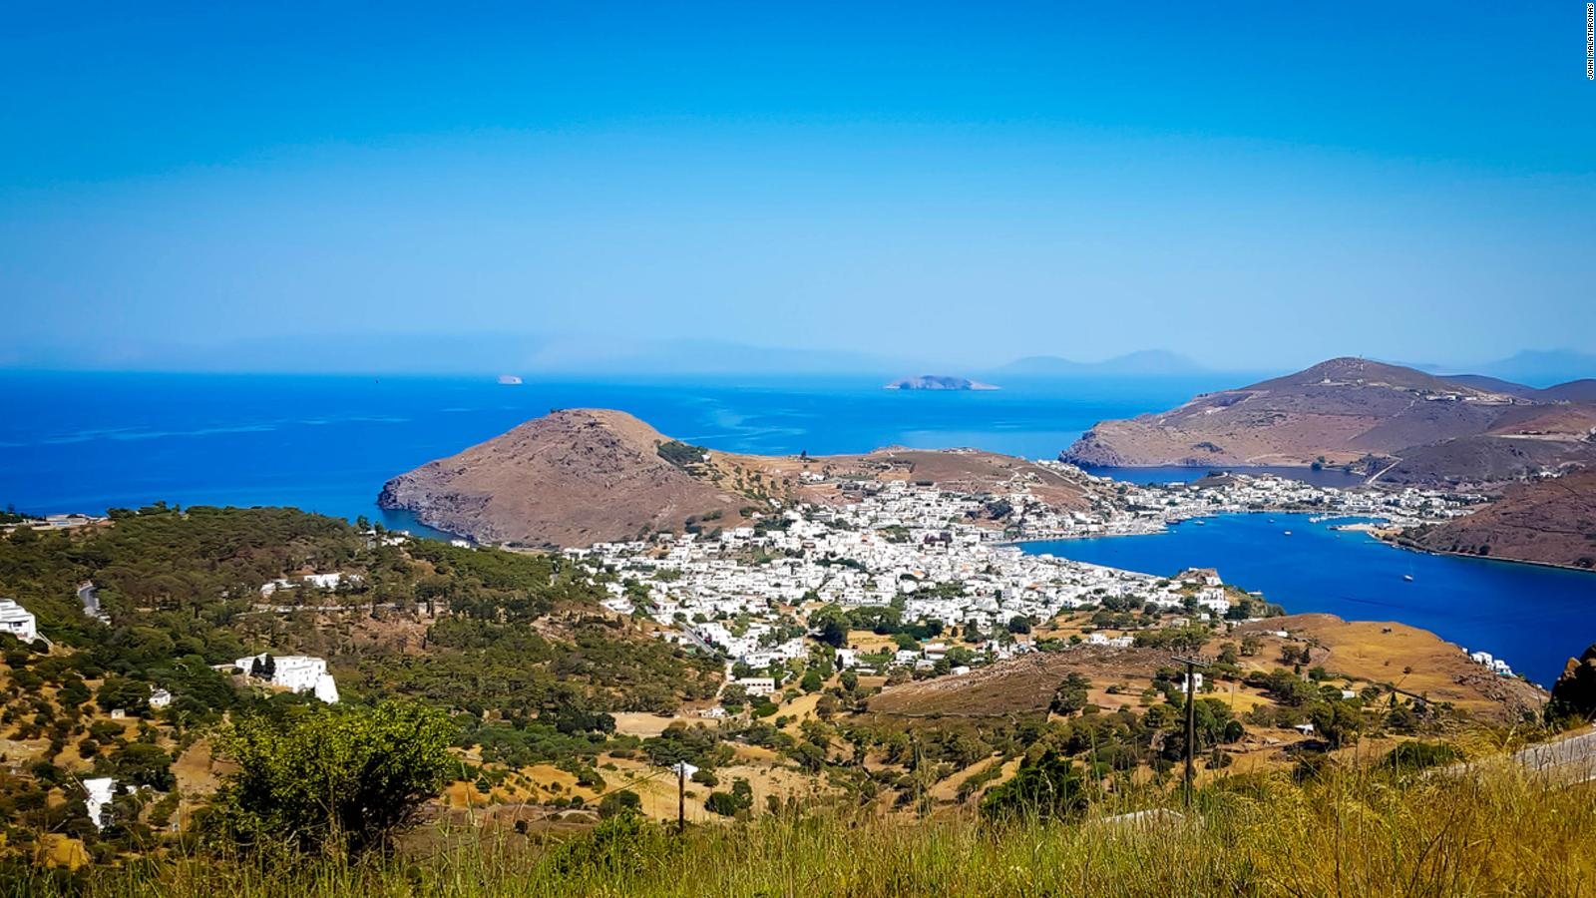
Modern Day Patmos

Slide 7
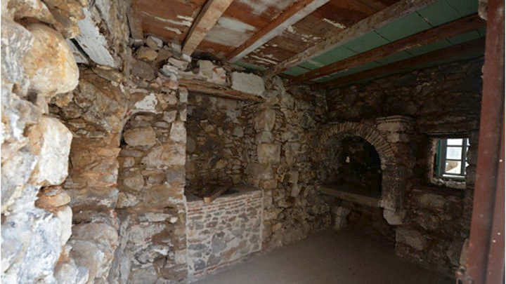
Prison Cell on Patmos

Slide 8
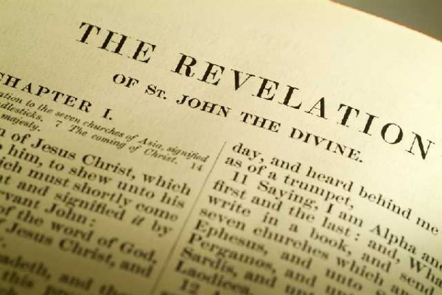
Date of the Book
Two possible dates:
  Before 70 AD (Nero)
  96 AD (Domitian)
I hold the later date.
Really does NOT matter, the dating is used to help identify the symbols in the book, BUT THE MESSAGE REMAINS THE SAME. THE SYMBOLS RELATE TO THE MESSAGE, EARLY OR LATE DATE, THE MESSAGE IS THE SAME!!
GOD AND HIS PEOPLE WILL BE VICTORIOUS!!!

Slide 9
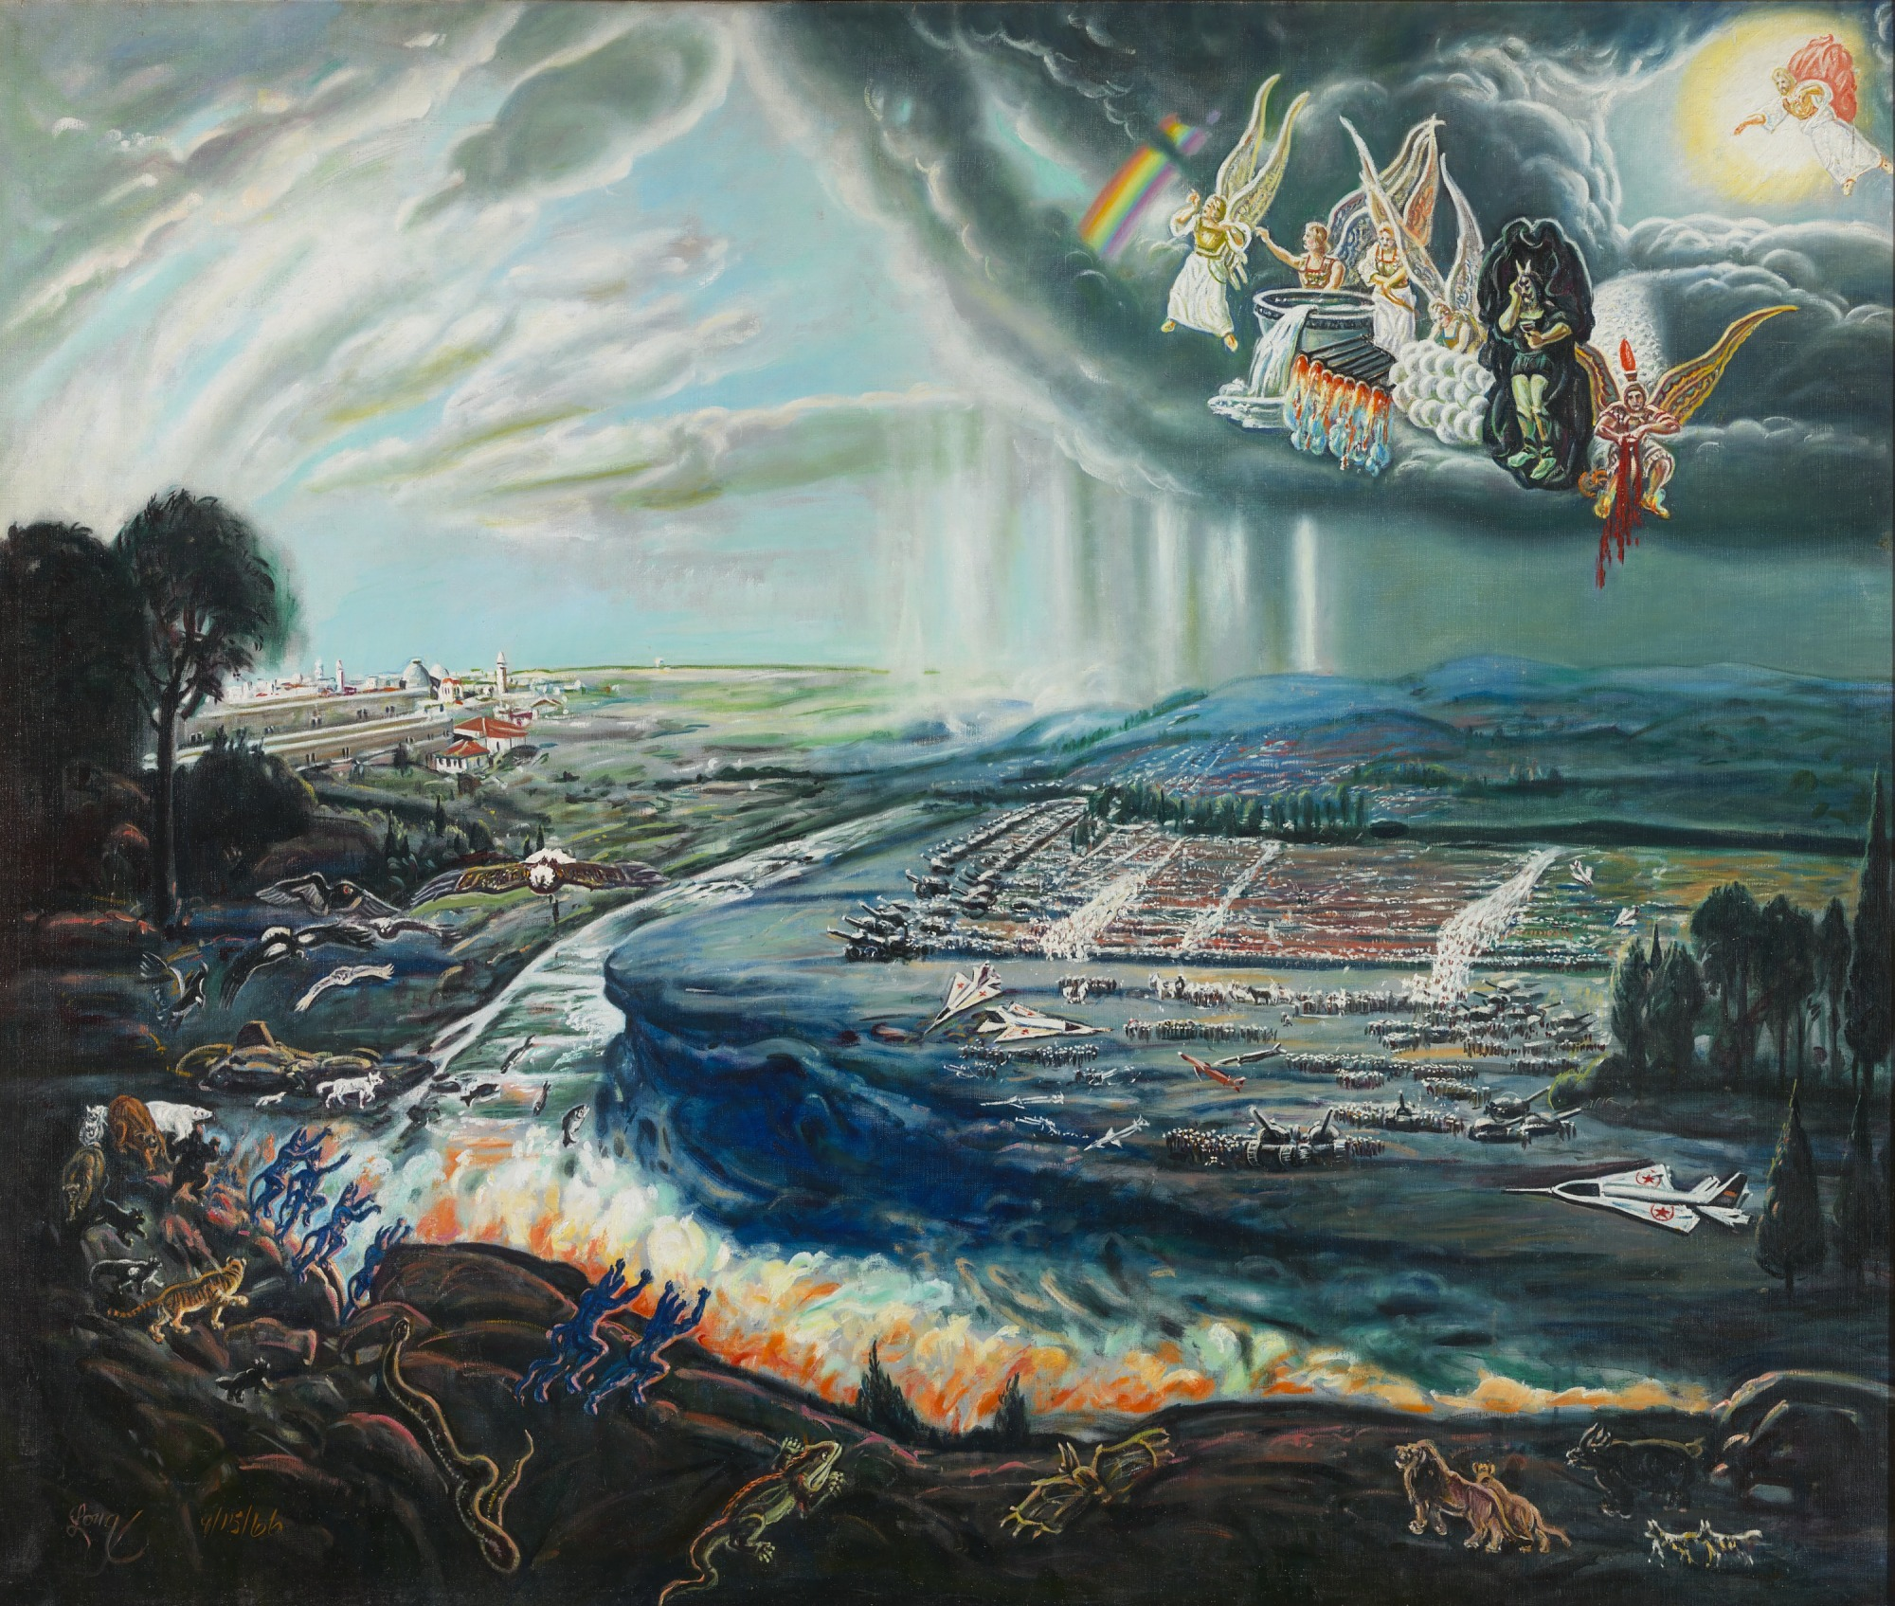
External Evidences for Dating of the Book
“In the persecution, it is handed down by
tradition that the apostle and evangelist John was
condemned to dwell on the isle of Patmos by
Domitian.”
- Eusebius (188 AD)
“For those was seen not very long since, but
Almost in our own day, toward the end of
Domitian’s reign.
- Irenaeus (140 AD)
“For when on the tyrant’s death, he returned
to Ephesus from the isle of Patmos.” (Tyrant
was Domitian according to church historian
Eusebius).
- Clement of Alexandria (193 AD)

Slide 10
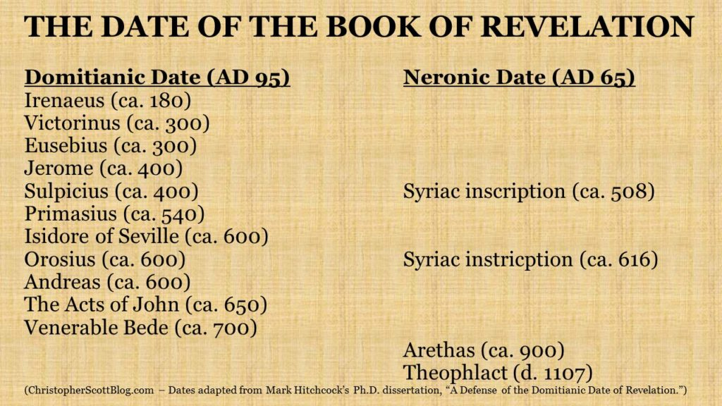

Slide 11
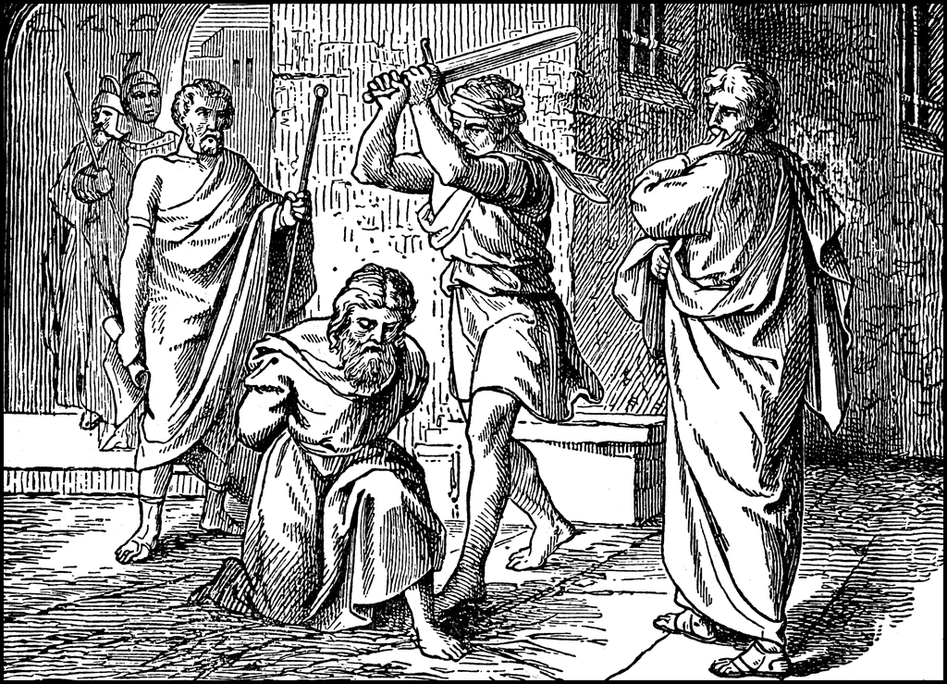
Paul
2 Timothy written in 65-68, Paul was in prison a second time when written.
Ignatius in 110 AD records that Paul was beheaded in Rome in 65-68 AD by the emperor Nero.
If book was written in 70 AD, then Paul would have very recently died and only two years or so had passed since his death for the churches to get into the shape they were in, in Revelation.

Slide 12
Internal Evidences
Ephesus – Left their first love (Rev 2:4); far cry from Ephesians 1:15
(62 AD) “the love which ye show toward all saints.”
Influence of the Nicolatians on Ephesus and Pergamum had to occur after
Paul’s influence (Rev 2:6, 15)
Laodicea has no commendation and was called “lukewarm”. In Paul’s
Letter to the Colossians (61 AD) Paul indicates Laodicea was an active
Group (4:13) and sent salutations to the brethren in Laodicea (4:15,16)
And their letter was read in Colosia.

Slide 13
Internal Evidences
Finally, there are some who claim that there is no ancient historian
who reports Domitian persecuted Christians. There are many
but there are many ancient historians who report Domitian savagely
persecuted Christians who did not bow to him and recognize him as
a god, not just solely on Christians. To explain these historians away,
some will claim they were being biased against Domitian.
“Although ancient historians speak profusely on Domitian’s savage
and immoral behavior, Leonard Thompson has argued that such claims
from historians Seutonius, Pliny and Tacitus, represent biased reporting
attempting to make Domitian look evil.”
- Oropeza, Churches Under Siege, p 178.

Slide 14
Paul
2 Timothy written in 65-68, Paul was in prison a second time when written.
Ignatius in 110 AD records that Paul was beheaded in Rome in 65-68 AD by the emperor Nero.
If book was written in 70 AD, then Paul would have very recently died and only two years or so had passed since his death for the churches to get into the shape they were in, in Revelation.
If the writing of Revelation occurred in 70 AD, and the churches were deteriorating during his lifetime . . . How would Paul have reacted?

Slide 15
Internal Evidences
So then, in essence, the general condition of the churches in
Chapters 2 and 3 would indicate that Paul’s influence was in
The distant past, and that over a course of many years the
Churches had gone from strong vibrant churches to facing
Problems and deterioration. OR, all happened quickly after
Paul’s death, like in two to four years.
Rev 6:9-11 and the cry of those under the altar indicates an
Impatient or restlessness at a long delay in vindicating Christian’s
Blood by avenging their death.

Slide 16
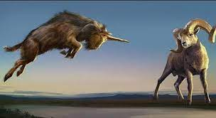
Revelation Still Unfulfilled?
POINT – Notice Dan 8:26 where Daniel is told to shut it up as it will take “MANY DAYS” to be fulfilled.
“And the vision of the evenings and mornings Which was told is true;
Therefore seal up the vision, For it refers to many days in the future.”
Took less than 400 years to be fulfilled, yet GOD says this is a long time away.
John is told THE OPPOSITE, don’t seal it up “And he said to me, “Do not seal the words of the prophecy of this book, for the time is at hand. ”
(Rev 22:10)
Could we NOT assume then that John’s prophecy must come to pass before 400 years had transpired?
According to historians, Rome fell in 455 AD, or about 359 years later.
Let’s look at Daniel 8:1 where Daniel has a vision of a ram and goat.
“In the third year of the reign of King Belshazzar a vision appeared to me—to me, Daniel—after the one that appeared to me the first time.”
The vision was fulfilled in about 164 BC (Dan 8:13,14)
¹³ Then I heard a holy one speaking; and another holy one said to that certain one who was speaking, “How long will the vision be, concerning the daily sacrifices and the transgression of desolation, the giving of both the sanctuary and the host to be trampled underfoot?” ¹⁴ And he said to me, “For two thousand three hundred days; then the sanctuary shall be cleansed.”

Slide 17
Chapter 1
GRAND THEME
Comfort in the knowledge of ultimate triumph! It may seem as if the forces of evil are winning, but Christ is in control and HIS people will be victorious!
KEY WORD OF THE BOOK
“These will make war with the lamb, and the Lamb will OVERCOME them, for He is Lord of lords and King of kings; and those who are with Him are called, chosen and faithful.”
(Rev 17:14)

