Slide 1
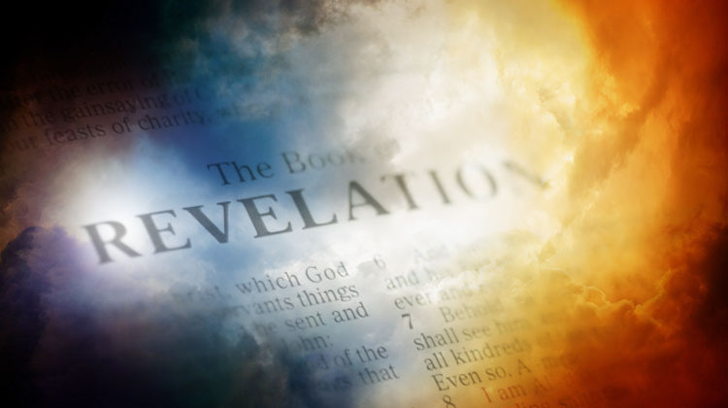
Chapter 1
GRAND THEME
Comfort in the knowledge of ultimate triumph! It may seem as if the forces of evil are winning, but Christ is in control and HIS people will be victorious!
KEY WORD OF THE BOOK
“These will make war with the lamb, and the Lamb will OVERCOME them, for He is Lord of lords and King of kings; and those who are with Him are called, chosen and faithful.”
(Rev 17:14)

Slide 2
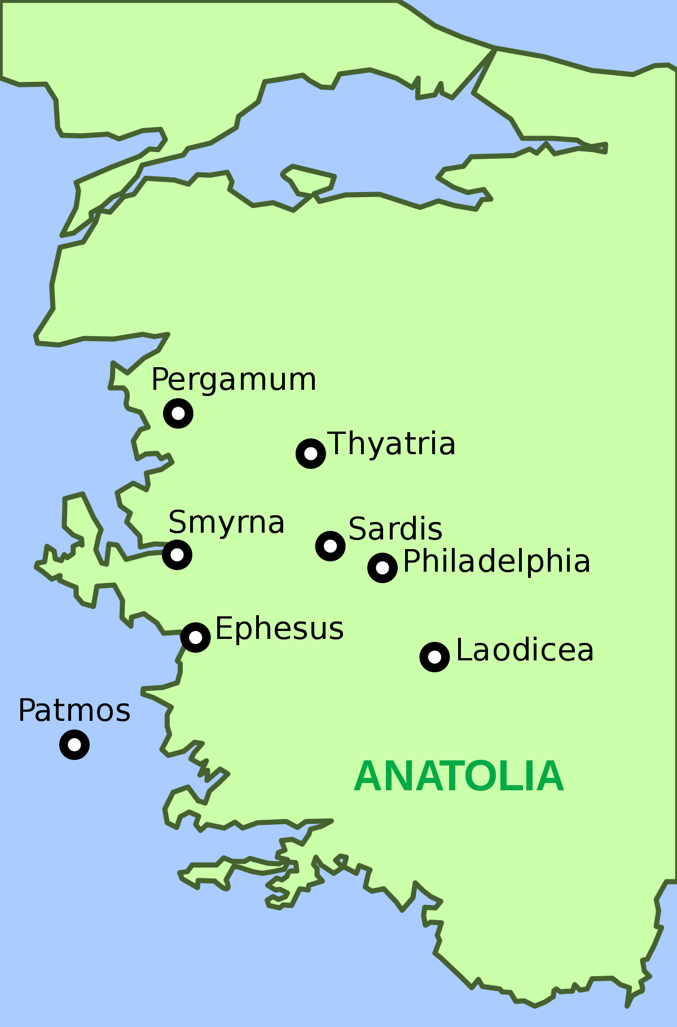

Slide 3
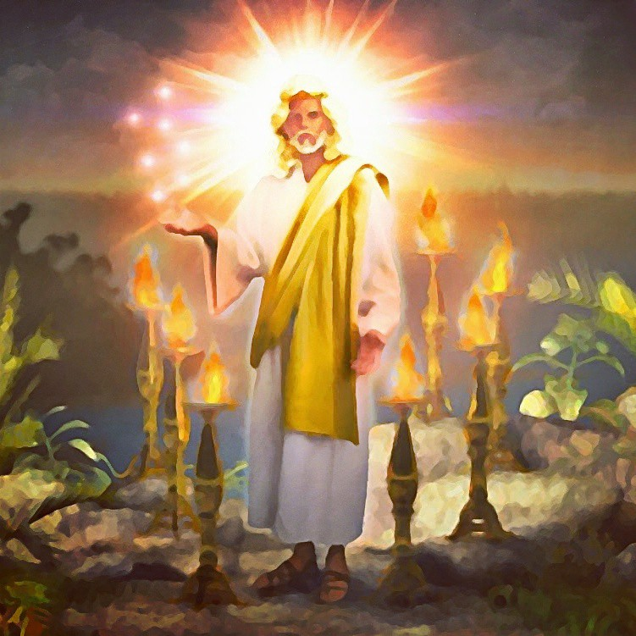
Central Theme of First Three Chapters

Slide 4
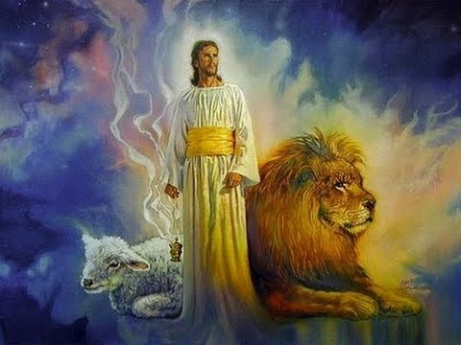
Introduction
The Revelation of Jesus Christ, which God gave Him to show His servants—things which must shortly take place. And He sent and signified it by His angel to His servant John, ² who bore witness to the word of God, and to the testimony of Jesus Christ, to all things that he saw. ³ Blessed is he who reads and those who hear the words of this prophecy, and keep those things which are written in it; for the time is near.
Chapter 1 tells of the Writer
And the AUTHOR
A message to the churches in their
greatest hour of trial.

Slide 5
Introduction
The Revelation of Jesus Christ, which God gave Him to show His servants—things which must shortly take place. And He sent and signified it by His angel to His servant John, ² who bore witness to the word of God, and to the testimony of Jesus Christ, to all things that he saw. ³ Blessed is he who reads and those who hear the words of this prophecy, and keep those things which are written in it; for the time is near.
V 3 – Eggus (time is near) – Same word found in
Mark 1:15 referencing the church/kingdom of God is about to begin “the kingdom of God is at hand.”
“And keeps those things which are written in it” – THESE folks were to keep, not those 1000s of years in the future

Slide 6
Why these churches?
⁴ John, to the seven churches which are in Asia: Grace to you and peace from Him who is and who was and who is to come, and from the seven Spirits who are before His throne, ⁵ and from Jesus Christ, the faithful witness, the firstborn from the dead, and the ruler over the kings of the earth. To Him who loved us and washed us from our sins in His own blood, ⁶ and has made us kings and priests to His God and Father, to Him be glory and dominion forever and ever. Amen. ⁷ Behold, He is coming with clouds, and every eye will see Him, even they who pierced Him. And all the tribes of the earth will mourn because of Him. Even so, Amen. ⁸ “I am the Alpha and the Omega, the Beginning and the End,” says the Lord, “who is and who was and who is to come, the Almighty.”
7 churches – In 4:5 referenced as lamps (“Seven lamps of fire were burning before the throne, which are the seven Spirits of God.”)
Referenced as 7 candlesticks later in chpt 1
Point - THESE ARE ALWAYS BEFORE GOD!!

Slide 7
Why these churches?
⁴ John, to the seven churches which are in Asia: Grace to you and peace from Him who is and who was and who is to come, and from the seven Spirits who are before His throne, ⁵ and from Jesus Christ, the faithful witness, the firstborn from the dead, and the ruler over the kings of the earth. To Him who loved us and washed us from our sins in His own blood, ⁶ and has made us kings and priests to His God and Father, to Him be glory and dominion forever and ever. Amen. ⁷ Behold, He is coming with clouds, and every eye will see Him, even they who pierced Him. And all the tribes of the earth will mourn because of Him. Even so, Amen. ⁸ “I am the Alpha and the Omega, the Beginning and the End,” says the Lord, “who is and who was and who is to come, the Almighty.”
The book of Acts tells us that there
was a church at Antioch Pisidia (Acts 13)
Colosse (Acts 19:10), Troas and
Hierapolis.

Slide 8
Why these churches?
⁴ John, to the seven churches which are in Asia: Grace to you and peace from Him who is and who was and who is to come, and from the seven Spirits who are before His throne, ⁵ and from Jesus Christ, the faithful witness, the firstborn from the dead, and the ruler over the kings of the earth. To Him who loved us and washed us from our sins in His own blood, ⁶ and has made us kings and priests to His God and Father, to Him be glory and dominion forever and ever. Amen. ⁷ Behold, He is coming with clouds, and every eye will see Him, even they who pierced Him. And all the tribes of the earth will mourn because of Him. Even so, Amen. ⁸ “I am the Alpha and the Omega, the Beginning and the End,” says the Lord, “who is and who was and who is to come, the Almighty.”
The number 7 is very important in the book
As the number is a PERFECT number.
Numbers are very important in the book and we
will study the different numbers as we progress

Slide 9
Why these churches?
⁴ John, to the seven churches which are in Asia: Grace to you and peace from Him who is and who was and who is to come, and from the seven Spirits who are before His throne, ⁵ and from Jesus Christ, the faithful witness, the firstborn from the dead, and the ruler over the kings of the earth. To Him who loved us and washed us from our sins in His own blood, ⁶ and has made us kings and priests to His God and Father, to Him be glory and dominion forever and ever. Amen. ⁷ Behold, He is coming with clouds, and every eye will see Him, even they who pierced Him. And all the tribes of the earth will mourn because of Him. Even so, Amen. ⁸ “I am the Alpha and the Omega, the Beginning and the End,” says the Lord, “who is and who was and who is to come, the Almighty.”
They were probably chosen because
these possessed qualities,
challenges, and problems congregations
throughout history have had.

Slide 10
Why these churches?
⁴ John, to the seven churches which are in Asia: Grace to you and peace from Him who is and who was and who is to come, and from the seven Spirits who are before His throne, ⁵ and from Jesus Christ, the faithful witness, the firstborn from the dead, and the ruler over the kings of the earth. To Him who loved us and washed us from our sins in His own blood, ⁶ and has made us kings and priests to His God and Father, to Him be glory and dominion forever and ever. Amen. ⁷ Behold, He is coming with clouds, and every eye will see Him, even they who pierced Him. And all the tribes of the earth will mourn because of Him. Even so, Amen. ⁸ “I am the Alpha and the Omega, the Beginning and the End,” says the Lord, “who is and who was and who is to come, the Almighty.”
V 7 – “He is coming with the clouds” points to the angelic prophecy (coming judgment) in Acts 1:11, “Men of Galilee, why do you stand gazing up into heaven? This same Jesus, who was taken up from you into heaven, will so come in like manner as you saw Him go into heaven.”

Slide 11
Revelation 1:4-8
Perhaps nothing could have served to quicken the hopes of the distressed Christians better than this vision of the exalted and triumphant Christ. It served the same purpose for John personally and those of us who are alive today.
Jesus Christ
Faithful witness
1st born from dead
Ruler over Kings
Cleansed us from our sins
Made us a kingdom of priests
He is coming; all will see Him
Beginning and End
Is
Was
Is to come
The Almighty

Slide 12
⁵ and from Jesus Christ, the faithful witness, the firstborn from the dead, and the ruler over the kings of the earth.
“When we see the mess the world is in, it’s sometimes hard for us
to believe that Christ is actually ‘the prince of the kings of the
earth.’ This is because even though Christ has the right to rule the
earth, He isn’t exercising this authority over the kings and
kingdoms at this time.”
- Hal Lindsey, There is
A New World Coming, p 26

Slide 13
⁵ and from Jesus Christ, the faithful witness, the firstborn from the dead, and the ruler over the kings of the earth.
“There are some who do not believe that Jesus is not ruling at this
very moment. They see the mess the world is in and just can’t
believe that Jesus is in charge. Was the world in a mess during
Nebechadnezzar’s day? Of course it was, and Nebechadnezzar
realized that after munching on the grass for a while.”
- Foy E Wallace

Slide 14
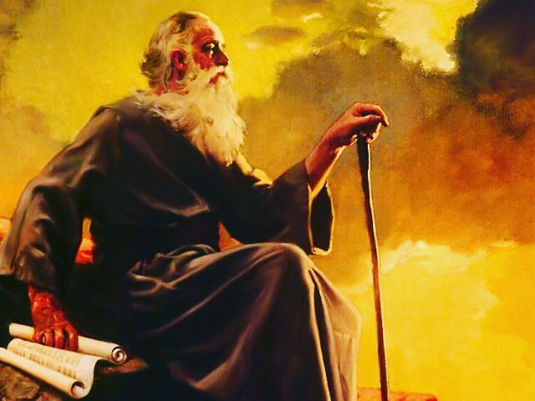
John the Writer
⁹ I, John, both your brother and companion in the tribulation and kingdom and patience of Jesus Christ, was on the island that is called Patmos for the word of God and for the testimony of Jesus Christ. ¹⁰ I was in the Spirit on the Lord’s Day, and I heard behind me a loud voice, as of a trumpet, ¹¹ saying, “I am the Alpha and the Omega, the First and the Last,” and, “What you see, write in a book and send it to the seven churches which are in Asia: to Ephesus, to Smyrna, to Pergamos, to Thyatira, to Sardis, to Philadelphia, and to Laodicea.”
Brother and Companion
In the same Tribulation
In the Spirit

Slide 15
John the Writer
⁹ I, John, both your brother and companion in the tribulation and kingdom and patience of Jesus Christ, was on the island that is called Patmos for the word of God and for the testimony of Jesus Christ. ¹⁰ I was in the Spirit on the Lord’s Day, and I heard behind me a loud voice, as of a trumpet, ¹¹ saying, “I am the Alpha and the Omega, the First and the Last,” and, “What you see, write in a book and send it to the seven churches which are in Asia: to Ephesus, to Smyrna, to Pergamos, to Thyatira, to Sardis, to Philadelphia, and to Laodicea.”
“In the Spirit” – Under the control of the Holy Spirit. Notice the following passages:
Ezekiel 3:12,14 - “¹² Then the Spirit lifted me up, and I heard behind me . . . ¹⁴ So the Spirit lifted me up and took me away, . . ..”
Ezekiel 8:3 – “. . . spirit lifted me up between earth and heaven, and brought me in visions of God to Jerusalem, . . ..”

Slide 16
John the Writer
⁹ I, John, both your brother and companion in the tribulation and kingdom and patience of Jesus Christ, was on the island that is called Patmos for the word of God and for the testimony of Jesus Christ. ¹⁰ I was in the Spirit on the Lord’s Day, and I heard behind me a loud voice, as of a trumpet, ¹¹ saying, “I am the Alpha and the Omega, the First and the Last,” and, “What you see, write in a book and send it to the seven churches which are in Asia: to Ephesus, to Smyrna, to Pergamos, to Thyatira, to Sardis, to Philadelphia, and to Laodicea.”
Acts 10 :10 – Peter – “Then he became very hungry and wanted to eat; but while they made ready, he fell into a trance”
2 Cor 12:2 - “I know a man in Christ who fourteen years ago—whether in the body I do not know, or whether out of the body I do not know, God knows—such a one was caught up to the third heaven.”

Slide 17
THE Christ
¹² Then I turned to see the voice that spoke with me. And having turned I saw seven golden lampstands, ¹³ and in the midst of the seven lampstands One like the Son of Man, clothed with a garment down to the feet and girded about the chest with a golden band. ¹⁴ His head and hair were white like wool, as white as snow, and His eyes like a flame of fire; ¹⁵ His feet were like fine brass, as if refined in a furnace, and His voice as the sound of many waters; ¹⁶ He had in His right hand seven stars, out of His mouth went a sharp two-edged sword, and His countenance was like the sun shining in its strength. ¹⁷ And when I saw Him, I fell at His feet as dead. But He laid His right hand on me, saying to me, “Do not be afraid; I am the First and the Last. ¹⁸ I am He who lives, and was dead, and behold, I am alive forevermore. Amen. And I have the keys of Hades and of Death. ¹⁹ Write the things which you have seen, and the things which are, and the things which will take place after this. ²⁰ The mystery of the seven stars which you saw in My right hand, and the seven golden lampstands: The seven stars are the angels of the seven churches, and the seven lampstands which you saw are the seven churches.

Slide 18
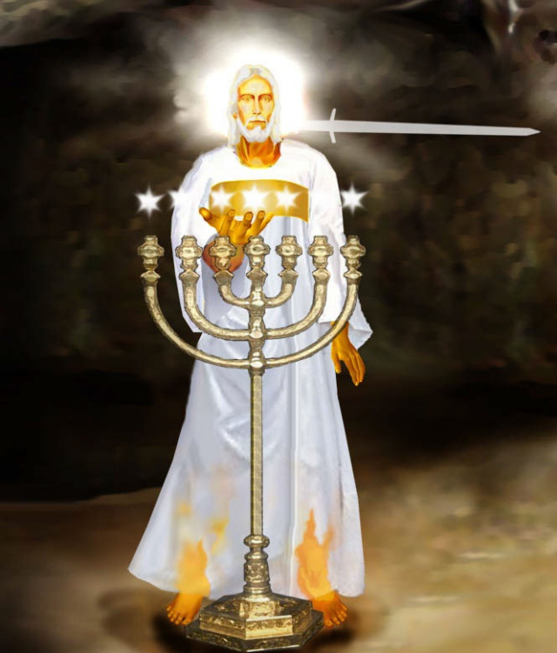
I am the FIRST and the LAST
He who lives Was Dead Alive Forevermore
Meaning of the Vision
A living, holy, majestic, omniscient,
authoritative, powerful Christ stands in the
midst of the churches, holds their destiny
in His hands and says, “Stop fearing. I was
dead. I am alive forever. More than that, I
hold in my hand the keys to death and the
grave. You should not fear to go to any
place to which I hold the key. You may be
persecuted to death, but I am still your
King.”
- Worthy Is the Lamb, p 105

Slide 19
I am the FIRST and the LAST
He who lives Was Dead Alive Forevermore
Clothes He wore – Clothes as described
were oriental mark of dignity.
Also same clothes worn by the high priest
under the Old Testament – Ex 28:39-42
Hair White as Wool – shows purity and
holiness
Eyes – Penetrating, fierce, loving all at once
Feet – Tread all enemies under foot
Voice – Powerful, strong, resolute

Slide 20
I am the FIRST and the LAST
He who lives Was Dead Alive Forevermore
Note His Description
Eyes of Fire
Sword in Mouth
He who lives, was dead, alive forever
Keys of death and hades He holds
Angels of churches in His hand
Churches are Lamps
John 16:33 – “These things I have spoken
to you, that in me you may have peace.
In the world you will have tribulation;
but be of good cheer, I have overcome
the world.”

Slide 21
I am the FIRST and the LAST
He who lives Was Dead Alive Forevermore
The lampstands formed a circle, with the glorified
Christ in the center. The churches are inseparable
from their head; He moves among them as their
King and High Priest, beholding and knowing
every facet of their life and conduct, in affliction.
He upholds all things and in Him all things adhere
(Heb 1:3; Col 1:17). He is the controlling force
and sustaining power in all congregations.”
- Revelation, Homer Hailey, p 109

Slide 22
THE LAMPS
Gold = Purity
Candlesticks = Light Bringer
Stars = Shinning in His hand – North Star leads a person home – Stars can and do lead a person home
HE IS IN THEIR MIDST!!!

Slide 23
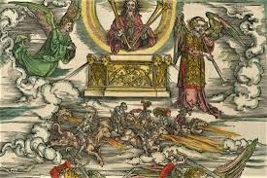
Angels of the Churches
Possibly messengers of the churches
Everything in Revelation has an angel
Milligan states: “an angel of a given thing is that thing itself in its essential nature (spiritual). It is given angelic personality to act out its part in the scheme of the book.”

Slide 24
Angels of the Churches
Note in 2:1,7 – In verse 1 it is said it is addressed to the angel of Ephesus. Then in verse 7 it says it is addressed to the church. It seems that both are one and the same.
Thus Milligan could be correct in that this description of the church as an angel would indicate how a church is viewed by God, as spiritual in nature.
Remember the rules for interpretation for the book.

