Slide 3
Central Theme of First Three Chapters

Slide 4
Letters to the 7 Churches Overview
These are chosen to show the problems/challenges that churches down through the centuries have faced. As we go through the letters we will be pointing out the problems each church faced as well as challenges and see if there are some mentioned more often than try to make some overall comments and thoughts for us today.

Slide 5
Letters to the 7 Churches Overview
In verse 23, Jesus claims that the judgment on Jezebel and her followers is to be a standing lesson to “all the churches.” and if it be true the Old Testament was written for our learning (Romans 15:4), then the same is true for these letters to the churches, written for all churches down through the ages learning.

Slide 6
“To the angel of the church of Ephesus write, ‘These things says He who holds the seven stars in His right hand, who walks in the midst of the seven golden lampstands: ² “I know your works, your labor, your patience, and that you cannot bear those who are evil. And you have tested those who say they are apostles and are not, and have found them liars; ³ and you have persevered and have patience, and have labored for My name’s sake and have not become weary. ⁴ Nevertheless I have this against you, that you have left your first love. ⁵ Remember therefore from where you have fallen; repent and do the first works, or else I will come to you quickly and remove your lampstand from its place—unless you repent. ⁶ But this you have, that you hate the deeds of the Nicolaitans, which I also hate. ⁷ “He who has an ear, let him hear what the Spirit says to the churches. To him who overcomes I will give to eat from the tree of life, which is in the midst of the Paradise of God.” ’

Slide 7
Temple of Diana
Temple of Diana was located in Ephesus. It was one of the seven wonders of the world. When Alexander conquered Ephesus, he offered to give ALL of his treasures he had and would gain from his conquest in order to put his name on ONE OF THE PILLARS.
They said no.

Slide 8
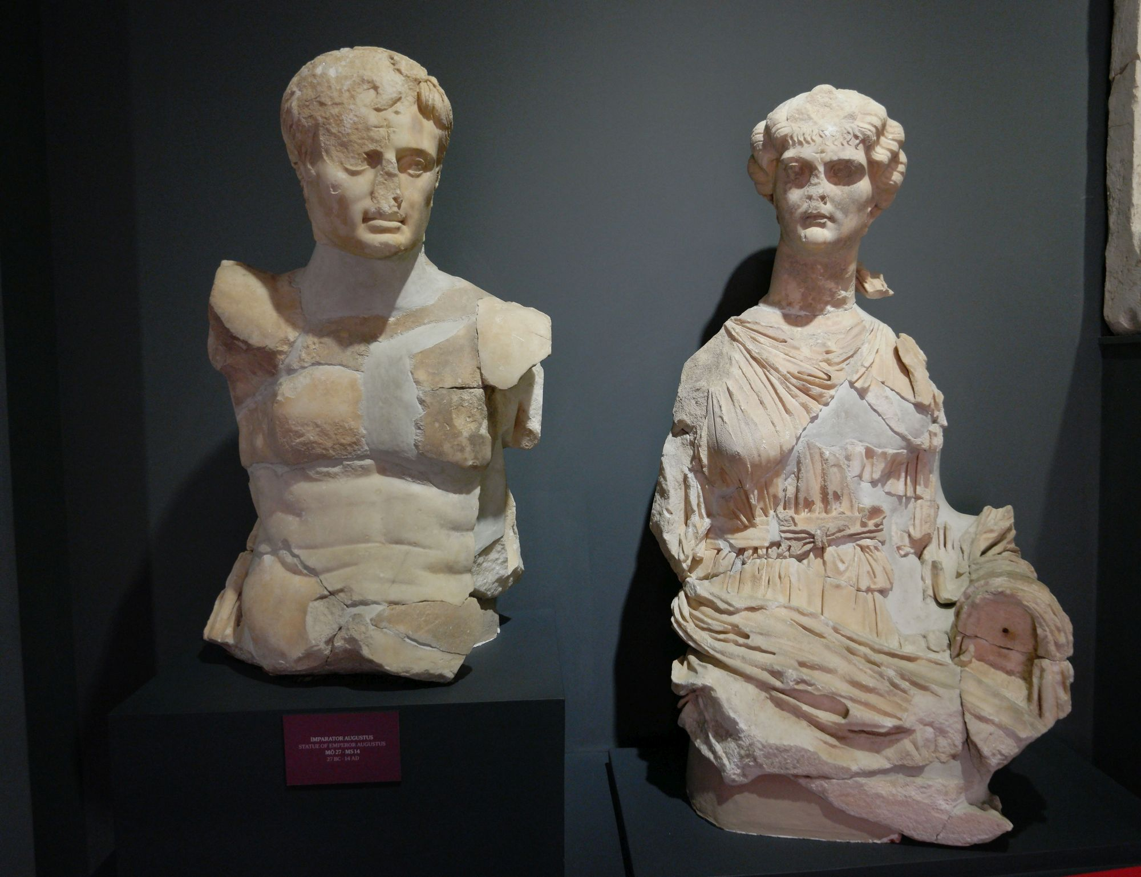
² “I know your works, your labor, your patience, and that you cannot bear those who are evil. And you have tested those who say they are apostles and are not, and have found them liars; ³ and you have persevered and have patience, and have labored for My name’s sake and have not become weary. . . ⁶ But this you have, that you hate the deeds of the Nicolaitans, which I also hate.
He KNOWS their labor, works and patience.
He KNOWS how they have persevered.
They fought false teaching
No sure who Nicolatians were.
Ephesus was the first to enforce emperor
worship in Asia Minor.

Slide 9
² “I know your works, your labor, your patience, and that you cannot bear those who are evil. And you have tested those who say they are apostles and are not, and have found them liars; ³ and you have persevered and have patience, and have labored for My name’s sake and have not become weary. . . ⁶ But this you have, that you hate the deeds of the Nicolaitans, which I also hate.
Another part of the “Code” of revelation?
“Nicolatians and Balaam as symbolic symbols and not literal? Both are similar in meaning. Nicolatians (vicar of the people) and Balaam name means “devourer of the people”. These 2 meanings of the words are significantly unite the symbols as signs of religious seductions of the libertine party.”
- Foy E Wallace
Ephesus was the first to enforce emperor
worship in Asia Minor.

Slide 10
Problems | Challenges
 | False Teachers (Ephesus) – 2:2,6

Slide 11
⁴ Nevertheless I have this against you, that you have left your first love. ⁵ Remember therefore from where you have fallen; repent and do the first works, or else I will come to you quickly and remove your lampstand from its place—unless you repent.
Problem – they left their first love
Ephesians 5 – comparison of Christ and church to marriage
They were in a loveless marriage
They were doing for Christ what they felt like doing, nothing more or less.

Slide 12
Characteristics of a Loveless Marriage
No Communication
Nonchalant Attitude (Habit only; the other is no longer special)
Selfish, focused ONLY on self
Not around one another
How are these attitudes and actions of a loveless marriage seen in a Christian’s life towards Christ?

Slide 13
How Can We Get Back to a Loving Marriage?
Prayer and study
Prioritize spiritual in our lives
We focus on REASON for doing what we do for Christ (not a habit)
Got to put our Lord and His people FIRST in our life
How do married people fall back in love with one another?

Slide 14
Problems | Challenges
Left first love (Ephesus) – 2:4,5 | False Teachers (Ephesus) – 2:2,6

Slide 15
⁸ “And to the angel of the church in Smyrna write, ‘These things says the First and the Last, who was dead, and came to life: ⁹ “I know your works, tribulation, and poverty (but you are rich); and I know the blasphemy of those who say they are Jews and are not, but are a synagogue of Satan. ¹⁰ Do not fear any of those things which you are about to suffer. Indeed, the devil is about to throw some of you into prison, that you may be tested, and you will have tribulation ten days. Be faithful until death, and I will give you the crown of life. ¹¹ “He who has an ear, let him hear what the Spirit says to the churches. He who overcomes shall not be hurt by the second death.” ’

Slide 16
Contest Winner
Smyrna was the capitol of Caesar worship. Smyrna won a contest. A contest to see who would erect a shrine to the defied Tiberius.
They took worship to the emperor VERY SERIOUSLY
Ruins of a temple in which Caesar worship
took place.

Slide 17
Dionysus Worship
The leading god of Smyrna was “Dionysus” the god of wine. Smyrna was famous for their vines.
Each year the death and resurrection of Dionysus was acted out (V 8)
So like the plagues in Egypt, much of what Christ says about Himself, is to show He is superior to the false gods.
“These things says the First and Last,
Who was dead, and came to life” (V 8)

Slide 18
⁹ “I know your works, tribulation, and poverty (but you are rich); and I know the blasphemy of those who say they are Jews and are not, but are a synagogue of Satan.
They were poor – physically and in poverty (but they were working!)
Christ focuses them on the spiritual and away from the physical
They were persecuted (a very bad combo, poor and persecuted).

Slide 19
⁹ “I know your works, tribulation, and poverty (but you are rich); and I know the blasphemy of those who say they are Jews and are not, but are a synagogue of Satan.
Being poor in this life has many challenges, so why would Jesus put the qualifier “but you are rich” SPIRITUALLY in this verse?
For any church that is poor in this world, the brethren CANNOT allow the situation in life to keep them from working or cause them to despair.

Slide 20
How can being poor be a challenge to Christians?
Limited Resources
Defeatist Attitude (I give up; Whoa is me)
Focus is wrong. View poverty as a hindrance.
For some, this all could be a hindrance/ reason for not doing.

Slide 21
Church of Macedonia and their Poverty View
The brethren in Macedonia didn’t allow their condition in life (poverty) to be an excuse to not work.
2 Corinthians 8:2 – “that in a great trail of affliction the abundance of their joy and their deep poverty abounded in the riches of their liberality.”
I don’t know if the Smyrna church viewed their poverty as a hindrance, but based on Christ’s qualifying comment “but you are rich”, I wonder if they where discouraged because their physical poverty.
We cannot allow our physical challenges in life dictate what type of Christian and work we will do or not do.

Slide 22
Smyrna Laodicia
When looking at Smyrna and Laodicia
you have two churches of extremes.
We will talk about how both, wealth
and poverty can impact your faith
negatively.

Slide 23
Both types of Christians can view their Christianity based upon their position “under the sun”
We have got to see ourselves NOT in the light under the sun, but in the light of the glorious gospel. In other words, we can do anything through Christ who strengthens us. We don’t need to look for reasons that will hinder our service. WE CANNOT DEFINE OURSELVES AS CHRISTIANS AS THE WORLD WOULD DEFINE US.
After studying the church at Laodicia, we will look at problems and challenges that face both types of Christians (wealthy and poor) so start thinking about the challenges Christians face who are either rich or poor in this present life.

Slide 24
¹⁰ Do not fear any of those things which you are about to suffer. Indeed, the devil is about to throw some of you into prison, that you may be tested, and you will have tribulation ten days. Be faithful until death, and I will give you the crown of life.
Daniel was tried 10 days (Dan 1:12-16)
Jacob was tried 10 times (Gen 31:7)
Job was tried 10 times by accusers
10 days is a period of trial and hardships which had or will come to this church.
Second time Christ mentions to this church persecutions. They were going to face some tough times.
Thesis of Book
Be faithful till death and be victorious

Slide 25
¹¹ “He who has an ear, let him hear what the Spirit says to the churches. He who overcomes shall not be hurt by the second death.” ’
VERSE 11 - Things equal to the same thing are equal to the other
2:11 Compared to 20:6
2:11 20:6
⁶ Blessed and holy is he who has part in the first resurrection. Over such the second death has no power, but they shall be priests of God and of Christ, and shall reign with Him a thousand years.
Overcoming persecutions equaled exemption from the second death.
Part in the first resurrection equaled exemption from the second death.
Therefore: the result of overcoming the persecutions was pictured as the first resurrection of the apocalypse, and was a prerequisite to the living and reigning with Christ in the triumphant state of victory that is described.

Slide 26
Problems | Challenges
Left first love (Ephesus) – 2:4,5 | False Teachers (Ephesus) – 2:2,6
 | Poor congregation (Smyrna) – 2:9
 | Persecuted (Smyrna) – 2:9

Slide 28
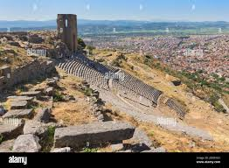
Up on a huge ledge jutting out from the hillside 800 feet or so, sat a huge altar. Smoke ascended endlessly from the sacrifices there. “No one could fail to see it since it would look like nothing so much like a great throne or seas (Barclay). Zeus sat upon that throne.

Slide 29
Revelation 2:12-17
12 “And to the angel of the church in Pergamos write, ‘These things says He who has the sharp two-edged sword: 13 “I know your works, and where you dwell, where Satan’s throne is. And you hold fast to My name, and did not deny My faith even in the days in which Antipas was My faithful martyr, who was killed among you, where Satan dwells. 14 But I have a few things against you, because you have there those who hold the doctrine of Balaam, who taught Balak to put a stumbling block before the children of Israel, to eat things sacrificed to idols, and to commit sexual immorality. 15 Thus you also have those who hold the doctrine of the Nicolaitans, which thing I hate. 16 Repent, or else I will come to you quickly and will fight against them with the sword of My mouth. 17 “He who has an ear, let him hear what the Spirit says to the churches. To him who overcomes I will give some of the hidden manna to eat. And I will give him a white stone, and on the stone a new name written which no one knows except him who receives it.” ’

Slide 30
Antipas
In the middle of the rampant heathenism and ruthless persecution, they held on. Who was Antipas? Who knows, but we do know enough. We know his faith and his message. We know his refusals. We can only guess on his sufferings. We know his influence and we know his end and reward!

Slide 31
OR
Antipas comes from the Greek word – Antipater which means:
Anti = Against
Pater = the gods
Symbolic for “one who stands against the gods”
Those members of the church would have known if Antipas was a member or this had another meaning

Slide 32
Problems | Challenges
Left first love (Ephesus) – 2:4,5 | False Teachers (Ephesus) – 2:2,6
 | Poor congregation (Smyrna) – 2:9
 | Persecuted (Smyrna) – 2:9
 | Persecuted (Pergamum) – 2:13
 | Lost a faithful member (Pergamum) – 2:13

Slide 33
Pergamum’s Problem
¹⁴ But I have a few things against you, because you have there those who hold
the doctrine of Balaam, who taught Balak to put a stumbling block before the
children of Israel, to eat things sacrificed to idols, and to commit sexual
immorality. ¹⁵ Thus you also have those who hold the doctrine of the
Nicolaitans, which thing I hate.
Doctrine of Balaam = seduce Israel into worshipping Baal and tempting men into lewdness and fornication
Could this be a reference to a teaching of immorality with outward profession of Christianity?
Nciolatians = not much known of this teaching. Was a different group from Balaamites.
Inference now – Based on what is said here, what did Christ expect from this church?

Slide 34
What did Jesus expect from them?
¹⁴ But I have a few things against you, because you have there those who hold
the doctrine of Balaam, who taught Balak to put a stumbling block before the
children of Israel, to eat things sacrificed to idols, and to commit sexual
immorality. ¹⁵ Thus you also have those who hold the doctrine of the
Nicolaitans, which thing I hate.
V 12 – Christ is described as having a sharp two-edged sword. Is this a warning to this church He is ready to war with them?
Why?
Could it be that they didn’t STOP the false teaching taking place? Discipline is necessary and expected with sin is involved (Corinthian church) and this church allowed the sin/false teaching to continue without taking action.
Now notice V 16 and the first word of the verse!

Slide 35
What did Jesus expect from them?
¹⁶ Repent, or else I will come to you quickly and will fight against them with the sword of My mouth.
REPENT!
By them permitting the false teaching to exist and continue in their presence, Christ says this is sin.
Thought Question – Why would this church or any church permit false teaching to be allowed in the church?

Slide 36
What did Jesus expect from them?
¹⁷ “He who has an ear, let him hear what the Spirit says to the churches. To him who overcomes I will give some of the hidden manna to eat. And I will give him a white stone, and on the stone a new name written which no one knows except him who receives it.” ’
Hidden Manna: Jesus claimed to be the manna from heaven – John 6:31-35
White indicates holiness, purity, etc.
Names meant a lot in the OT – Abram to Abraham; Jacob to Israel; Simon to Peter; “Desolate” and “Forsaken” (Isaiah 62:2ff) to “Beluah” and “Hephzibah”
A new name speaks of a new relationship, new status, or change of circumstance. In 19:12-13, Christ has a name no one knew.

Slide 37
Problems | Challenges
Left first love (Ephesus) – 2:4,5 | False Teachers (Ephesus) – 2:2,6
Not fighting false doctrine (Pergamum) – 2:14,15 | Poor congregation (Smyrna) – 2:9
 | Persecuted (Smyrna) – 2:9
 | Persecuted (Pergamum) – 2:13
 | Lost a faithful member (Pergamum) – 2:13

Slide 38
Thyatira
¹⁸ “And to the angel of the church in Thyatira write, ‘These things says the Son of God, who has eyes like a flame of fire, and His feet like fine brass: ¹⁹ “I know your works, love, service, faith, and your patience; and as for your works, the last are more than the first. ²⁰ Nevertheless I have a few things against you, because you allow that woman Jezebel, who calls herself a prophetess, to teach and seduce My servants to commit sexual immorality and eat things sacrificed to idols. ²¹ And I gave her time to repent of her sexual immorality, and she did not repent. ²² Indeed I will cast her into a sickbed, and those who commit adultery with her into great tribulation, unless they repent of their deeds. ²³ I will kill her children with death, and all the churches shall know that I am He who searches the minds and hearts. And I will give to each one of you according to your works. ²⁴ “Now to you I say, and to the rest in Thyatira, as many as do not have this doctrine, who have not known the depths of Satan, as they say, I will put on you no other burden. ²⁵ But hold fast what you have till I come. ²⁶ And he who overcomes, and keeps My works until the end, to him I will give power over the nations— ²⁷ ‘He shall rule them with a rod of iron; They shall be dashed to pieces like the potter’s vessels’— as I also have received from My Father; ²⁸ and I will give him the morning star. ²⁹ “He who has an ear, let him hear what the Spirit says to the churches.” ’

Slide 39
This town was a gateway to Asia Minor. It was a very important town and strongly guarded by the Romans. A town of many trade guilds. Metal workers flourished. Ramsey says that Thyatira was very much a bronze town. The trade guilds worshipped the god who worked in bronze.

Slide 40
¹⁹ “I know your works, love, service, faith, and your patience; and as for your works, the last are more than the first.
It is evident that progress was being made by SOME in Thyatira
How much is not known nor indicated. The point, GROWTH is what Jesus wants in His people
Some WERE faithful in this congregation that had such sin going on it

Slide 41
It is believed Jezebel was
an evil corrupt woman who
was claiming to have mystic
powers from God.
Don’t have to worry about
this false doctrine because
Christ said:
I WILL take care of it!
²⁰ Nevertheless I have a few things against you, because you allow that woman Jezebel, who calls herself a prophetess, to teach and seduce My servants to commit sexual immorality and eat things sacrificed to idols. ²¹ And I gave her time to repent of her sexual immorality, and she did not repent. ²² Indeed I will cast her into a sickbed, and those who commit adultery with her into great tribulation, unless they repent of their deeds. ²³ I will kill her children with death, and all the churches shall know that I am He who searches the minds and hearts. And I will give to each one of you according to your works.

Slide 42
“. . . because you ALLOW it . . ..”
Why would the faithful allow her to do such things????
Could discipline then not be said to be a sign of maturity for a congregation?
To not discipline equates to immaturity?
²⁰ Nevertheless I have a few things against you, because you allow that woman Jezebel, who calls herself a prophetess, to teach and seduce My servants to commit sexual immorality and eat things sacrificed to idols. ²¹ And I gave her time to repent of her sexual immorality, and she did not repent. ²² Indeed I will cast her into a sickbed, and those who commit adultery with her into great tribulation, unless they repent of their deeds. ²³ I will kill her children with death, and all the churches shall know that I am He who searches the minds and hearts. And I will give to each one of you according to your works.

Slide 43
Why would the faithful ALLOW her to do these things?
Can it be, they had not grown to the mature point of being willing to practice discipline?
Fear?
If this is all the case, does this mean then that practicing discipline is a sign of maturity and bravery to act in Christ?
²⁰ Nevertheless I have a few things against you, because you allow that woman Jezebel, who calls herself a prophetess, to teach and seduce My servants to commit sexual immorality and eat things sacrificed to idols. ²¹ And I gave her time to repent of her sexual immorality, and she did not repent. ²² Indeed I will cast her into a sickbed, and those who commit adultery with her into great tribulation, unless they repent of their deeds. ²³ I will kill her children with death, and all the churches shall know that I am He who searches the minds and hearts. And I will give to each one of you according to your works.

Slide 44
Problems | Challenges
Left first love (Ephesus) – 2:4,5 | False Teachers (Ephesus) – 2:2,6
Not fighting false doctrine (Pergamum) – 2:14,15 | Poor congregation (Smyrna) – 2:9
Permitting False Teaching (Thyatira) – 2:20-23 | Persecuted (Smyrna) – 2:9
 | Persecuted (Pergamum) – 2:13
 | Lost a faithful member (Pergamum) – 2:13

Slide 45
²¹ And I gave her time to repent of her sexual immorality, and she did not repent. ²² Indeed I will cast her into a sickbed, and those who commit adultery with her into great tribulation, unless they repent of their deeds.
God gave Jezebel time to repent
All will have time to repent
THIS IS A SECONDARY THEME OF THE BOOK
An answer to the question, why does God allow Christians to suffer?

Slide 46
²⁴ “Now to you I say, and to the rest in Thyatira, as many as do not have this doctrine, who have not known the depths of Satan, as they say, I will put on you no other burden. ²⁵ But hold fast what you have till I come.
As we look at Thyatira and then Sardis, notice that there was horrendous false teaching and sin occurring AND faithful brethren in attendance. After we are done with Sardis, we will look at what Jesus tells these faithful brethren to do and what he does not tell them to do.

Slide 47
Notes about BOTH Thyatira and Pergamum
Both had false teaching in the church
Both are seemingly permitting it
But both STILL HAD FAITHFUL
Jesus was going to deal with both situations
But He still expects the church to do something as well

Slide 48
Problems | Challenges
Left first love (Ephesus) – 2:4,5 | False Teachers (Ephesus) – 2:2,6
Not fighting false doctrine (Pergamum) – 2:14,15 | Poor congregation (Smyrna) – 2:9
Permitting False Teaching (Thyatira) – 2:20-23 | Persecuted (Smyrna) – 2:9
 | Persecuted (Pergamum) – 2:13
 | Lost a faithful member (Pergamum) – 2:13
 | Needed to Fight False Teaching – (Thyatira) – 2:24

