Slide 2
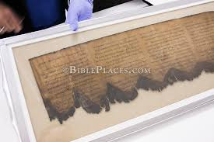

Slide 4
The Law (Torah): Genesis, Exodus, Leviticus, Numbers, Deuteronomy
Prophets (Nevim):
1. Former prophets: Joshua, Judges, Samuel, Kings
2. Latter prophets: Isaiah, Jeremiah, Ezekiel, The 12
The Writings: Psalms, Job, Proverbs, Ecclesiastes, Ruth, Lamentations, Song of Solomon, Esther, Daniel, Ezra-Nehemiah, Chronicles

