Slide 1
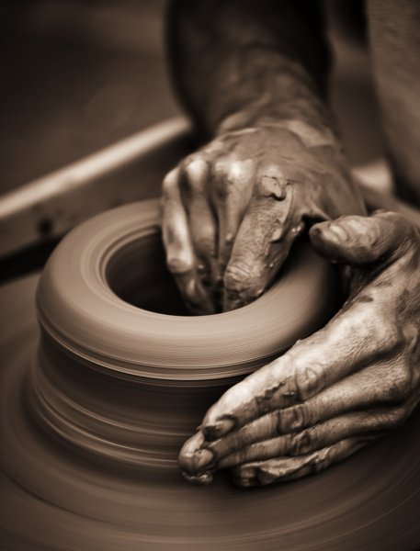
Developing Positive Christian Character
Workbook by Roger Hillis

Slide 2
Developing Positive Christian Character
HUMILITY
RESPECT
MATURITY
KINDNESS
DILIGENCE
PERSEVERANCE
FAITHFULNESS
CONTENTMENT
COURAGE
INTEGRITY
COMPASSION
MORAL PURITY

Slide 3
PERSEVERANCE
Words used interchangeably: perseverance, patience, endurance, longsuffering, & steadfastness
“Perseverance in performing a task; endurance without complaining”
Enables us to wait calmly for a result, to “keep on keeping on”
HUMILITY
RESPECT
MATURITY
KINDNESS
DILIGENCE
FAITHFULNESS
CONTENTMENT
COURAGE
INTEGRITY
COMPASSION
MORAL PURITY

Slide 4
PERSEVERANCE
“Nothing in the world can take the place of persistence. Talent will not; nothing is more common than unsuccessful men with talent. Genius will not; unrewarded genius is almost a proverb. Education will not; the world is full of educated derelicts. Persistence and determination alone are omnipotent.” (Calvin Coolidge)
HUMILITY
RESPECT
MATURITY
KINDNESS
DILIGENCE
FAITHFULNESS
CONTENTMENT
COURAGE
INTEGRITY
COMPASSION
MORAL PURITY

Slide 5
PERSEVERANCE
The Bible on Perseverance:
“I press toward the goal for the prize of the upward call of God in Christ Jesus.” (Phil. 3:14)
“For this reason I also suffer these things; nevertheless I am not ashamed, for I know whom I have believed and am persuaded that He is able to keep what I have committed to Him until that Day.” (2 Tim. 1:12)
“Therefore, my beloved brethren, be steadfast, immovable, always abounding in the work of the Lord, knowing that your labor is not in vain in the Lord.” (1 Cor. 15:58)
HUMILITY
RESPECT
MATURITY
KINDNESS
DILIGENCE
FAITHFULNESS
CONTENTMENT
COURAGE
INTEGRITY
COMPASSION
MORAL PURITY

Slide 6
PERSEVERANCE
Bible Examples of Perseverance
Noah
Joseph
Moses
Job
HUMILITY
RESPECT
MATURITY
KINDNESS
DILIGENCE
FAITHFULNESS
CONTENTMENT
COURAGE
INTEGRITY
COMPASSION
MORAL PURITY

Slide 7
PERSEVERANCE
Patience vs Explosive Temper
Is anger wrong? Verses?
What about wrath? Verses?
What about being quick-tempered? Verses?
What kinds of things make you impatient with people & situations?
HUMILITY
RESPECT
MATURITY
KINDNESS
DILIGENCE
FAITHFULNESS
CONTENTMENT
COURAGE
INTEGRITY
COMPASSION
MORAL PURITY

Slide 8
PERSEVERANCE
Endurance in Hebrews
3:6
4:1
4:9-11
6:11-12
10:23
10:36-39
12:1-2
HUMILITY
RESPECT
MATURITY
KINDNESS
DILIGENCE
FAITHFULNESS
CONTENTMENT
COURAGE
INTEGRITY
COMPASSION
MORAL PURITY

Slide 9
PERSEVERANCE
Galatians 6:9
What are some things that have discouraged you spiritually in the past?
Why does the verse say we shouldn’t give up?
Practical suggestions to overcome discouragement in your life?
HUMILITY
RESPECT
MATURITY
KINDNESS
DILIGENCE
FAITHFULNESS
CONTENTMENT
COURAGE
INTEGRITY
COMPASSION
MORAL PURITY

Slide 10
PERSEVERANCE
2 Corinthians 11:23-29
Which of these trials of Paul do you think would have been the worst?
Is there any one (or more) of these that would have made you say, “That’s it; I’ve had enough”? Be honest with yourself.
HUMILITY
RESPECT
MATURITY
KINDNESS
DILIGENCE
FAITHFULNESS
CONTENTMENT
COURAGE
INTEGRITY
COMPASSION
MORAL PURITY

Slide 11
PERSEVERANCE
Final thoughts
“My brethren, count it all joy when you fall into various trials, knowing that the testing of your faith produces patience. But let patience have its perfect work, that you may be perfect and complete, lacking nothing.” (James 1:2-4)
HUMILITY
RESPECT
MATURITY
KINDNESS
DILIGENCE
FAITHFULNESS
CONTENTMENT
COURAGE
INTEGRITY
COMPASSION
MORAL PURITY

Slide 12
PERSEVERANCE
Final thoughts
“Therefore, having been justified by faith, we have peace with God through our Lord Jesus Christ, 2 through whom also we have access by faith into this grace in which we stand, and rejoice in hope of the glory of God. 3 And not only that, but we also glory in tribulations, knowing that tribulation produces perseverance; 4 and perseverance, character; and character, hope.” (Romans 5:1-4)
HUMILITY
RESPECT
MATURITY
KINDNESS
DILIGENCE
FAITHFULNESS
CONTENTMENT
COURAGE
INTEGRITY
COMPASSION
MORAL PURITY

Slide 13
Developing Positive Christian Character
PERSEVERANCE
Let us continue daily to develop:
Faithfulness
Contentment
Courage
Integrity
Compassion
Moral Purity
Humility
Respect
Maturity
Kindness
Diligence
Perseverance
HUMILITY
RESPECT
MATURITY
KINDNESS
DILIGENCE
FAITHFULNESS
CONTENTMENT
COURAGE
INTEGRITY
COMPASSION
MORAL PURITY

Slide 14
Developing Positive Christian Character
HUMILITY
RESPECT
MATURITY
KINDNESS
DILIGENCE
PERSEVERANCE
FAITHFULNESS
CONTENTMENT
COURAGE
INTEGRITY
COMPASSION
MORAL PURITY

