Slide 1
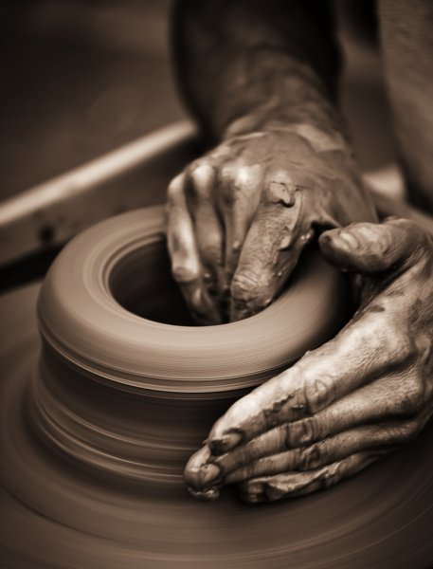
Developing Positive Christian Character
Workbook by Roger Hillis

Slide 2
Developing Positive Christian Character
HUMILITY
RESPECT
MATURITY
KINDNESS
DILIGENCE
PERSEVERANCE
FAITHFULNESS
CONTENTMENT
COURAGE
INTEGRITY
COMPASSION
MORAL PURITY

Slide 3
HUMILITY
Pride in Proverbs
List type of pride & how seen these proverbs come true.
6:16-17
8:13
11:2
13:10
14:3
15:25
15:33
16:5
16:18
16:19
18:12
21:24
22:4
25:6-7
28:25
29:23
RESPECT
MATURITY
KINDNESS
DILIGENCE
PERSEVERANCE
FAITHFULNESS
CONTENTMENT
COURAGE
INTEGRITY
COMPASSION
MORAL PURITY

Slide 4
HUMILITY
What are some results of being filled with pride?
Not admitting faults
Not admitting when wrong so won’t correct
Not looking at Bible to compare self to but rather comparing self to weaker Christians to prove “worth”
Blind to needs of others
In the end, destruction
RESPECT
MATURITY
KINDNESS
DILIGENCE
PERSEVERANCE
FAITHFULNESS
CONTENTMENT
COURAGE
INTEGRITY
COMPASSION
MORAL PURITY

Slide 5
HUMILITY
What are some results of being a person of humility?
Realize their need for mercy, forgiveness, & God
Treat others above yourself
Peace
Exalted in heaven
RESPECT
MATURITY
KINDNESS
DILIGENCE
PERSEVERANCE
FAITHFULNESS
CONTENTMENT
COURAGE
INTEGRITY
COMPASSION
MORAL PURITY

Slide 6
Developing Positive Christian Character
HUMILITY
“in like manner also, that the women adorn themselves in modest apparel, with propriety and moderation, not with braided hair or gold or pearls or costly clothing, but, which is proper for women professing godliness, with good works.”(1 Tim. 2:9-10)
How does 1 Tim. 2:9-10 connect modesty & humility?
RESPECT
MATURITY
KINDNESS
DILIGENCE
PERSEVERANCE
FAITHFULNESS
CONTENTMENT
COURAGE
INTEGRITY
COMPASSION
MORAL PURITY

Slide 7
Developing Positive Christian Character
HUMILITY
RESPECT
MATURITY
KINDNESS
DILIGENCE
PERSEVERANCE
FAITHFULNESS
CONTENTMENT
COURAGE
INTEGRITY
COMPASSION
MORAL PURITY

Slide 8
RESPECT
Respect for others seems to be lacking in modern society
To think about, speak about and act toward others in a way that shows honor & esteem (high regard)
Needs to be taught in home with children (respect for parents → teachers & admins at school → civil government → superiors at job)
Children MUST be shown proper respect for rights & property of others
Leads young to respect their elders & ultimately God
HUMILITY
MATURITY
KINDNESS
DILIGENCE
PERSEVERANCE
FAITHFULNESS
CONTENTMENT
COURAGE
INTEGRITY
COMPASSION
MORAL PURITY

Slide 9
RESPECT
Respect for Parents (Eph. 6:1-3)
How do you show respect or honor parents?
Difference between respecting them as parents & respecting their actions?
If lousy sinful parents – not have to show respect? Why?
If disagree with parents, what to do?
How should disrespectful children be disciplined?
Use of spanking?
If OT rule of “he who curses [treat with contempt/bring dishonor] father or mother shall surely be put to death” (Ex. 21:17), how long would you have lasted?
HUMILITY
MATURITY
KINDNESS
DILIGENCE
PERSEVERANCE
FAITHFULNESS
CONTENTMENT
COURAGE
INTEGRITY
COMPASSION
MORAL PURITY

Slide 10
RESPECT
Respect for Parents (Eph. 6:1-3)
Being respectful in Proverbs called “wise”; not showing respect is called a “fool”.
Proverbs to challenge our relationship with parents:
Pro. 10:1
Pro. 13:1
Pro. 15:5
Pro. 15:20
Pro. 19:26-27
Pro. 20:20
Pro. 23:22, 24-25
HUMILITY
MATURITY
KINDNESS
DILIGENCE
PERSEVERANCE
FAITHFULNESS
CONTENTMENT
COURAGE
INTEGRITY
COMPASSION
MORAL PURITY

