Slide 1
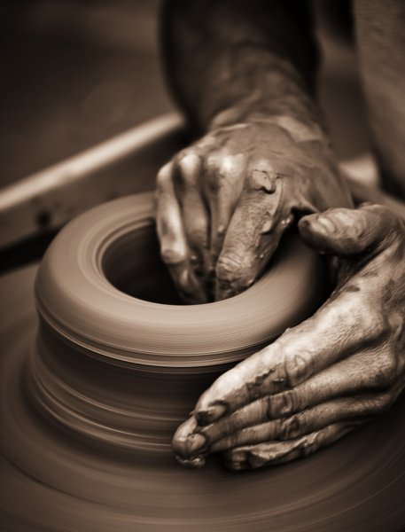
Developing Positive Christian Character
Workbook by Roger Hillis

Slide 2
Developing Positive Christian Character
HUMILITY
RESPECT
MATURITY
KINDNESS
DILIGENCE
PERSEVERANCE
FAITHFULNESS
CONTENTMENT
COURAGE
INTEGRITY
COMPASSION
MORAL PURITY

Slide 3
COMPASSION
Barnabas – “Son of Encouragement” – Who & how?
Acts 4:32-37
Acts 9:27
Acts 11:22-26
Acts 15:36-39
HUMILITY
RESPECT
MATURITY
KINDNESS
DILIGENCE
PERSEVERANCE
FAITHFULNESS
CONTENTMENT
COURAGE
INTEGRITY
MORAL PURITY

Slide 4
Developing Positive Christian Character
COMPASSION
Phil. 2:3-4 – “Let nothing be done through selfish ambition or conceit, but in lowliness of mind let each esteem others better than himself. Let each of you look out not only for his own interests, but also for the interests of others.”
Some specific ways to show compassion (to family, friends, co-workers, etc)
HUMILITY
RESPECT
MATURITY
KINDNESS
DILIGENCE
PERSEVERANCE
FAITHFULNESS
CONTENTMENT
COURAGE
INTEGRITY
MORAL PURITY

Slide 5
Developing Positive Christian Character
HUMILITY
RESPECT
MATURITY
KINDNESS
DILIGENCE
PERSEVERANCE
FAITHFULNESS
CONTENTMENT
COURAGE
INTEGRITY
COMPASSION
MORAL PURITY

Slide 6
MORAL PURITY
“Pure and undefiled religion before God and the Father is this: to visit orphans and widows in their trouble, and to keep oneself unspotted from the world.” (Jas. 1:27)
Christians are to keep themselves morally pure; radically different from the world.
Eph. 5:3
NKJV – “But fornication and all uncleanness or covetousness, let it not even be named among you, as is fitting for saints;”
HUMILITY
RESPECT
MATURITY
KINDNESS
DILIGENCE
PERSEVERANCE
FAITHFULNESS
CONTENTMENT
COURAGE
INTEGRITY
COMPASSION

Slide 7
MORAL PURITY
“Pure and undefiled religion before God and the Father is this: to visit orphans and widows in their trouble, and to keep oneself unspotted from the world.” (Jas. 1:27)
Christians are to keep themselves morally pure; radically different from the world.
Eph. 5:3
CSB – “But sexual immorality and any impurity or greed should not even be heard of among you, as is proper for saints.”
HUMILITY
RESPECT
MATURITY
KINDNESS
DILIGENCE
PERSEVERANCE
FAITHFULNESS
CONTENTMENT
COURAGE
INTEGRITY
COMPASSION

Slide 8
MORAL PURITY
“Pure and undefiled religion before God and the Father is this: to visit orphans and widows in their trouble, and to keep oneself unspotted from the world.” (Jas. 1:27)
Christians are to keep themselves morally pure; radically different from the world.
Eph. 5:3
NIV – “But among you there must not be even a hint of sexual immorality, or of any kind of impurity, or of greed, because these are improper for God’s holy people.”
HUMILITY
RESPECT
MATURITY
KINDNESS
DILIGENCE
PERSEVERANCE
FAITHFULNESS
CONTENTMENT
COURAGE
INTEGRITY
COMPASSION

Slide 9
MORAL PURITY
As discussed Wed. night with apostasy, Satan entices us to take small steps (not huge leaps) from purity.
Syn: Righteousness, holiness, godliness, sanctification, virtue
“Do not lay hands on anyone hastily, nor share in other people’s sins; keep yourself pure.” (1 Tim. 5:22)
“Let no one despise your youth, but be an example to the believers in word, in conduct, in love, in spirit, in faith, in purity.” (1 Tim. 4:12)
Comes from being pure in heart. (Matt. 5:8)
HUMILITY
RESPECT
MATURITY
KINDNESS
DILIGENCE
PERSEVERANCE
FAITHFULNESS
CONTENTMENT
COURAGE
INTEGRITY
COMPASSION

Slide 10
MORAL PURITY
2 Timothy 2:22
What are examples of “youthful lusts”?
What does it mean to “flee”?
Why pursue righteousness, faith, love & peace?
“Flee … but pursue …”
Relationship between these and calling on the Lord “out of a “pure heart”?
HUMILITY
RESPECT
MATURITY
KINDNESS
DILIGENCE
PERSEVERANCE
FAITHFULNESS
CONTENTMENT
COURAGE
INTEGRITY
COMPASSION

Slide 11
MORAL PURITY
Ephesians 5:3-7
Define these words listing forms or impurity.
Fornication
Uncleanness
Covetousness
Filthiness
Foolish talking
Coarse jesting
HUMILITY
RESPECT
MATURITY
KINDNESS
DILIGENCE
PERSEVERANCE
FAITHFULNESS
CONTENTMENT
COURAGE
INTEGRITY
COMPASSION

Slide 12
MORAL PURITY
Genesis 39:1-20
How old was Joseph?
Gen. 37:2 – 17 years old before pit, Midianites, & Potiphar
41:46 - 30 years old
41:1: “After 2 years” so at end of ch. 40 – 28
Given time to earn keeper of prison’s favor and for Joseph to gain authority (39:21-23) before butler & baker are imprisoned and then interpret dream, have butler released & baker hanged and then time for butler to not remember Joseph (40:23) – estimated around 20-25
HUMILITY
RESPECT
MATURITY
KINDNESS
DILIGENCE
PERSEVERANCE
FAITHFULNESS
CONTENTMENT
COURAGE
INTEGRITY
COMPASSION

Slide 13
MORAL PURITY
Genesis 39:1-20
How old was Joseph?
Who would have known if Joseph had laid with Potiphar’s wife?
How does v. 9 describe why Joseph’s refused her advances?
What does account ending with Joseph in jail teach us about consequences of doing the right thing?
What do we learn from verse 5?
HUMILITY
RESPECT
MATURITY
KINDNESS
DILIGENCE
PERSEVERANCE
FAITHFULNESS
CONTENTMENT
COURAGE
INTEGRITY
COMPASSION

