Slide 1
Church History
Apostasy, Reformation, and Restoration

Slide 2
Apostasy (12th - 13th Century)
Lesson 6: Birth of Reformation
Petrobrusians
Henricians
Waldensians

Slide 3
What were some reasons Christianity continued to grow during these times of persecutions?

Slide 4
What were some reasons Christianity continued to grow during these times of persecutions?
Salvation

Slide 5
What were some reasons Christianity continued to grow during these times of persecutions?
Salvation
The Idea of a witnessed Human/God that Lived and died for the People

Slide 6
What were some reasons Christianity continued to grow during these times of persecutions?
Salvation
The Idea of a witnessed Human/God that Lived and died for the People
Salvation by Baptism over pain or expense initiation rites

Slide 7
What were some reasons Christianity continued to grow during these times of persecutions?
Salvation
The Idea of a witnessed Human/God that Lived and died for the People
Salvation by Baptism over pain or expense initiation rites
The offer of a personal relationship with God

Slide 8
What were some reasons Christianity continued to grow during these times of persecutions?
Salvation
The Idea of a witnessed Human/God that Lived and died for the People
Salvation by Baptism over pain or expense initiation rites
The offer of a personal relationship with God
The idea that people would help each other simply by Loving each other

Slide 9
What were some reasons Christianity continued to grow during these times of persecutions?
Salvation
The Idea of a witnessed Human/God that Lived and died for the People
Salvation by Baptism over pain or expense initiation rites
The offer of a personal relationship with God
The idea that people would help each other simply by Loving each other
Colossians 3:10-11 A since of belonging

Slide 10
False Teaching in the Catholic Church
Infant Baptism
The veneration of the Cross
Transubstantiation
Prayers for the Dead

Slide 11
False Teaching in the Catholic Church
Infant Baptism
Irenaeus and Tertullian

Slide 12
False Teaching in the Catholic Church
Infant Baptism
Irenaeus (185 AD) and Tertullian (210 AD)

Slide 13
False Teaching in the Catholic Church
Infant Baptism
Irenaeus (185 AD)
He came to save all through means of Himself—all … who through Him are born again to God—infants, and children, and boys, and youths, and old men. He therefore passed through every age, becoming an infant for infants, thus sanctifying infants; a child for children, thus sanctifying those who are of this age, being at the same time made to them an example of piety, righteousness, and submission … (Against Heresies II:22:4)

Slide 14
False Teaching in the Catholic Church
Infant Baptism
Tertullian (210 AD)
According to the circumstances and disposition, and even age, of each individual, the delay of baptism is preferable; principally, however, in the case of little children. … The Lord does indeed say, "Do not forbid them to come to me." Let them come, then, while they are growing up! Let them "come" while they are learning, while they are learning where to come to! Let them become Christians when they have become able to know Christ.† Why does the innocent period of life hasten to the remission of sins? … Let them know how to ask for salvation, that you may seem to have given "to him that asks." (On Baptism 18)

Slide 15
False Teaching in the Catholic Church
Infant Baptism
Colossians 2:11-13
11 In Him you were also circumcised with the circumcision made without hands, by putting off the body of the sins of the flesh, by the circumcision of Christ, 12 buried with Him in baptism, in which you also were raised with Him through faith in the working of God, who raised Him from the dead. 13 And you, being dead in your trespasses and the uncircumcision of your flesh, He has made alive together with Him, having forgiven you all trespasses,

Slide 16
False Teaching in the Catholic Church
Infant Baptism
Acts 16:33
33 And he took them the same hour of the night and washed their stripes. And immediately he and all his family were baptized.
Acts 18:8
8 Then Crispus, the ruler of the synagogue, believed on the Lord with all his household. And many of the Corinthians, hearing, believed and were baptized.

Slide 17
False Teaching in the Catholic Church
Infant Baptism
The veneration of the Cross

Slide 18
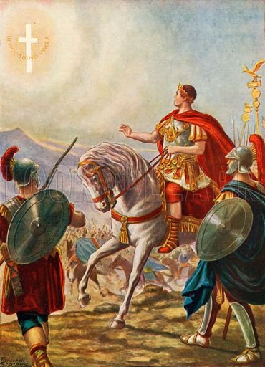
False Teaching in the Catholic Church
The veneration of the Cross (After 325 AD)
The crucifixion and death of Jesus on the cross conferred a new significance to the use of the cross in Christianity. The cross was used privately among Christians and its purpose was restricted. After the Constantine, the use of the cross was acknowledged as a symbol of Christianity.

Slide 19
False Teaching in the Catholic Church
Infant Baptism
The veneration of the Cross
Transubstantiation

Slide 20
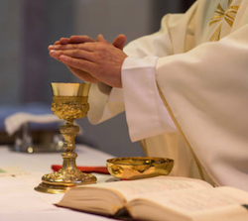
False Teaching in the Catholic Church
Transubstantiation (Change the substance)
According to the teaching of the Catholic Church, "the change of the whole substance of bread into the substance of the Body of Christ and of the whole substance of wine into the substance of his Blood"

Slide 21
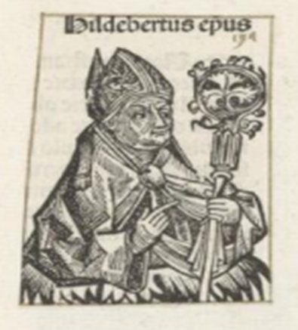
False Teaching in the Catholic Church
Transubstantiation (Change the substance)
Hildebert de Lavardin, Archbishop of Tours. (11th Century)

Slide 22
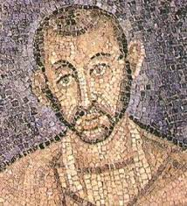
False Teaching in the Catholic Church
Transubstantiation (Change the substance)
Ambrose the Bishop of Milan (Approx. 380 AD)
Perhaps you will say, "I see something else, how is it that you assert that I receive the Body of Christ?" ...Let us prove that this is not what nature made, but what the blessing consecrated, and the power of blessing is greater than that of nature, because by blessing nature itself is changed. ...For that sacrament which you receive is made what it is by the word of Christ. But if the word of Elijah had such power as to bring down fire from heaven, shall not the word of Christ have power to change the nature of the elements? ...Why do you seek the order of nature in the Body of Christ, seeing that the Lord Jesus Himself was born of a Virgin, not according to nature? It is the true Flesh of Christ which was crucified and buried, this is then truly the Sacrament of His Body. The Lord Jesus Himself proclaims: "This Is My Body." Before the blessing of the heavenly words another nature is spoken of, after the consecration the Body is signified. He Himself speaks of His Blood. Before the consecration it has another name, after it is called Blood. And you say, Amen, that is, It is true. Let the heart within confess what the mouth utters, let the soul feel what the voice speaks

Slide 23
False Teaching in the Catholic Church
Infant Baptism
The veneration of the Cross
Transubstantiation
Prayers for the Dead

Slide 24
False Teaching in the Catholic Church
Prayers for the Dead

Slide 25
False Teaching in the Catholic Church
Prayers for the Dead
2 Timothy 1:16–18
16 The Lord grant mercy to the household of Onesiphorus, for he often refreshed me, and was not ashamed of my chain; 17 but when he arrived in Rome, he sought me out very zealously and found me. 18 The Lord grant to him that he may find mercy from the Lord in that Day—and you know very well how many ways he ministered to me at Ephesus.
2 Timothy 4:19
“19 Greet Prisca and Aquila, and the household of Onesiphorus.”

Slide 26
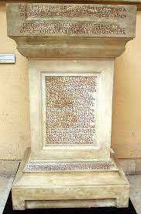
False Teaching in the Catholic Church
Prayers for the Dead Abercius Bishop of Hieropolis (approx. 250 AD)
“Let every friend who observes this pray for me"

Slide 27
Your Thoughts

Slide 28
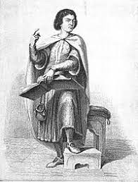
Petrobrusians (approx. 1120 AD)
Peter of Bruys
Medieval French religious teacher
He was called a heresiarch (leader of a heretical movement) by the Roman Catholic Church
He opposed infant baptism, the erecting of churches and the veneration of crosses, the doctrine of transubstantiation and prayers for the dead.

Slide 29
Petrobrusians (approx. 1120 AD)
Peter of Bruys
The first was their denial "that children, before the age of understanding, can be saved by the baptism... According to the Petrobrusians, not another's, but one's own faith, together with baptism, saves, as the Lord says, 'He who will believe and be baptized will be saved, but he who will not believe will be condemned.'"

Slide 30
Petrobrusians (approx. 1120 AD)
Peter of Bruys
The second was that the Petrobrusians said, "Edifices for temples and churches should not be erected... The Petrobrusians are quoted as saying, 'It is unnecessary to build temples, since the church of God does not consist in a multitude of stones joined together, but in the unity of the believers assembled.”

Slide 31
Petrobrusians (approx. 1120 AD)
Peter of Bruys
The third was that the Petrobrusians "command the sacred crosses to be broken in pieces and burned, because that form or instrument by which Christ was so dreadfully tortured, so cruelly slain, is not worthy of any adoration, or veneration or supplication, but for the avenging of his torments and death it should be treated with unseemly dishonor, cut in pieces with swords, burnt in fire."

Slide 32
Petrobrusians (approx. 1120 AD)
Peter of Bruys
The fourth was that the Petrobrusians denied transubstantiation. They say, 'Oh, people, do not believe the bishops, priests, or clergy who seduce you; who, as in many things, so in the office of the altar, deceive you when they falsely profess to make the body of Christ and give it to you for the salvation of your souls.’

Slide 33
Petrobrusians (approx. 1120 AD)
Peter of Bruys
The fifth was that they denied teaching that prayer for the dead had any effect. "they deride sacrifices, prayers, alms, and other good works by the faithful living for the faithful dead, and say that these things cannot aid any of the dead even in the least... The good deeds of the living cannot profit the dead, because transferred from this life their merits cannot be increased or diminished, because beyond this life, there is no longer place for merits, only for retribution. Nor can a dead man hope to gain from anybody that which he did not obtain while alive in the world. Therefore those things are pointless that are done by the living for the dead, because they are mortal and have passed by death beyond the way for all flesh, into the state of the future world, and took with them all their merit, to which nothing can be added."

Slide 34
Petrobrusians (approx. 1120 AD)
Peter of Bruys
Crosses became for the Petrobrusians objects of desecration and were destroyed in bonfires.

Slide 35
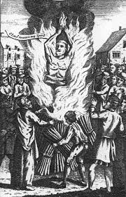
Petrobrusians (approx. 1120 AD)
Peter of Bruys
Crosses became for the Petrobrusians objects of desecration and were destroyed in bonfires.
In 1131 AD, Peter was publicly burning crosses in St Gilles, near Nîmes. The local populace, angered by Peter's destruction of the crosses, cast him into the flames of his own bonfire

Slide 36
Your Thoughts

Slide 37
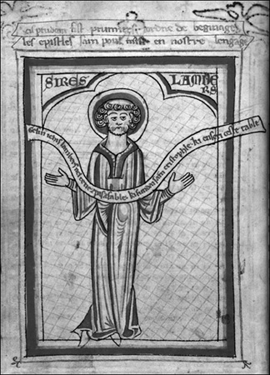
Henricians (approx. 1135 AD)
Henry of Lausanne
A former Cluniac monk
Adopted the Petrobrusians' teachings about 1135
Modified form of Peter of Bruy’s teaching, opposing all worship involving the church clergy.

Slide 38
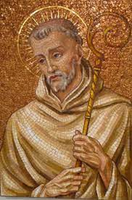
Henricians (approx. 1135 AD)
Henry of Lausanne
Bernard of Clairvaux, in writing to a nobleman and inviting him to put down the heretics.
“The churches are without flocks, the flocks without priests, the priests are nowhere treated with due reverence, the churches are leveled down to synagogues, the sacraments are not esteemed holy, the festivals are no longer celebrated.”

Slide 39
Henricians (approx. 1135 AD)
Henry of Lausanne
Arrested sent to prison for life in 1148 AD but died within a year.
Both the Petrobrusians and Henrician sects died out by 1151 AD

Slide 40
Your Thoughts

Slide 41
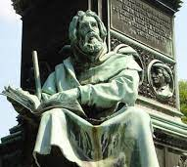
Waldensians (approx. 1170 AD)
‘Peter’ Waldo
A wealthy merchant who gave away his property around 1170 AD, preaching apostolic poverty as the way to perfection.

Slide 42
Waldensians (approx. 1170 AD)
‘Peter’ Waldo
In the spring of 1179, Waldo and his followers were forbidden by the church to preach unless explicitly invited by a priest.
Several years later, around 1183, Waldo was banned from the city by the archbishop of Lyons.
When he was warned to stop preaching, Waldo responded with the words of the Apostle Peter in Acts 4:19: “Do you think God wants us to obey you rather than him?”
Some historians believe this episode was the catalyst for Waldo being referred to as “Peter Waldo” by future Waldensians.

Slide 43
Waldensians (approx. 1170 AD)
Temporal offices and dignities were not meant for preachers of the Gospel
Relics were no different from any other bones and should not be regarded as special or holy
Holy water was no more valuable than rainwater
Prayer was just as effectual if offered in a church or a barn
Catholic Church as the harlot of the Apocalypse.
They rejected what they perceived as the idolatry of the Catholic Church and considered the Papacy as the Antichrist of Rome.

Slide 44
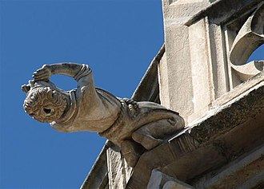
Waldensians (approx. 1170 AD)
Saw themselves as part of the Roman Catholic Church until the time of the Reformation.
Many took communion at least once a year and baptized their children.
Waldo depicted as a gargoyle on Lyon Cathedral: he is depicted with a hollow head, like a madman, preaching towards the sky, instead of prostrating himself before God.

Slide 45
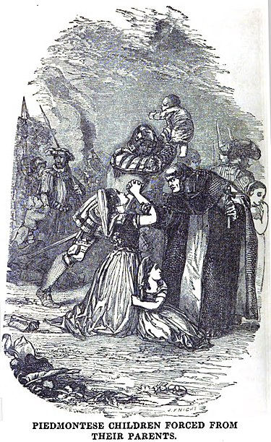
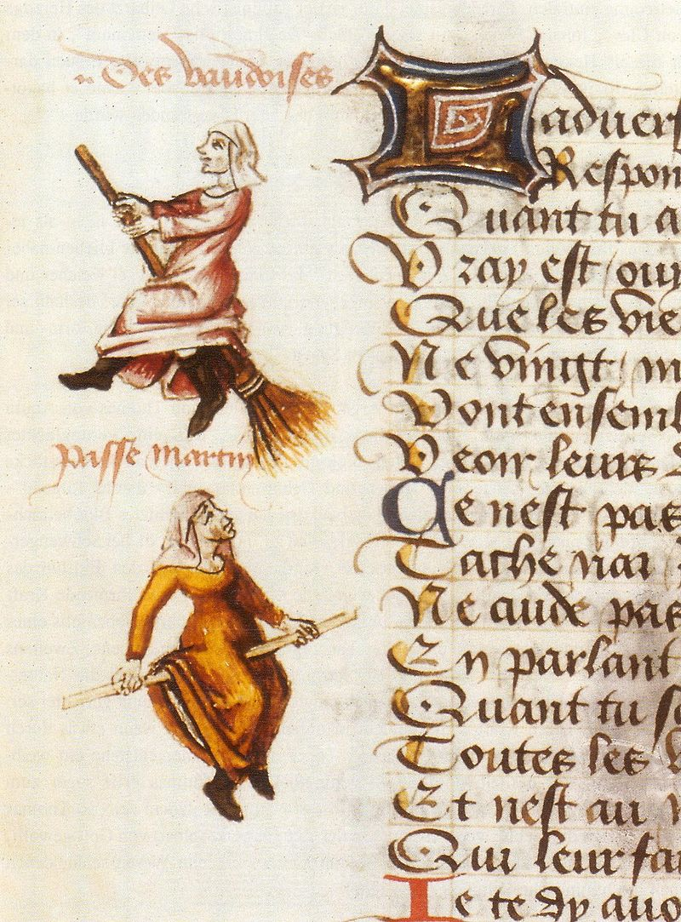
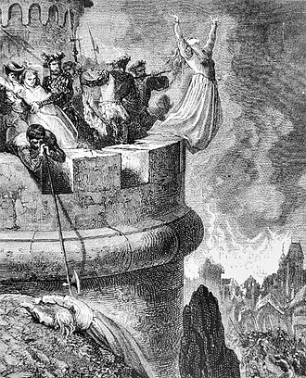
Waldensians (approx. 1170 AD)
Centuries of persecutions

Slide 46
Your Thoughts

