Slide 1
Church History
Apostasy, Reformation, and Restoration

Slide 2
Apostasy (1st Century)
Lesson 3: Early Church Apostasy cont.’
Separation of Elders and Bishops
Constantine
Nicene Creed

Slide 3
Chairman, Presiding President, Bishop
Bishop – Chairman of Church
City Bishop – Church Ruler over Diocese
County Bishop – Works between City Bishop and Church Elders
150AD approx. rise of Ministers and Deacons
Metropolitans – Head Bishop of Councils and Synods (300AD approx.)

Slide 4
Early Organizational Apostasy

Slide 5
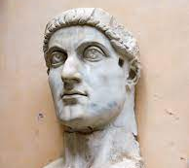
313 AD Emperor Constantine
Defeats all challengers for the throne
Reunites Rome
Edict of Milan

Slide 6
313-325 AD Church Controversy
The Arain Controversy (was Jesus, God, man or both?)

Slide 7
313-325 AD Church Controversy
The Arain Controversy (was Jesus God man or both?)
The Apollinarian Controversy (Jesus had a human body and soul but did not have a human brain, but a divine mind and not a human rational mind)

Slide 8
313-325 AD Church Controversy
The Arain Controversy (was Jesus God man or both?)
The Appolinarian Controversy (Jesus had a human body and soul but did not have a human brain, but a divine mind and not a human rational mind)
The Pelagian Controversy (Arguments over original sin)

Slide 9
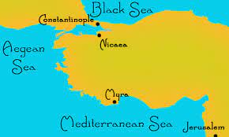
325 AD Church at Nicaea

Slide 10
325 AD Church at Nicaea
Constantine named himself “Bishop of Bishop”

Slide 11
325 AD Church at Nicaea
Constantine named himself “Bishop of Bishop”
318 Bishops voted on all Controversies

Slide 12
325 AD Church at Nicaea
Constantine named himself “Bishop of Bishop”
318 Bishops voted on all Controversies
August 325AD Nicene Creed was written, and Christianity had become a State Religion

Slide 13
Your Thoughts

Slide 14
Apostasy (4th t0 7th Century)
Lesson 4:
Rise of Catholicism
State religion

Slide 15
What is the teaching of Christ and His apostles on the relationship of church and state?
Matthew 22:21
They said to Him, “Caesar’s.” And He said to them, “Render therefore to Caesar the things that are Caesar’s, and to God the things that are God’s.”

Slide 16
What is the teaching of Christ and His apostles on the relationship of church and state?
Romans 13:1
13 Let every soul be subject to the governing authorities. For there is no authority except from God, and the authorities that exist are appointed by God.
1 Timothy 2:1,2
2 Therefore I exhort first of all that supplications, prayers, intercessions, and giving of thanks be made for all men, 2 for kings and all who are in authority, that we may lead a quiet and peaceable life in all godliness and reverence.

Slide 17
What is the teaching of Christ and His apostles on the relationship of church and state?
Titus 3:1
3 Remind them to be subject to rulers and authorities, to obey, to be ready for every good work,
1 Peter 2:13,14
13 Therefore submit yourselves to every ordinance of man for the Lord’s sake, whether to the king as supreme, 14 or to governors, as to those who are sent by him for the punishment of evildoers and for the praise of those who do good.

Slide 18
What is the teaching of Christ and His apostles on the relationship of church and state?
Titus 3:1
3 Remind them to be subject to rulers and authorities, to obey, to be ready for every good work,
1 Peter 2:13,14
13 Therefore submit yourselves to every ordinance of man for the Lord’s sake, whether to the king as supreme, 14 or to governors, as to those who are sent by him for the punishment of evildoers and for the praise of those who do good.
What are the two conclusions drawn from these scriptures?

Slide 19
What are the two conclusions drawn from these scriptures?
We must be law abiding citizens
God’s authority is above all

Slide 20
What are the two conclusions drawn from these scriptures?
We must be law abiding citizens
God’s authority is above all
Acts 5:29
29 But Peter and the other apostles answered and said: “We ought to obey God rather than men.

Slide 21
Positive Results Experienced by Christians.

Slide 22
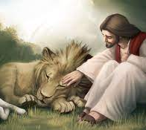
Positive Results Experienced by Christians.
1. Persecutions Ceased

Slide 23
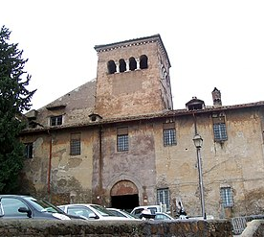
Positive Results Experienced by Christians.
1. Persecutions Ceased
2. Churches were rebuilt

Slide 24
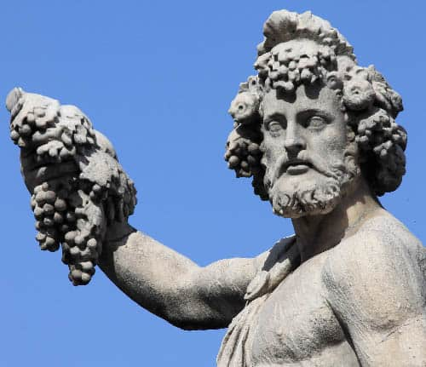
Positive Results Experienced by Christians.
1. Persecutions Ceased
2. Churches were rebuilt
3. Heathenism was discouraged

Slide 25
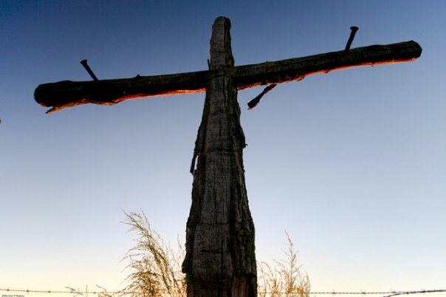
Positive Results Experienced by Christians.
1. Persecutions Ceased
2. Churches were rebuilt
3. Heathenism was discouraged
4. Abolishment of Crucifixion

Slide 26
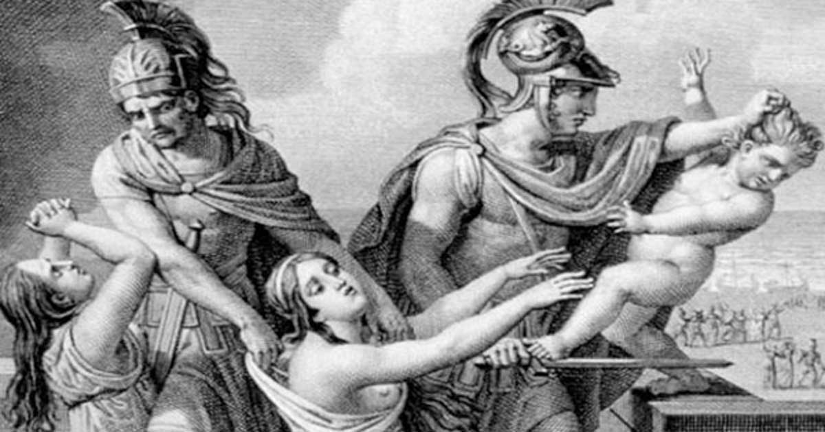
Positive Results Experienced by Christians.
1. Persecutions Ceased
2. Churches were rebuilt
3. Heathenism was discouraged
4. Abolishment of Crucifixion
5. Repression of infanticide

Slide 27
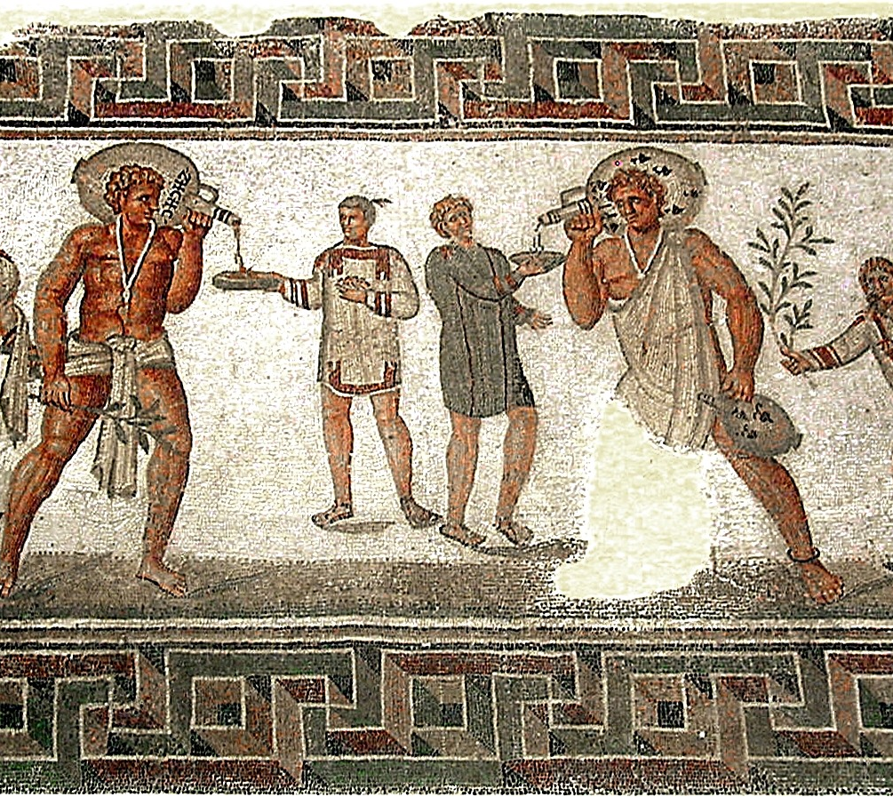
Positive Results Experienced by Christians.
1. Persecutions Ceased
2. Churches were rebuilt
3. Heathenism was discouraged
4. Abolishment of Crucifixion
5. Repression of infanticide
6. More humane treatment of slaves

Slide 28
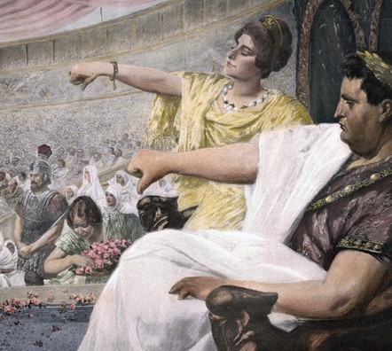
Positive Results Experienced by Christians.
1. Persecutions Ceased
2. Churches were rebuilt
3. Heathenism was discouraged
4. Abolishment of Crucifixion
5. Repression of infanticide
6. More humane treatment of slaves
7. Suppression of Gladiator contests

Slide 29
Evil Results Experienced by Christians.
Everyone sought membership.
Scramble for higher positions in the church.
New ceremonies
Installation of memorial images
The Church was transformed by the world

Slide 30
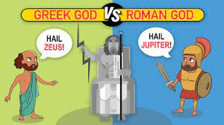
Roman Empire or Catholic Church

Slide 31
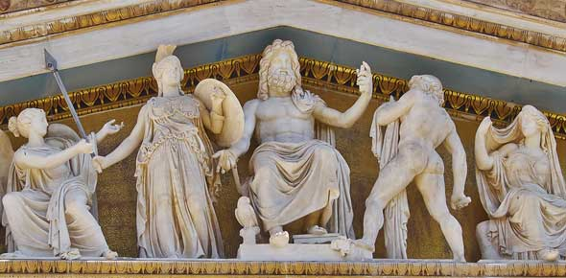
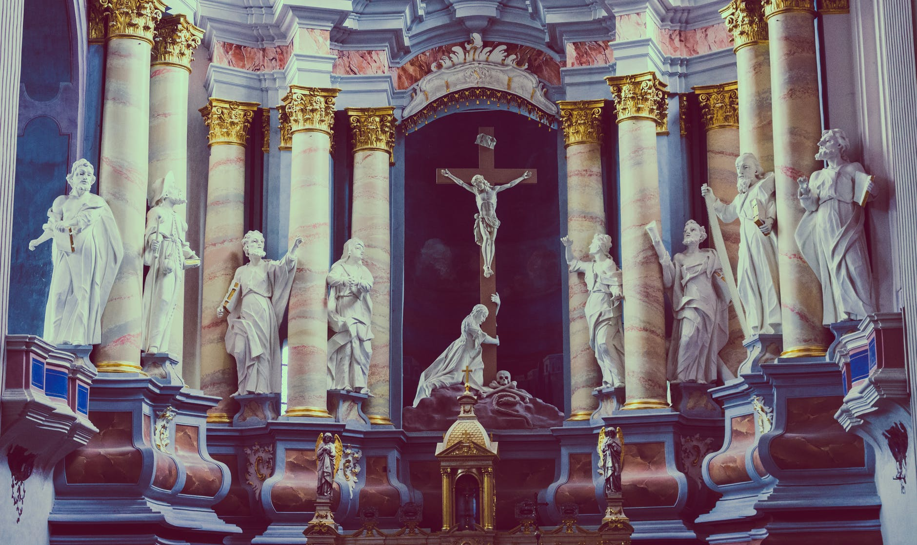
Roman Empire or Catholic Church

Slide 32
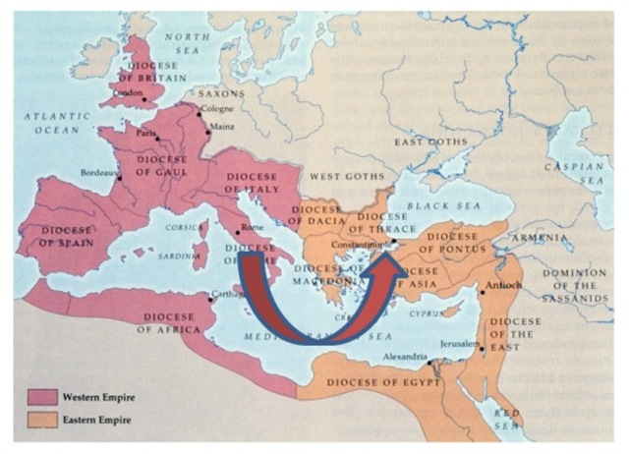
313AD approx. Constantine Moves Roman Capital

Slide 33
Church Patriarchs

Slide 34
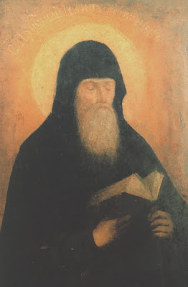
588AD John the Faster “Universal Bishop of the Church”

Slide 35
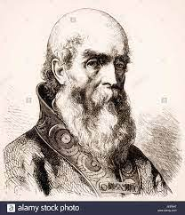
606AD Pope Boniface III “Universal Bishop”

Slide 36
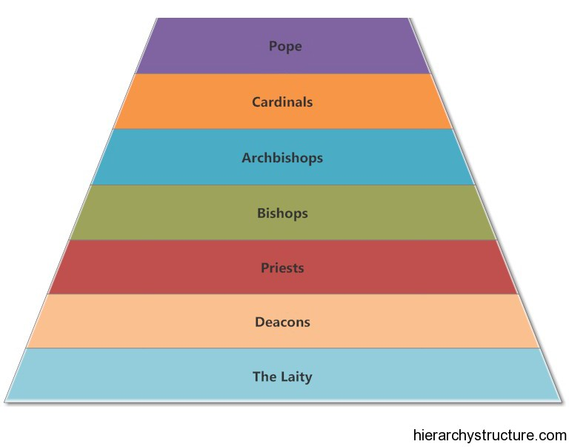
Roman Empire or Catholic Church

Slide 37
Your Thoughts

