Slide 1
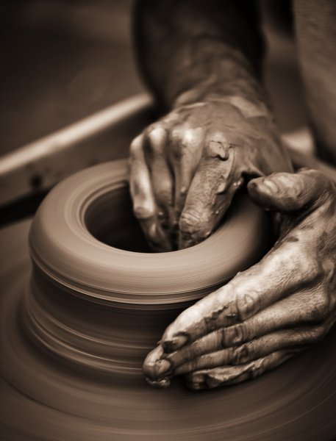
Developing Positive Christian Character
Workbook by Roger Hillis

Slide 2
Developing Positive Christian Character
Reputation is what people think about you (Pro. 22:1)
Be a good example & have a good reputation (Matt. 5:13-16)
Character is what you are on the inside. (Phil. 2:22)
Reputation is what people think you are; character is what God knows you are.
Your character is a matter of choice, not of birth.
You can become what you want to be.
You can change parts of your character that are not what you (or God) want them to be.
God looks at the heart, not what man sees. (1 Sam. 16:7)

Slide 3
Developing Positive Christian Character
HUMILITY
RESPECT
MATURITY
KINDNESS
DILIGENCE
PERSEVERANCE
FAITHFULNESS
CONTENTMENT
COURAGE
INTEGRITY
COMPASSION
MORAL PURITY

Slide 4
CONTENTMENT
Jesus on Money
Matt. 6:19-21
Mark 4:18-19
Mark 10:23
Luke 12:15
Luke 16:13-14
Epistles
Phil. 4:11-12
1 Tim. 6:6-10
1 Tim. 6:17-19
Heb. 13:5
Rev. 3:17
HUMILITY
RESPECT
MATURITY
KINDNESS
DILIGENCE
PERSEVERANCE
FAITHFULNESS
COURAGE
INTEGRITY
COMPASSION
MORAL PURITY

Slide 5
CONTENTMENT
New Testament Examples of Covetousness
Rich Young Ruler (Matt. 19:16-22)
Rich farmer (Luke 12:16-21)
Felix (Acts 24:26)
Judas Iscariot (Matt. 26:14-16)
HUMILITY
RESPECT
MATURITY
KINDNESS
DILIGENCE
PERSEVERANCE
FAITHFULNESS
COURAGE
INTEGRITY
COMPASSION
MORAL PURITY

Slide 6
Developing Positive Christian Character
CONTENTMENT
May be more warnings in Bible against covetousness
Every kind of evil springs forth from greedy heart
Examine your own attitude towards money & possessions (wants vs needs)
Do not lose your soul over money.
HUMILITY
RESPECT
MATURITY
KINDNESS
DILIGENCE
PERSEVERANCE
FAITHFULNESS
COURAGE
INTEGRITY
COMPASSION
MORAL PURITY

Slide 7
Developing Positive Christian Character
HUMILITY
RESPECT
MATURITY
KINDNESS
DILIGENCE
PERSEVERANCE
FAITHFULNESS
CONTENTMENT
COURAGE
INTEGRITY
COMPASSION
MORAL PURITY

Slide 8
COURAGE
Eph. 6:10 – “Finally, my brethren, be strong in the Lord and in the power of His might.”
Courage
Bravery, willingness to face difficult situation head-on
Boldness, attitude that overcomes opposition
Not the absence of fear but doing what needs to be done in spite of fear
Character quality not letting other intimidate or push around
Quotes - Mark Twain
HUMILITY
RESPECT
MATURITY
KINDNESS
DILIGENCE
PERSEVERANCE
FAITHFULNESS
CONTENTMENT
INTEGRITY
COMPASSION
MORAL PURITY

Slide 9
COURAGE
Key to being courageous is found in desire to please God
Gal. 1:10 – Persuade men or God? Seek to please men?
Possible to please both man & God (child & parent)
When a difficult choice has to be made, a person of courage makes the right decision regardless of what others may think, does what is right in the sight of God.
Psa. 27:14
Josh. 24:15
HUMILITY
RESPECT
MATURITY
KINDNESS
DILIGENCE
PERSEVERANCE
FAITHFULNESS
CONTENTMENT
INTEGRITY
COMPASSION
MORAL PURITY

Slide 10
COURAGE
Josh. 1:1-9
What was Joshua’s job?
How many times did God tell Joshua to be courageous?
What was the key to Joshua’s success?
Who told Joshua to be courageous in v.18?
What was the military strategy against Jericho?
Why did the strategy take courage?
HUMILITY
RESPECT
MATURITY
KINDNESS
DILIGENCE
PERSEVERANCE
FAITHFULNESS
CONTENTMENT
INTEGRITY
COMPASSION
MORAL PURITY

