Slide 2
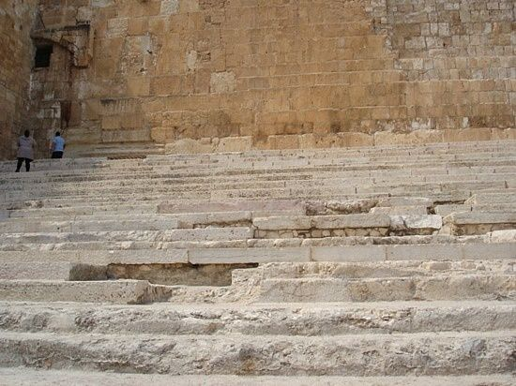
Songs of Ascents
Psalms 120-134

Slide 3
PSALM 122 Jerusalem's Prominence and Peace
Jerusalem's PROMINENCE (1-5)
"The house of the LORD" (v. 1)
"The tribes of the LORD" (v. 4)
"The name of the LORD" (v. 4)
Philippians 3:1; 4:4, 10
Songs of Ascents

Slide 4
PSALM 122 Jerusalem's Prominence and Peace
Jerusalem's PROMINENCE (1-5)
Protection ("within your gates" - v. 2)
Unity/harmony ("compact together" - v. 3) among God's diverse people ("the tribes of the Lord" - v. 4)
Justice for every Jew ("thrones were set for judgment" - v. 5)
Songs of Ascents

Slide 5
PSALM 122 Jerusalem's Prominence and Peace
Jerusalem's PROMINENCE (1-5)
Jerusalem's PEACE (6-8)
Hebrews 7:1-2
Songs of Ascents

Slide 6
PSALM 122 Seeing Myself
What does David's attitude toward physical Jerusalem teach me about my attitude toward spiritual Jerusalem?
How does this psalm prepare me to worship God?
Songs of Ascents

